Slide 2
Reality and Perspectives of Timor Leste in the context of the Bonn Call for Action
Dr. Abraham Gregorio de Rosa,Sp.Rad
Radiologist in HNGV Dili, Timor Leste

Slide 3
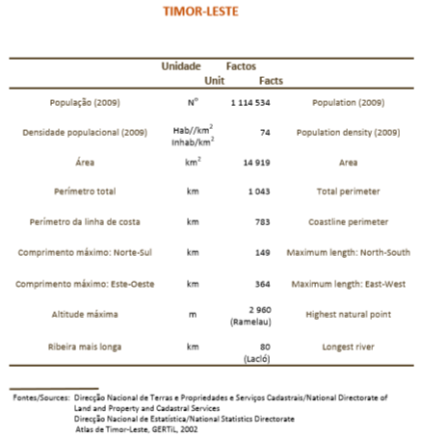
BACKGROUND:

Slide 4
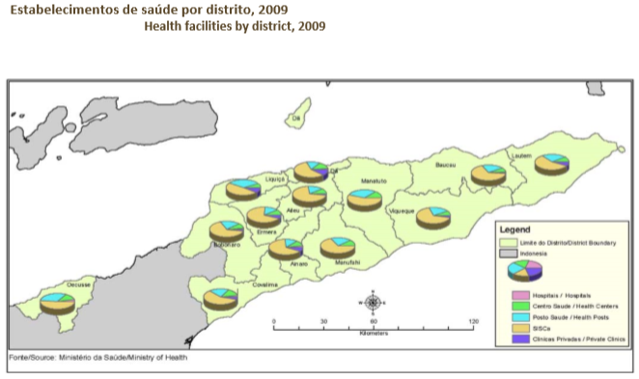

Slide 5
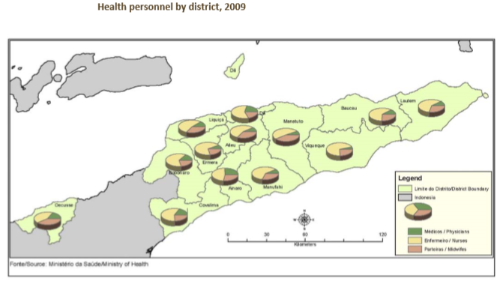

Slide 6
RADIATION WORKER IN WHOLE TIMOR LESTE:
- 10 RADIOGRAPHER ASSISTANT
- 9 RADIOGRAPHER
- 1 RADIOLOGIST

Slide 7
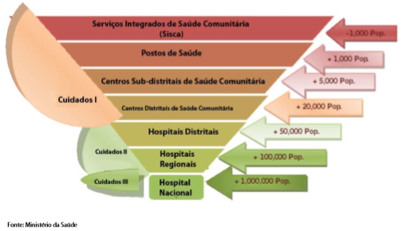
Have Radiology Facility

Slide 8
1-2 Radiographer Assistant
No radiographer
No radiologist
5 Regional Hospital

Slide 9
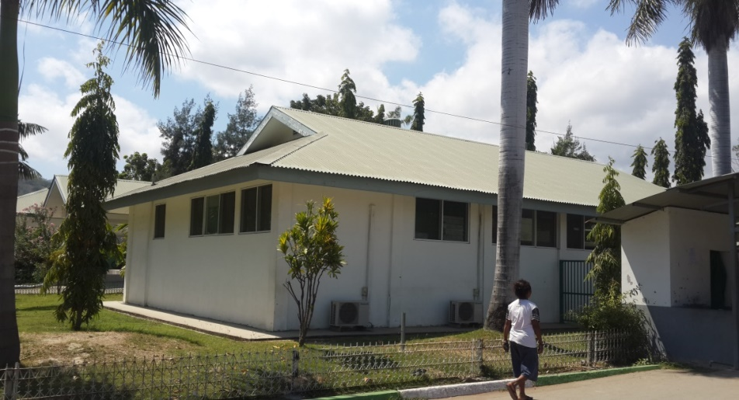
Nacional Hospital
2 Assistant Radiographer
6 Radiographer
1 Radiologist

Slide 10
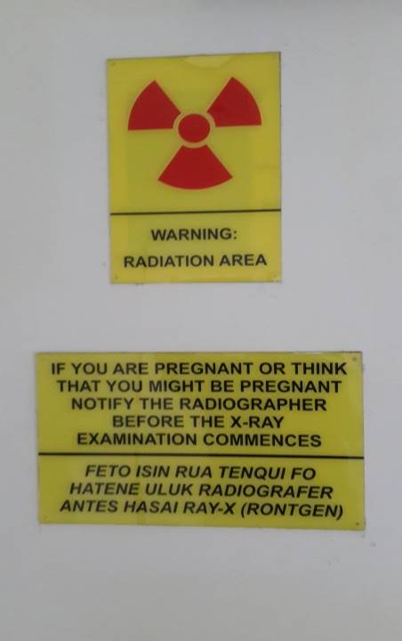
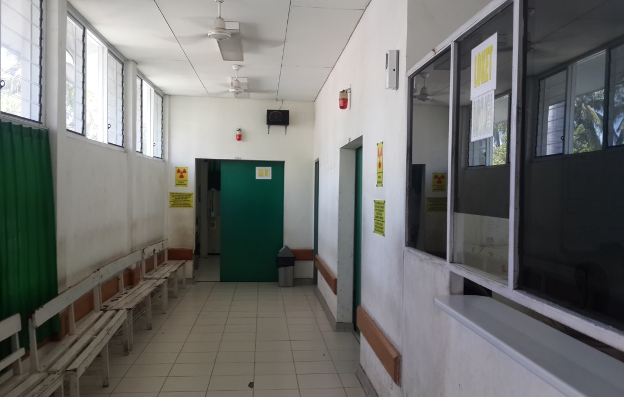
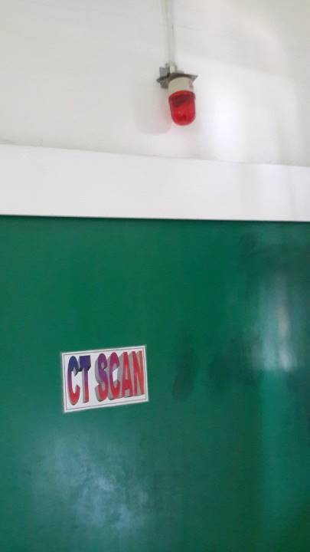

Slide 11
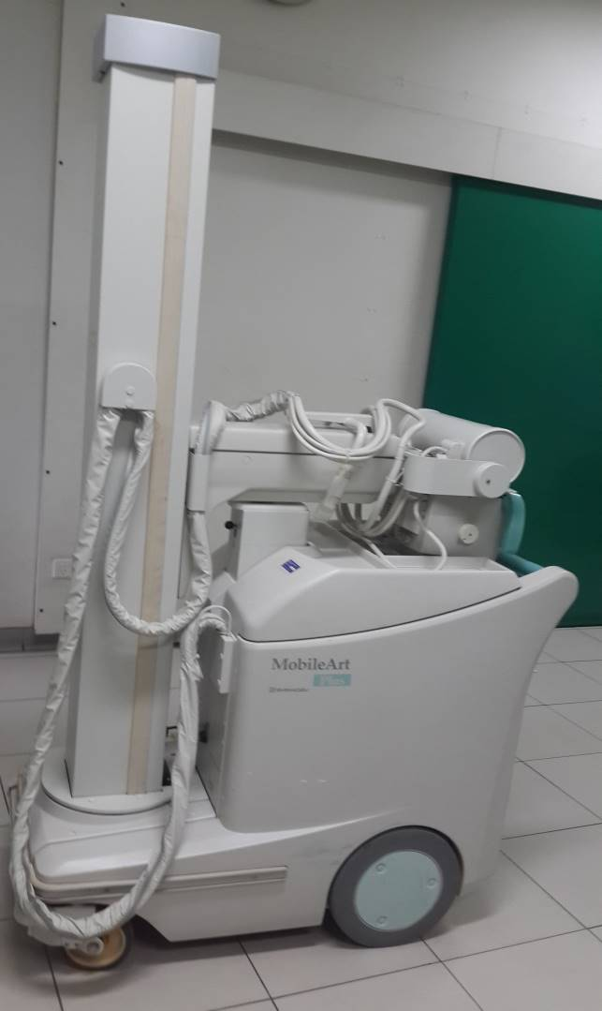
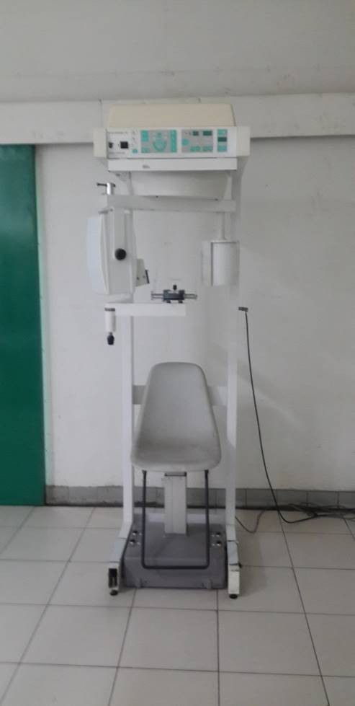

Slide 12
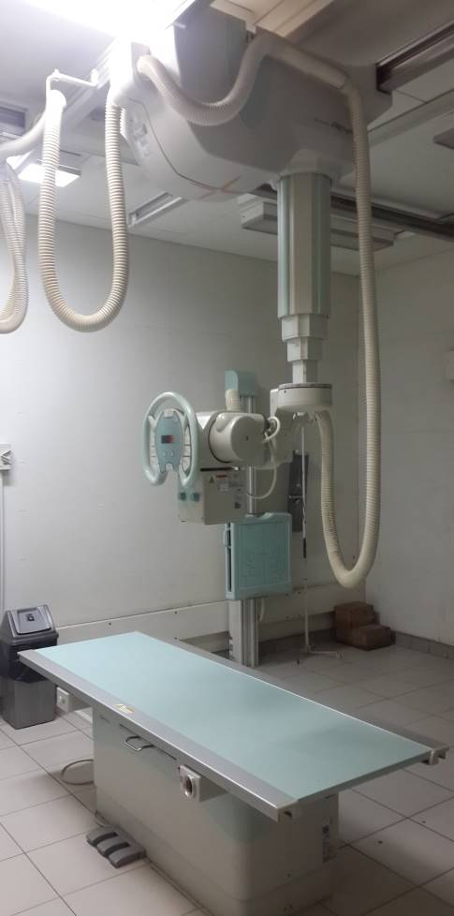
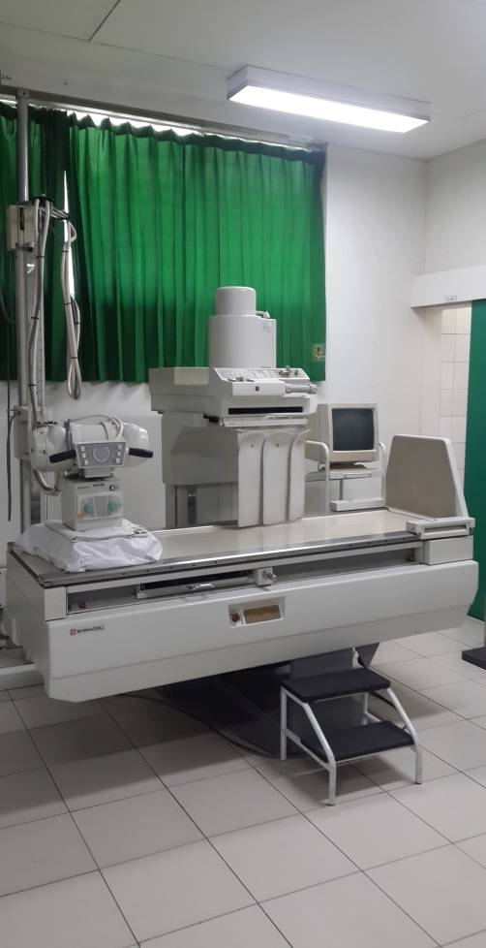
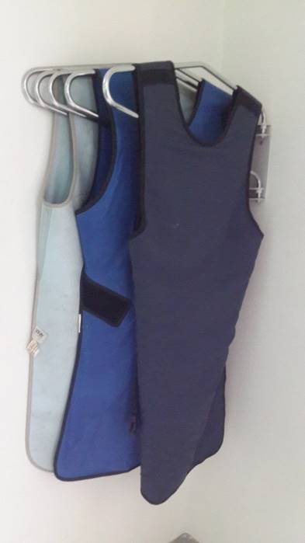

Slide 13
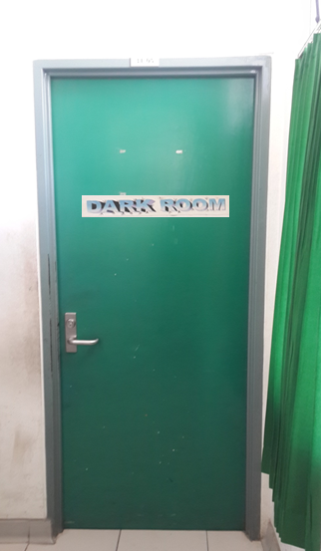
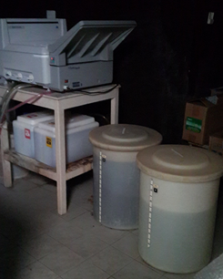
Radiological waste dumped into the underground sewage tank

Slide 15
BONN CALL FOR ACTION
10 Actions to Improve Radiation Protection in Medicine:
Enhance the implementation of the principle of justification
Enhance the implementation of the principle of optimization of protection and safety
Strengthen manufacturers’ role in contributing to the overall safety regime
Strengthen radiation protection education and training of health professionals
Shape and promote a strategic research agenda for radiation protection in medicine
Increase availability of improved global information on medical exposures and occupational exposures in medicine
Improve prevention of medical radiation incidents and accidents
Strengthen radiation safety culture in health care
Foster an improved radiation benefit-risk-dialogue
Strengthen the implementation of safety requirements globally

Slide 16
Enhance the implementation of the principle of justification
Introduce and apply the 3A’s (awareness, appropriateness and audit), which are seen as tools that are likely to facilitate and enhance justification in practice;
Develop harmonized evidence-based criteria to strengthen the appropriateness of clinical imaging, including diagnostic nuclear medicine and non-ionizing radiation procedures, and involve all stakeholders in this development;
Implement clinical imaging referral guidelines globally, keeping local and regional variations in mind, and ensure regular updating, sustainability and availability of these guidelines;
Strengthen the application of clinical audit in relation to justification, ensuring that justification becomes an effective, transparent and accountable part of normal radiological practice;
Introduce information technology solutions, such as decision support tools in clinical imaging, and ensure that these are available and freely accessible at the point-of-care;
Further develop criteria for justification of health screening programmes for asymptomatic populations (e.g. mammography screening) and for medical imaging of asymptomatic individuals who are not participating in approved health screening programmes (e.g. use of CT for individual health surveillance)

Slide 17
02. Enhance the implementation of the principle of optimization of protection and safety
Ensure establishment, use of, and regular update of diagnostic reference levels for radiological procedures, including interventional procedures, in particular for children;
Strengthen the establishment of quality assurance programmes for medical exposures, as part of the application of comprehensive quality management systems;
Implement harmonized criteria for release of patients after radionuclide therapy, and develop further detailed guidance as necessary;
Develop and apply technological solutions for patient exposure records, harmonize the dose data formats provided by imaging equipment, and increase utilization of electronic health records.

Slide 18
03. Strengthen manufacturers’ role in contributing to the overall safety regime
Ensure improved safety of medical devices by enhancing the radiation protection features in the design of both physical equipment and software and to make these available as default features rather than optional extra features;
Support development of technical solutions for reduction of radiation exposure of patients, while maintaining clinical outcome, as well as of health workers;
Enhance the provision of tools and support in order to give training for users that is specific to the particular medical devices, taking into account radiation protection and safety aspects;
Reinforce the conformance to applicable standards of equipment with regard to performance, safety and dose parameters;
Address the special needs of health care settings with limited infrastructure, such as sustainability and performance of equipment, whether new or refurbished;
Strengthen cooperation and communication between manufacturers and other stakeholders, such as health professionals and professional societies;
Support usage of platforms for interaction between manufacturers and health and radiation regulatory authorities and their representative organizations.

Slide 19
04. Strengthen radiation protection education and training of health professionals
Prioritize radiation protection education and training for health professionals globally, targeting professionals using radiation in all medical and dental areas;
Further develop the use of newer platforms such as specific training applications on the Internet for reaching larger groups for training purposes;
Integrate radiation protection into the curricula of medical and dental schools, ensuring theestablishment of a core competency in these areas;
Strengthen collaboration in relation to education and training among education providers in health care settings with limited infrastructure as well as among these providers and international organizations and professional societies;
Pay particular attention to the training of health professionals in situations of implementing new technology.

Slide 20
05. Shape and promote a strategic research agenda for radiation protection in medicine
Explore the re-balancing of radiation research budgets in recognition of the fact that an overwhelming percentage of human exposure to man- made sources is medical;
Strengthen investigations in low-dose health effects and radiological risks from external and internal exposures, especially in children and pregnant women, with an aim to reduce uncertainties in risk estimates at low doses;
Study the occurrence of and mechanisms for individual differences in radiosensitivity and hyper-sensitivity to ionizing radiation, and their potential impact on the radiation protection system and practices;
Explore the possibilities of identifying biological markers specific to ionizing radiation;
Advance research in specialized areas of radiation effects, such as characterization of deterministic health effects, cardiovascular effects, and post-accident treatment of overexposed individuals;
Promote research to improve methods for organ dose assessment, including patient dosimetry when using unsealed radioactive sources, as well as external beam small-field dosimetry.

Slide 21
06. Increase availability of improved global information on medical exposures and occupational exposures in medicine.
Improve collection of dose data and trends on medical exposures globally, and especially in low- and middle-income countries, by fostering international co-operation;
Improve data collection on occupational exposures in medicine globally, also focussing on corresponding radiation protection measures taken in practice;
Make the data available as a tool for quality management and for trend analysis, decision making and resource allocation.

Slide 22
07. Improve prevention of medical radiation incidents and accidents
Implement and support voluntary educational safety reporting systems for the purpose of learning from the return of experience of safety related events in medical uses of radiation;
Harmonize taxonomy in relation to medical radiation incidents and accidents, as well as related communication tools such as severity scales, and consider harmonization with safety taxonomy in other medical areas;
Work towards inclusion of all modalities of medical usage of ionizing radiation in voluntary safety reporting, with an emphasis on brachytherapy, interventional radiology, and therapeutic nuclear medicine in addition to external beam radiotherapy;
Implement prospective risk analysis methods to enhance safety in clinical practice;
Ensure prioritization of independent verification of safety at critical steps, as an essential component of safety measures in medical uses of radiation

Slide 23
08. Strengthen radiation safety culture in health care
Establish patient safety as a strategic priority in medical uses of ionizing radiation, and recognize leadership as a critical element of strengthening radiation safety culture;
Foster closer co-operation between radiation regulatory authorities, health authorities and professional societies;
Foster closer co-operation on radiation protection between different disciplines of medical radiation applications as well as between different areas of radiation protection overall, including professional societies and patient associations;
Learn about best practices for instilling a safety culture from other areas, such as the nuclear power industry and the aviation industry;
Support integration of radiation protection aspects in health technology assessment;
Work towards recognition of medical physics as an independent profession in health care, with radiation protection responsibilities;
Enhance information exchange among peers on radiation protection and safety-related issues, utilizing advances in information technology.

Slide 24
09. Foster an improved radiation benefit-risk-dialogue
Increase awareness about radiation benefits and risks among health professionals, patients and the public;
Support improvement of risk communication skills of health care providers and radiation protection professionals – involve both technical and communication experts, in collaboration with patient associations, in a concerted action to develop clear messages tailored to specific target groups;
Work towards an active informed decision making process for patients

Slide 25
10. Strengthen the implementation of safety requirements globally
Develop practical guidance to provide for the implementation of the International Basic Safety Standards in health care globally;
Further the establishment of sufficient legislative and administrative framework for the protection of patients, workers and the public at national level, including enforcing requirements for radiation protection education and training of health professionals, and performing on-site inspections to identify deficits in the application of the requirements of this framework.

Slide 26
Bonn Call for Action in Timor Leste
CHALLENGES :
National Agency for Atomic-Energy
Radiation Safety and Management System:
Organization of radiation protection,
Radiation dose monitoring and monitoring of radioactivity,
Radiation protection equipment,
Medical examination,
Document storage,
Quality assurance,
Education and training

Slide 27
THANK YOU FOR YOUR ATTENTION

