Slide 1
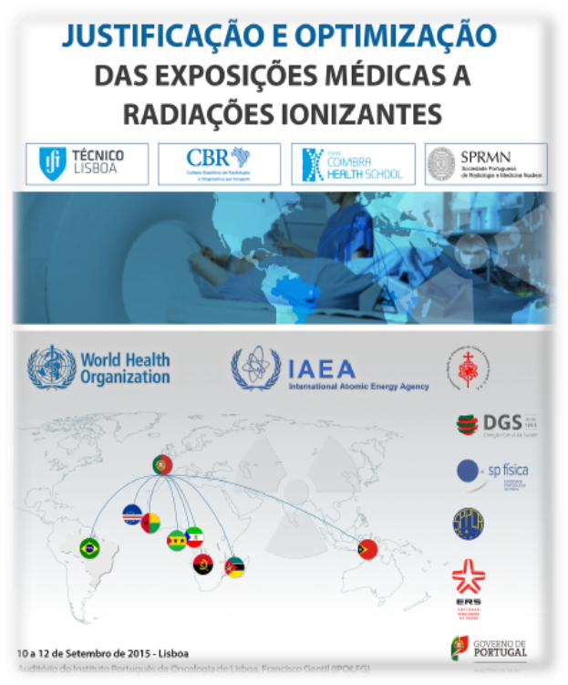
WHO Welcome Address
Dr Maria del Rosario Pérez
Department Public Health and Environmental & Social Determinants of Health (PHE)

Slide 2

On behalf of the World Health Organization it is a pleasure and a honor to welcome you to this Workshop on Justification and Optimization in Medical Exposures for Portuguese-speaking countries.
I wish to express our gratitude to the Portuguese Institute of Oncology Lisbon , Francisco Gentil for hosting this meeting. I congratulate the co-organizers: the Lisbon Technical Institute, the Coimbra Health School, the Brazilian College of Radiology and the Portuguese Society of Radiology and Nuclear Medicine, for all the efforts undertaken in this regard.
WHO is pleased to cosponsor this event with the Ministry of Health and General Direction of Health of Portugal, Health Regulatory Body, the Portuguese Society of Physics, the Portuguese Society of Protection against Radiation, and the International Atomic Energy Agency (IAEA).

Slide 3
Health is defined in the WHO’s Constitution as ”a state of complete physical, mental and social well-being and not merely the absence of disease or infirmity". As the agency within the United Nations system with specific mandate on public health, WHO’s objective is the attainment by all peoples of the highest possible level of health. The purpose of this Workshop is consistent with this.
Over the past decade there have been major advances in health technology and medical devices using radiation for diagnostic and therapeutic purposes. The use of radiation in medicine brings enormous benefits to health care and, at the same time, poses significant challenges in terms of safety and quality.
We all, as partners of this Workshop, share a common goal: the continuous improvement of health service quality and the safeguard of quality assurance standards in health service delivery worldwide.

Slide 4
Good health services deliver safe and effective health interventions to those that need them, when and where needed, with minimum waste of resources. This requires an environment that fosters excellence in clinical care, aspiring to move beyond benchmarks to achieve highest attainable levels of health services.
Good medical practice encompasses radiation safety in health care, which is the ultimate purpose of the WHO Global Initiative on Radiation Safety in Health Care Settings. WHO is pleased to collaborate with global, regional and national partners to improve quality and safety in radiation medicine. The comprehensive agenda to be covered these forthcoming three days calls for readiness to share knowledge & expertise and to learn from others.

Slide 5

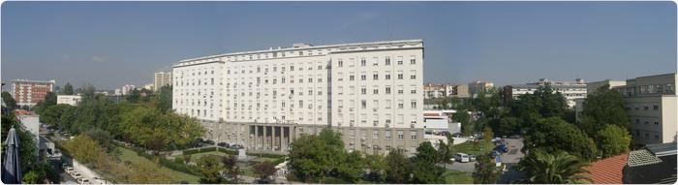
I wish you a productive and successful workshop and an enjoyable stay in Lisbon
Benvindos e muito obrigada !

