Slide 1
Implementation of Euratom Basic Safety Standards into Radiological Practice
In Focus: Justification
Georgi Simeonov
European Commission
DG ENER, Radiation Protection Unit (D3)
Justificação e Optimização das Exposições Médicas a Radiações Ionizantes
16 September 2015, Lisbon

Slide 2

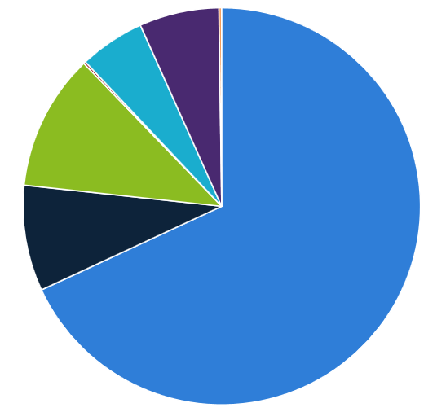
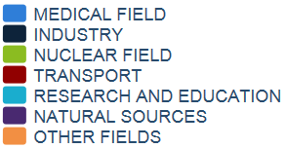


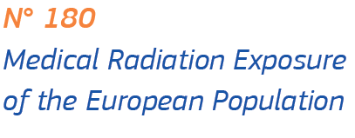
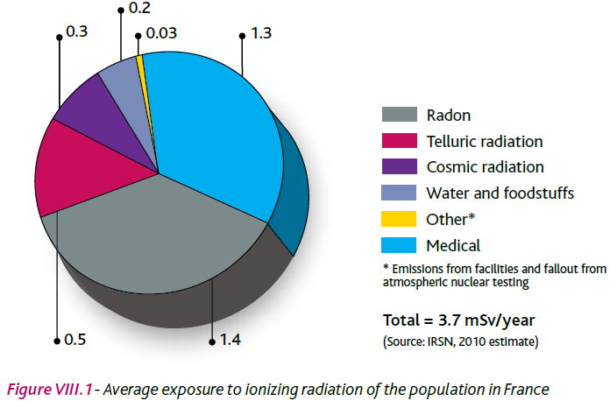
MEDICAL RADIATION
The EU Context
Monitored workers in Europe: ~1 million
European market for medical equipment … €20 billion for COCIR member companies
COCIR is the European Trade Association representing the medical imaging, health ICT and electromedical industries
~700 000
The total annual frequency of x-ray procedures in the European countries is 590 million, or 1100 examinations per 1000 of population, or 1,1 examinations per European citizen
Notes:
The medical imaging equipment market, as reported by COCIR – the European Trade Association representing the medical imaging, health ICT and electromedical industries
The global market for medical equipment is worth €80 billion with around €28 billion in Europe, and of this up to €20 billion for medical imaging equipment
Medical imaging is among the most innovative and dynamic industry sectors in Europe and globally – annual growth rate of 5% and investments in R&D representing up to 8% of sales volume.
Number of 'radiation workers', as reported by ESOREX – the European Platform for Occupational Radiation Exposure (2013 (rounded) data for 22 countries; big missing countries – Italy, Poland, UK)
About 1 million total number of monitored workers in the EU
Medical – about 700 000 workers, more than 2/3 of all monitored workers
Nuclear – about 120 000 workers, a bit more than 10% of all monitored
Other (industry, research, etc.) – about 200 000 workers, about 20%
EU population doses from medical exposure:
On average, an EU citizen will have one x-ray procedures per year (including dental, "high-dose" x-ray procedures, such as computed tomography (CT), fluoroscopy, interventional radiology form less than 15% of the total number of procedures)
By far the most important man-made source of radiation – on average, an EU citizen's medical radiation dose (1mSv per year, up to 2 mSv in some EU countries) is 100s times the dose from nuclear industry.
The average EU citizen's radiation dose from medical uses is about 1/3 of the total exposure from all sources (on par with Radon, the biggest natural source)
Individual patient's exposure from a single medical diagnostic procedure, e.g. CT, can be several times the normal annual background dose. Even higher individual doses in interventional procedures or in case of frequent diagnostic examinations.
Yet, the medical radiation dose of the average EU citizen is about half of the global average for the Healthcare Level 1 countries reported by UNSCEAR in 2008. Some economically developed countries have higher levels of medical exposure, e.g. United States NCRP reported in 2009 per caput doses of medical radiation in the US about three times higher than in the EU. These differences probably have much to do with the different ways healthcare is organised in the different regions (e.g. national health services in the EU vs. mostly private healthcare in the US); however, they could be partially due to the existence of European legal system for radiation protection of patients (as explained below).

Slide 3
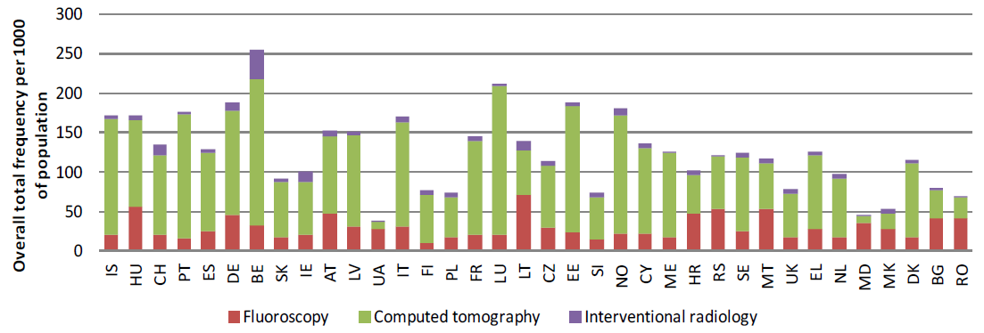
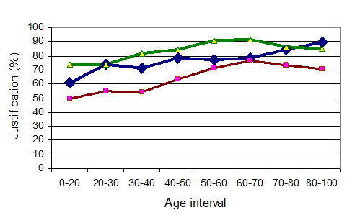
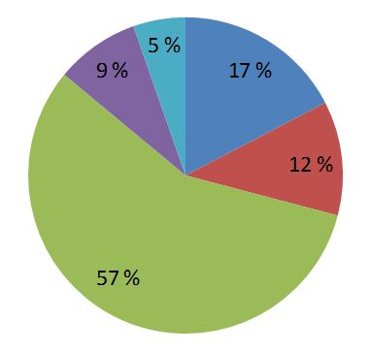
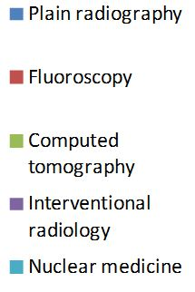

JUSTIFICATION:
The EU Context
Contribution to medical exposure in the EU
(RP 180, EC 2015)
W. Leitz, A. Almén, S. Richter, A study on justification of CT examinations in Sweden
Notes:
- Frequency of CT procedures in the EU – significant national variations (e.g. from less than 30 to about 200 per 1000 of population per year)
- About 20% of the CT examinations may be unnecessary, in some cases much higher (limited data available, e.g. from Sweden 2009 and Finland 2009)
Focus on sensitive groups (e.g. children), relatively high-dose common procedures, e.g. computed tomography (CT).
CT in the EU – less than 10% of the frequency of radiodiagnostic procedures but more than 50% of the radiation dose
Justification is difficult to tackle as it involves complex decisions and intervenes in some cultural and systemic basics of healthcare, e.g. the autonomy of the physicians and the healthcare funding mechanisms (e.g. pay-per-service vs. pay for quality / patient outcomes). Very little has been done on justification so far. Future work should focus on implementing the specific BSS requirements relevant to justification

Slide 4
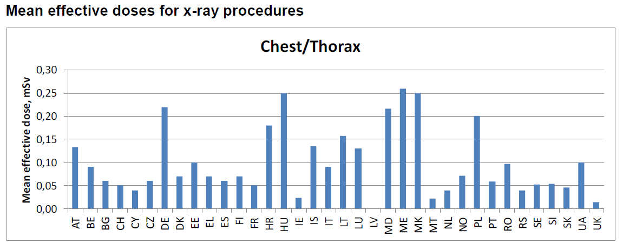
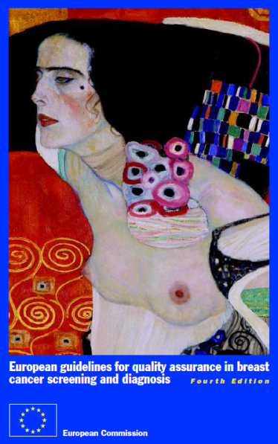
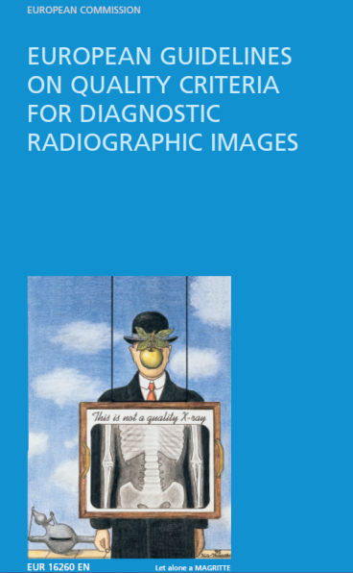
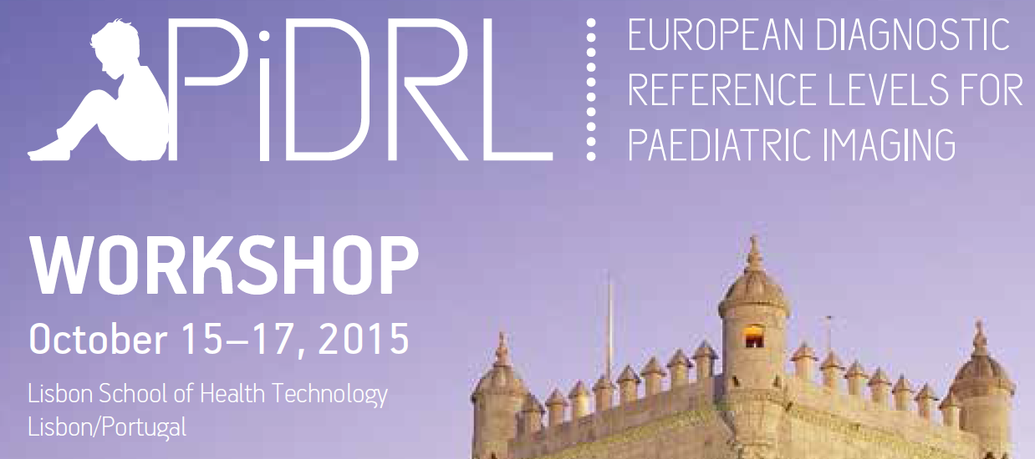
OPTIMISATION:
The EU Context
Notes:
- Frequency of CT procedures in the EU – significant national variations (e.g. from less than 30 to about 200 per 1000 of population per year)
- About 20% of the CT examinations may be unnecessary, in some cases much higher (limited data available, e.g. from Sweden 2009 and Finland 2009)
Focus on sensitive groups (e.g. children), relatively high-dose common procedures, e.g. computed tomography (CT).
CT in the EU – less than 10% of the frequency of radiodiagnostic procedures but more than 50% of the radiation dose
Justification is difficult to tackle as it involves complex decisions and intervenes in some cultural and systemic basics of healthcare, e.g. the autonomy of the physicians and the healthcare funding mechanisms (e.g. pay-per-service vs. pay for quality / patient outcomes). Very little has been done on justification so far. Future work should focus on implementing the specific BSS requirements relevant to justification

Slide 5
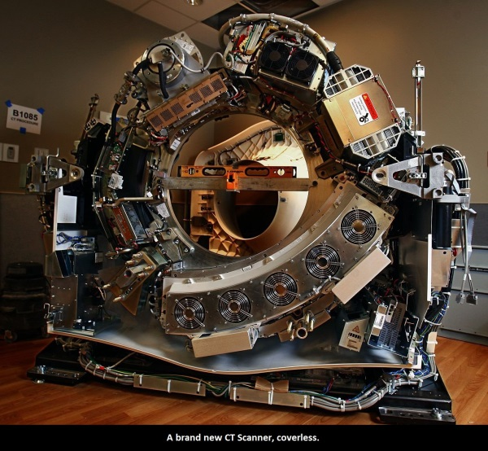
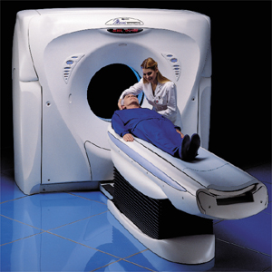
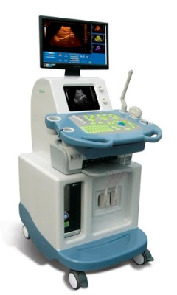
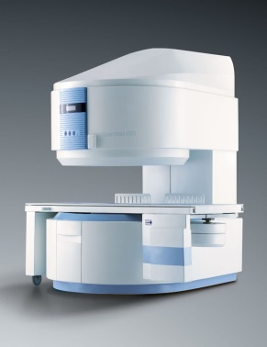
JUSTIFICATION: What is it?
Risk
Benefit
New class /type
Consider alternatives:
?
Individual patient
Notes:
Art. 55 Justification
1. Medical exposure shall show a sufficient net benefit, weighing the total potential diagnostic or therapeutic benefits it produces, including the direct benefits to health of an individual and the benefits to society, against the individual detriment that the exposure might cause, taking into account the efficacy, benefits and risks of available alternative techniques having the same objective but involving no or less exposure to ionising radiation.
2. Member States shall ensure that the principle defined in paragraph 1 is applied and in particular that:
new types of practices involving medical exposure are justified in advance before being generally adopted
(b) all individual medical exposures are justified in advance taking into account the specific objectives of the exposure and the characteristics of the individual involved

Slide 6
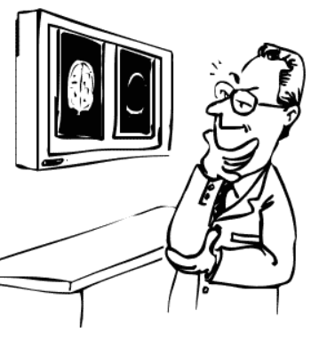
Responsibilities
Referring physician | Radiological practitioner | National authorities
Justification process: Establish patient characteristics and exam objectives Seek previous information Inform patient | Justification process: verify patient characteristics and exam objectives (?) Seek / provide previous information Inform patient | Who can refer patients Who can take clinical responsibility Who should inform patients (what)? Specify involvement of referrer and practitioner
Clinical responsibility!
Notes:
Art. 55.2. Member States shall ensure that …
(b) all individual medical exposures are justified in advance taking into account the specific objectives of the exposure and the characteristics of the individual involved.
(d) the referrer and the practitioner, as specified by Member States, seek, where practicable, to obtain previous diagnostic information or medical records relevant to the planned exposure and consider these data to avoid unnecessary exposure.
Art. 57. Member States shall ensure that …
any medical exposure takes place under the clinical responsibility of a practitioner
(c) the referrer and the practitioner are involved, as specified by Member States, in the justification process
(d) wherever practicable and prior to the exposure taking place, the practitioner or the referrer, as specified by Member States, ensures that the patient or their representative is provided with adequate information relating to the benefits and risks associated with the radiation dose from the medical exposure
Clinical responsibility: responsibility of a practitioner for individual medical exposures, in particular, justification; … obtaining information … on previous examinations; providing existing … records to other practitioners and/or the referrer, as required; and giving information … to patients and other individuals involved
Practitioner: a medical doctor, dentist or other health professional who is entitled to take clinical responsibility for an individual medical exposure in accordance with national requirements
Referrer: a medical doctor, dentist or other health professional who is entitled to refer individuals for medical radiological procedures to a practitioner, in accordance with national requirements

Slide 7
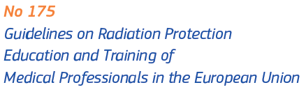
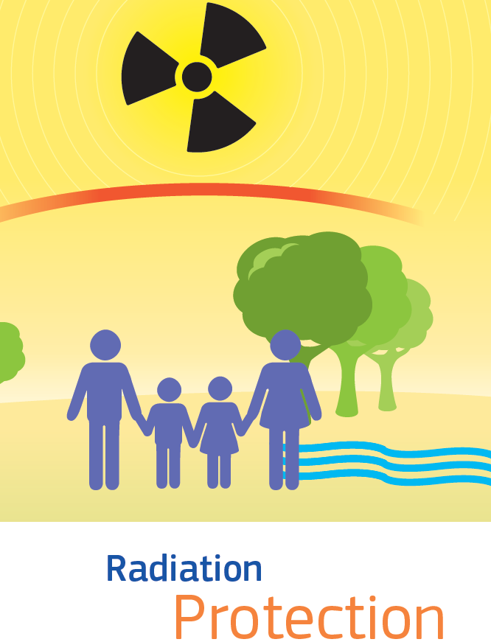
Education and Training
Radiation protection course in basic med / dental curricula | Procedure-specific Radiation protection Theoretical + practical Initial + continuing New techniques
Encourage | Establish / verify appropriate curricula Recognise diplomas / certificates / qualifications
Notes:
Article 18
Education, information and training in the field of medical exposure
1. Member States shall ensure that practitioners and the individuals involved in the practical aspects of medical radiological procedures have adequate education, information and theoretical and practical training for the purpose of medical radiological practices, as well as relevant competence in radiation protection.
For this purpose Member States shall ensure that appropriate curricula are established and shall recognise the corresponding diplomas, certificates or formal qualifications.
2. Individuals undergoing relevant training programmes may participate in practical aspects of medical radiological procedures as set out in Article 57(2).
3. Member States shall ensure that continuing education and training after qualification is provided and, in the special case of the clinical use of new techniques, training is provided on these techniques and the relevant radiation protection requirements.
4. Member States shall encourage the introduction of a course on radiation protection in the basic curriculum of medical and dental schools.

Slide 8

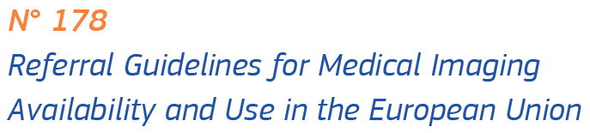

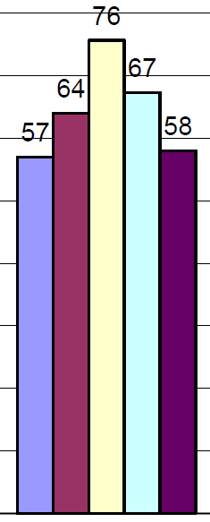
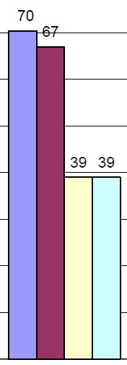
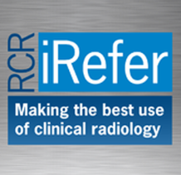




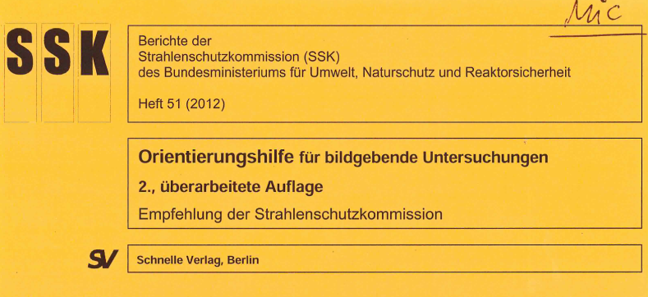
Referral Guidelines
Member States shall ensure that referral guidelines for medical imaging, taking into account the radiation doses, are available to the referrers
CDS system
Electronic requesting
Education
Referrer involvement
Other
Internal clinical audit
External clinical audit
Voluntary reporting
Inspection
Notes:
Art. 58. Member States shall ensure that …
(c) referral guidelines for medical imaging, taking into account the radiation doses, are available to the referrers

Slide 9
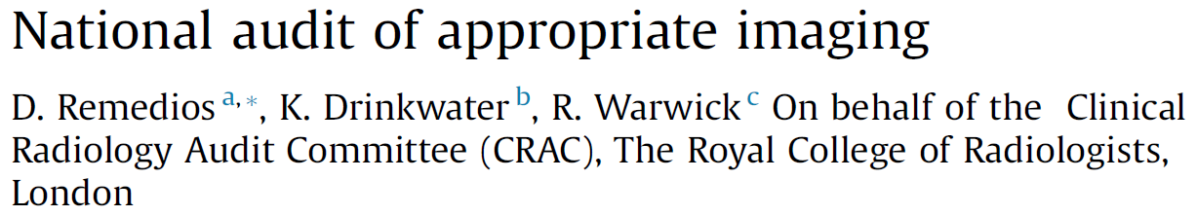
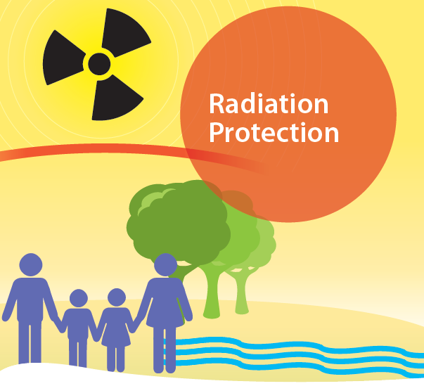
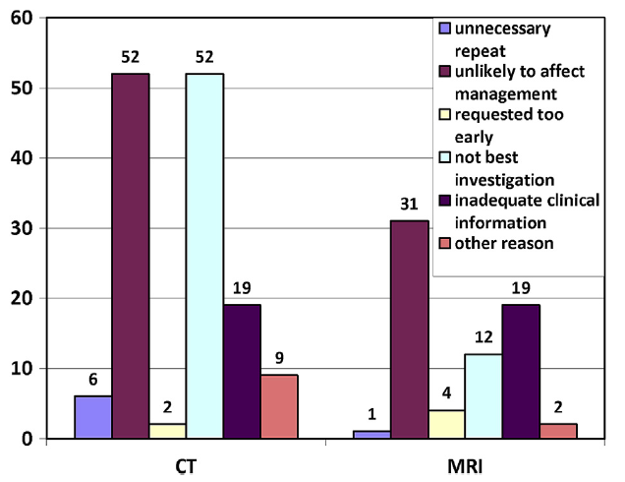
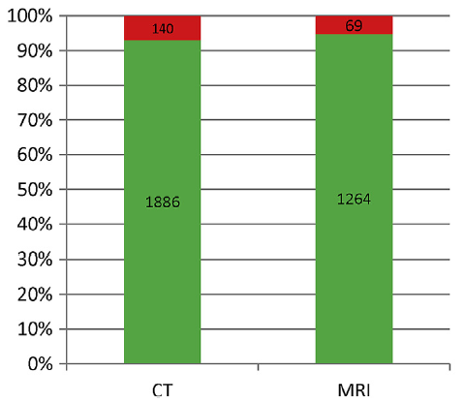

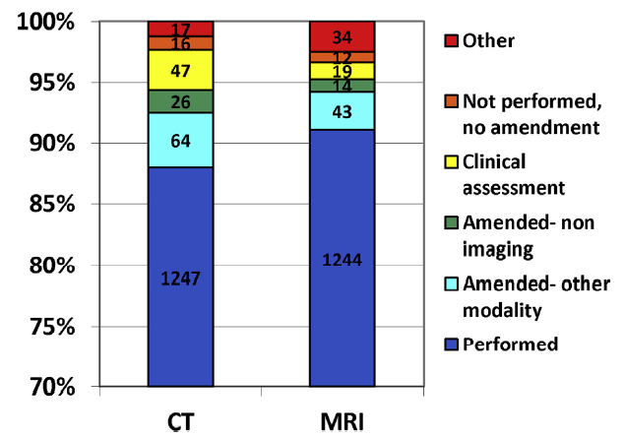
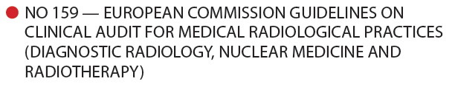
Clinical Audit
Member States shall ensure that clinical audits are carried out in accordance with national procedures
Notes:
Art. 58. Member States shall ensure that …
(e) clinical audits are carried out in accordance with national procedures
Clinical audit: a systematic examination or review of medical radiological procedures which seeks to improve the quality and outcome of patient care through structured review, whereby medical radiological practices, procedures and results are examined against agreed standards for good medical radiological procedures, with modification of practices, where appropriate, and the application of new standards if necessary

Slide 10
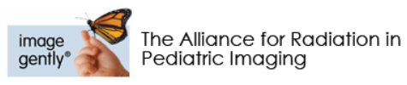
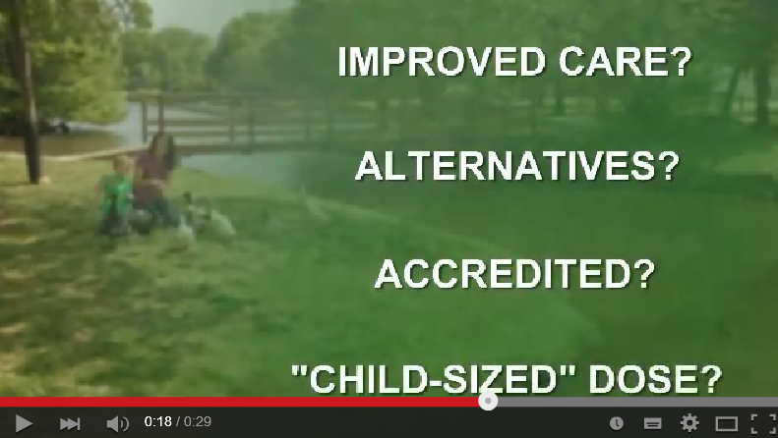
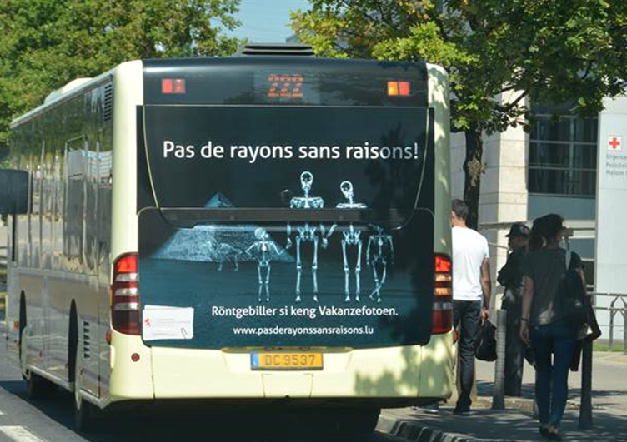
Information to Patients
Notes:
Art. 57. Member States shall ensure that …
(d) wherever practicable and prior to the exposure taking place, the practitioner or the referrer, as specified by Member States, ensures that the patient or their representative is provided with adequate information relating to the benefits and risks associated with the radiation dose from the medical exposure
Clinical responsibility: responsibility of a practitioner for individual medical exposures, in particular, justification; … obtaining information … on previous examinations; providing existing … records to other practitioners and/or the referrer, as required; and giving information … to patients and other individuals involved
Article 62. Special protection during pregnancy and breastfeeding
4. Without prejudice to paragraphs 1, 2 and 3, Member States shall take measures to increase the awareness of individuals to whom this Article applies, through measures such as public notices in appropriate places

Slide 11

RESPONSIBILITIES:
Summary
Define Who
Can refer (for what)
Can take clinical responsibility
Does what as part of justification process
Will inform patients
Establish
Clinical audit procedures
E&T curricula and recognition
Make available
Referral guidelines
Takes responsibility
Individual exposures
Obtaining information
Providing records
Informing patients
Takes part in
Justification process
Clinical audits
RP education and training
Could take part in
Referral guidelines development
Takes responsibility
Seek information
Takes part in
Justification process
Could be responsible
Informing patients
Could take part in
RP education and training
Clinical audits
Referral guidelines development

Slide 12


The Competent Authority
Competent authority:
an authority or system of authorities designated by Member States as having legal authority for the purposes of this Directive
Notification and authorisation of practice
Define Who
Can refer (for what)
Can take clinical responsibility
Does what as part of justification process
Will inform patients
Establish
Clinical audit procedures
E&T curricula and recognition
Make available
Referral guidelines
Inspection
establish inspection programme
functionally separate from … promotion or utilisation of practices
Require remedial / preventive action
Withdraw authorisation
legal powers and human and financial resources necessary to fulfil its obligations

Slide 13
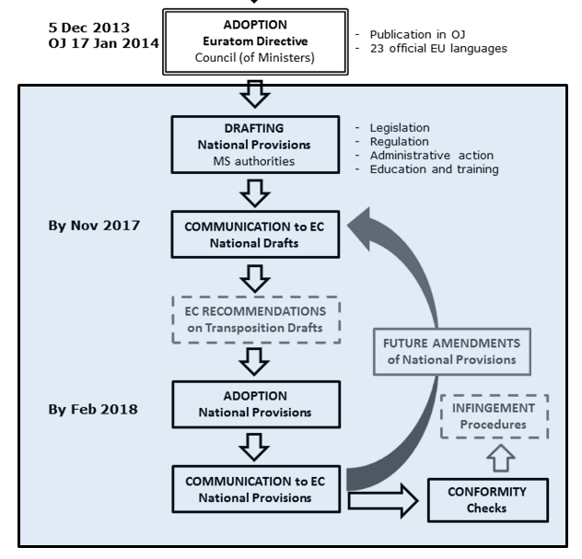
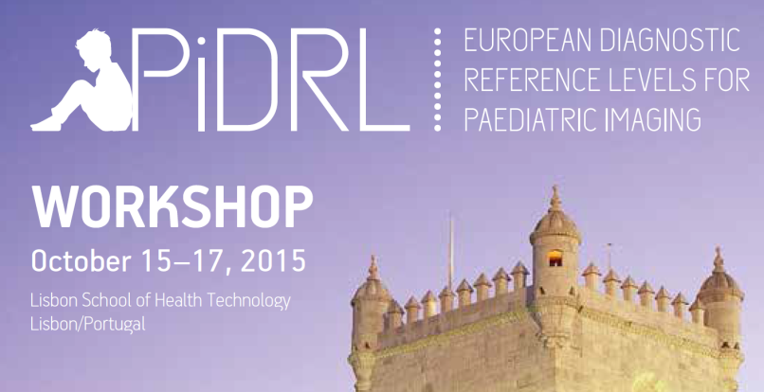
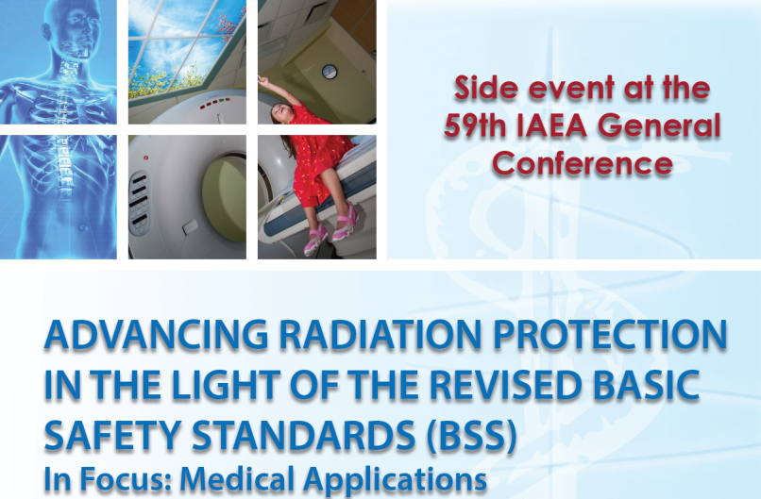
Commission
future activities
Evaluation of national plans – BSS in medicine
  Survey: Jan – June 2016
  Workshop: Sep 2016

Slide 14
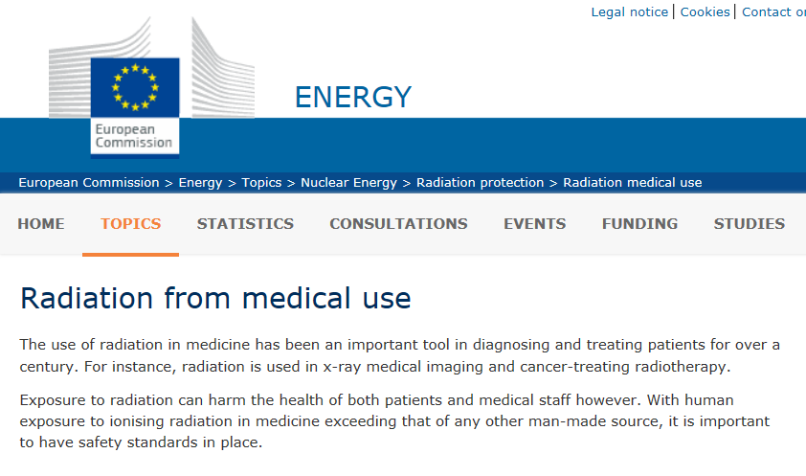
Thank you for your attention
http://ec.europa.eu/energy/en/topics/nuclear-energy/radiation-protection/radiation-medical-use

