Slide 1
Diagnostic reference levels in Medical Imaging. Concept and practice
Eliseo Vano
ICRP Committee 3
Radiology Department. Faculty of Medicine
Complutense University. Madrid. Spain
eliseov@med.ucm.es

Slide 2
International Commission on Radiological Protection (ICRP) and Diagnostic Reference Levels (DRLs)
Committee 3 (Protection in Medicine) of the ICRP develops recommendations and guidance for protection of patients, staff, and the public regarding radiation exposure in medicine.
While preparing its recommendations, ICRP is in contact with other organizations (e.g. WHO, IAEA, EC, etc.) working on similar topics and coordinates its work to avoid potential discrepancies.
ICRP is finalizing a new document on “Diagnostic Reference Levels (DRLs) in Medical Imaging”.

Slide 3
The RP system of ICRP of humans
Occupational exposures.
Public exposures.
Medical exposures of patients (the exposure is intentional and for the direct benefit of the patient).
Diagnostic.
Interventional.
Therapeutic procedures.
Justification
Occupational and Public
Optimisation
Medical exposure of patients (no limits)
Dose limits

Slide 4
Help in the optimisation of RP of patients
In the case of exposure from diagnostic and interventional medical procedures, the DRL has the objective to help in the optimisation of protection (ICRP-103).
Diagnostic reference levels are used in medical imaging to indicate whether, in routine conditions, the levels of patient dose from, or administered activity (amount of radioactive material) for, a specified imaging procedure are unusually high or low for that procedure.
If so, a local review should be initiated to determine if a corrective action is required

Slide 5
The need of a new set of ICRP recommendations on DRLs
In 2007, ICRP-I05 recognized the benefit of DRLs in fluoroscopy guided procedures but taking into account the complexity of procedures when setting these levels.
In addition to digital techniques and interventional procedures, new combined imaging techniques such as PET-CT may also benefit from the use of DRLs (different patient dose related quantities for PET and CT, and different diagnostic information may be required).
In addition, it has been realized that the proper use of DRLs is still rather poor within the medical community. More detailed advice, with examples of its application in several imaging modalities, is necessary.

Slide 6
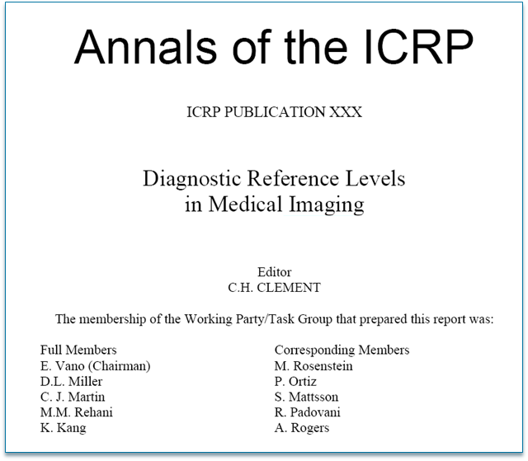
Expected to be ready for public consultation before de end of 2015

Slide 7
Contents of the new ICRP document
Glossary and Introduction.
Considerations in conducting surveys to establish DRLs.
Radiography and diagnostic fluoroscopy.
Interventional procedures.
Digital radiography, CT, nuclear medicine, and multimodality procedures.
Paediatrics.
Application of DRLs in clinical practice.
Summary of the Commission’s recommendations.

Slide 8
Why more advice on DRLs?
Multimodality imaging procedures (e.g. PET-CT).
Lack of knowledge on DRLs and lack of use.
Digital radiology (selection of different image quality).
Automatic dose reporting systems.
Differences between DRLs and organ dose evaluations.
Not applicable to individuals.
Need to use sample of patients and not phantoms.
Easily measured quantities.
Review at intervals of 3-5 years or after relevant changes.
Corrective actions without delay.
Patient weigh for paediatrics and not age bands.

Slide 9
The new ICRP document on DRLs (1)
The new document of ICRP highlights that the application of DRLs by itself is not sufficient for optimization of protection.
Image quality or, more generally, the diagnostic information provided by the examination (including the effects of post-processing), must be evaluated.
Quantities used for DRLs should be appropriate to the imaging modality being evaluated, assess the amount of ionizing radiation applied to perform a medical imaging task, and be measured directly.

Slide 10
The new ICRP document on DRLs (2)
For interventional procedures, complexity of the procedure may be considered in setting DRLs.
National and regional DRLs should be revised at regular intervals (3-5 years) or more frequently when substantial changes in technology, new imaging protocols or post-processing of images become available.
DRLs shall not be used for individual patients or as trigger (alert or alarm) levels for individual patients or individual examinations.
The concept and proper use of DRLs should be included in the education and training programmes of the health professionals involved in medical imaging with ionizing radiation.

Slide 11
Key points on Diagnostic Reference Levels
DRLs are an effective tool that aids in optimisation of protection in the medical exposure of patients and should be part of education and training programmes.
When two imaging modalities are used for the same procedure (e.g. PET/CT) it is appropriate to set DRLs for both modalities independently.
National and regional DRLs should be revised at regular intervals (3-5 years) or more frequently when substantial changes in technology, new imaging protocols or post-processing of images become available.
If a DRL value for any procedure is consistently exceeded, appropriate corrective action should be taken without undue delay.

Slide 12
Thank you
www.ICRP.org
www.icrp.org

