Slide 1
Teamplay
Connect, compare, collaborate.
www.siemens.com/teamplay

Slide 2
Three ways how big data can transform healthcare^{1,2}
Pool data
Big data may not cure cancer today, but its promise lies in what it can uncover to enhance diagnostics and treatment tomorrow
16,000
hospitals worldwide collect data on patients.
80 %
of health data is unstructured and stored in hundreds of forms such as lab results, images, and medical transcripts.
Transform data into information
Improve data communications and quality. Enhanced and efficient care will follow.
$300bn-$450bn
If big data was used effectively, the U.S. healthcare sector could save every year
Support providers
New user-friendly support systems alleviate pressures by saving time, money and improving outcomes.
¹ Healthcare IT Connect, http://bit.ly/1zP0QPd
²IBM, McKinsey Global Institute, http://bit.ly/1qaeJ9t

Slide 3

Siemens users in Portugal are creating big data
100,000s
scanners
100,000s
users
1,000,000s
exams
Notes:
Benchmark to other countries

Slide 4
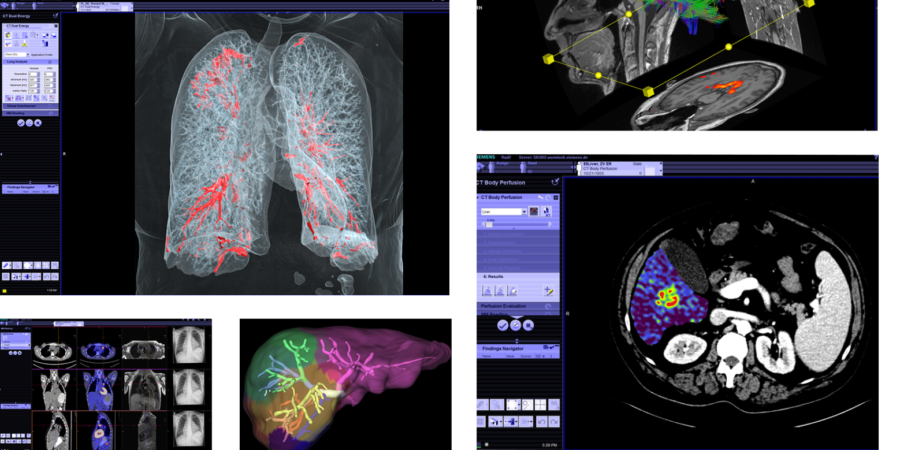
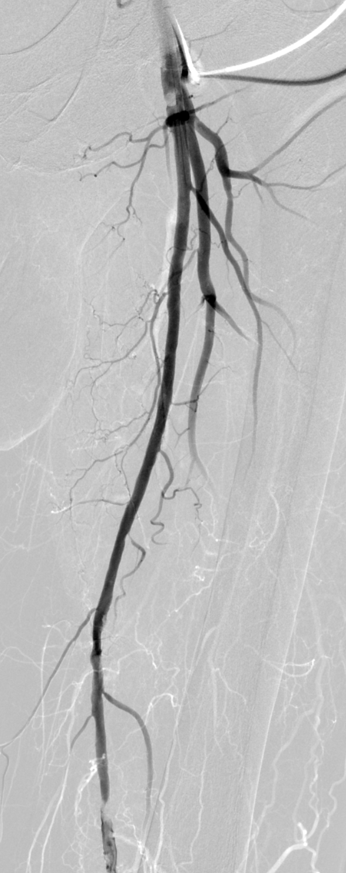
There's is more than just images
Tremendous amount of information is not utilized today

Slide 5

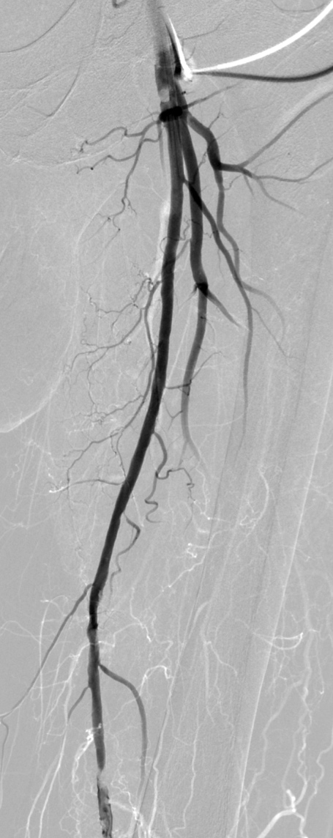

Precious data “behind” the images
Using this data to create benefits for our customers
Patient change time
Exams per hour
Dose DLP
CTDIVol

Slide 6
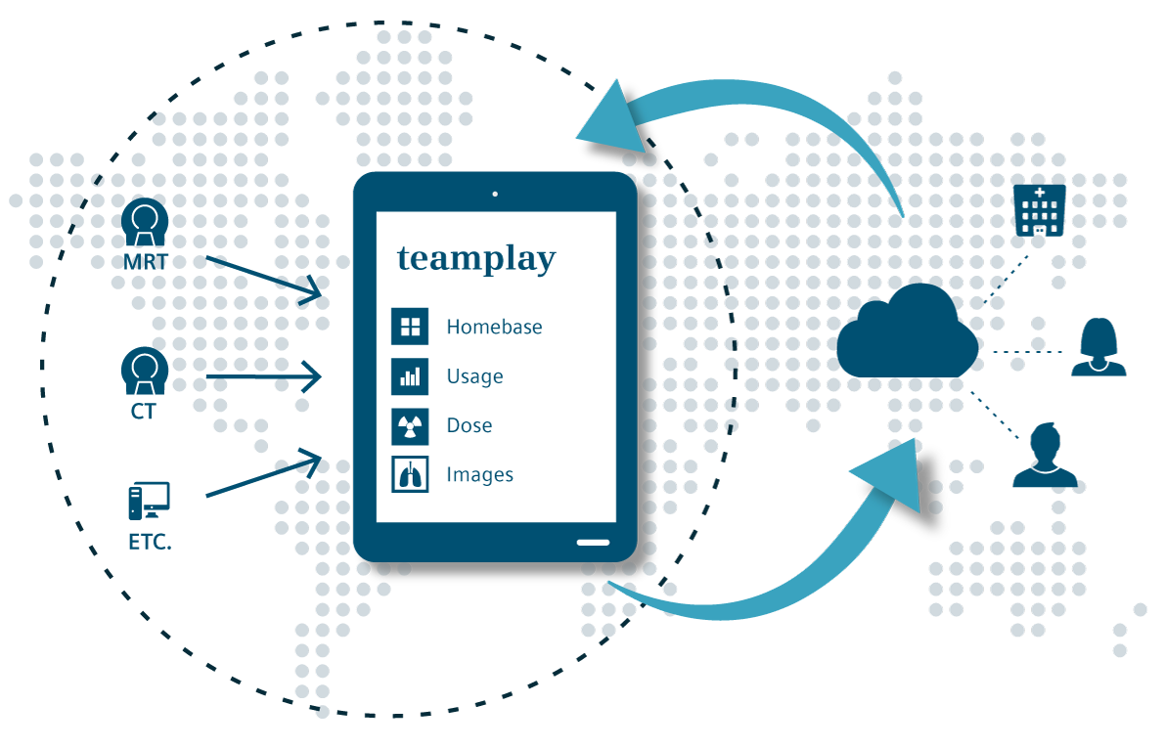
teamplay
Connect, compare, collaborate.
teamplay is a network that brings together healthcare professionals in order to advance medicine and human health

Slide 7
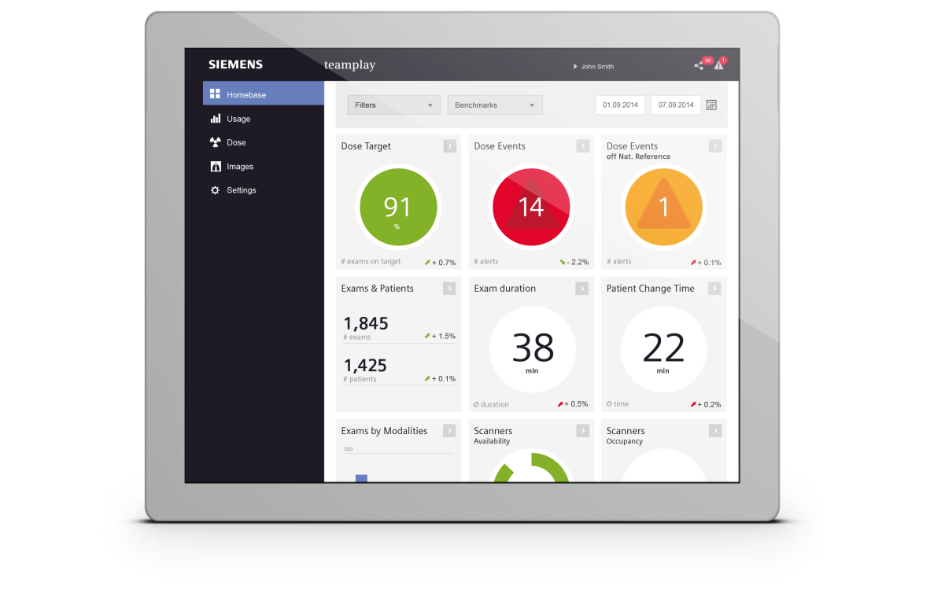
teamplay
Connect, compare, collaborate.
Consolidation
Cloud based
Optimization
Fleet management
Efficiency
Networking
Benchmarking
Instant access
2nd opinion
Universal
Multi-vendor
All in One solution
Instant access at your fingertips
Dose monitoring
No upfront investment

Slide 8

teamplay is a cloud-based solution
Cloud-based solutions offer huge possibilities
Central updates only to the cloud -> no need for local server updates
No need for client updates, because everything is browser-based
One update push will reach all customers
Data in the cloud enables future big data applications around clinical and operational data

Slide 9

Data privacy and data security teamplay targets to be HIPAA & EuroPriSe compliant
Providing different data privacy level to be compliant in
  HIPAA¹ (US)
  EuroPriSe² (Europe)
  ULD³ (Germany)
No protected health information (PHI) will be sent into teamplay without customer agreement
Going beyond HIPAA / EuroPriSe compliance by providing highest encryption methods for data security ensures best patient data privacy
EuroPriSe²
HIPAA¹
ULD³
¹HIPAA compliant
²EuroPriSe - Certified to European Privacy Seal standard is initiated but pending
³ULD - Certified to ULD Seal standard is initiated but pending

Slide 10


teamplay concept
Easy and self installable DICOM teamplay Receiver software
teamplay Receiver software connects to imaging devices
Relevant data is transferred to teamplay network
Features designed to protect personal information
Users have Web-based access to apps from everywhere¹, based on role and rights of account
Microsoft Azure Cloud
Web
Access
Web
Access
Web
Access
3rd-party
Scanner
Siemens
Scanner
Home
External physicians
Hospital
  ¹ Prerequisites include: connection to a network, meeting recommended minimum hardware or browser requirements, and adherence to local data security regulations

Slide 11
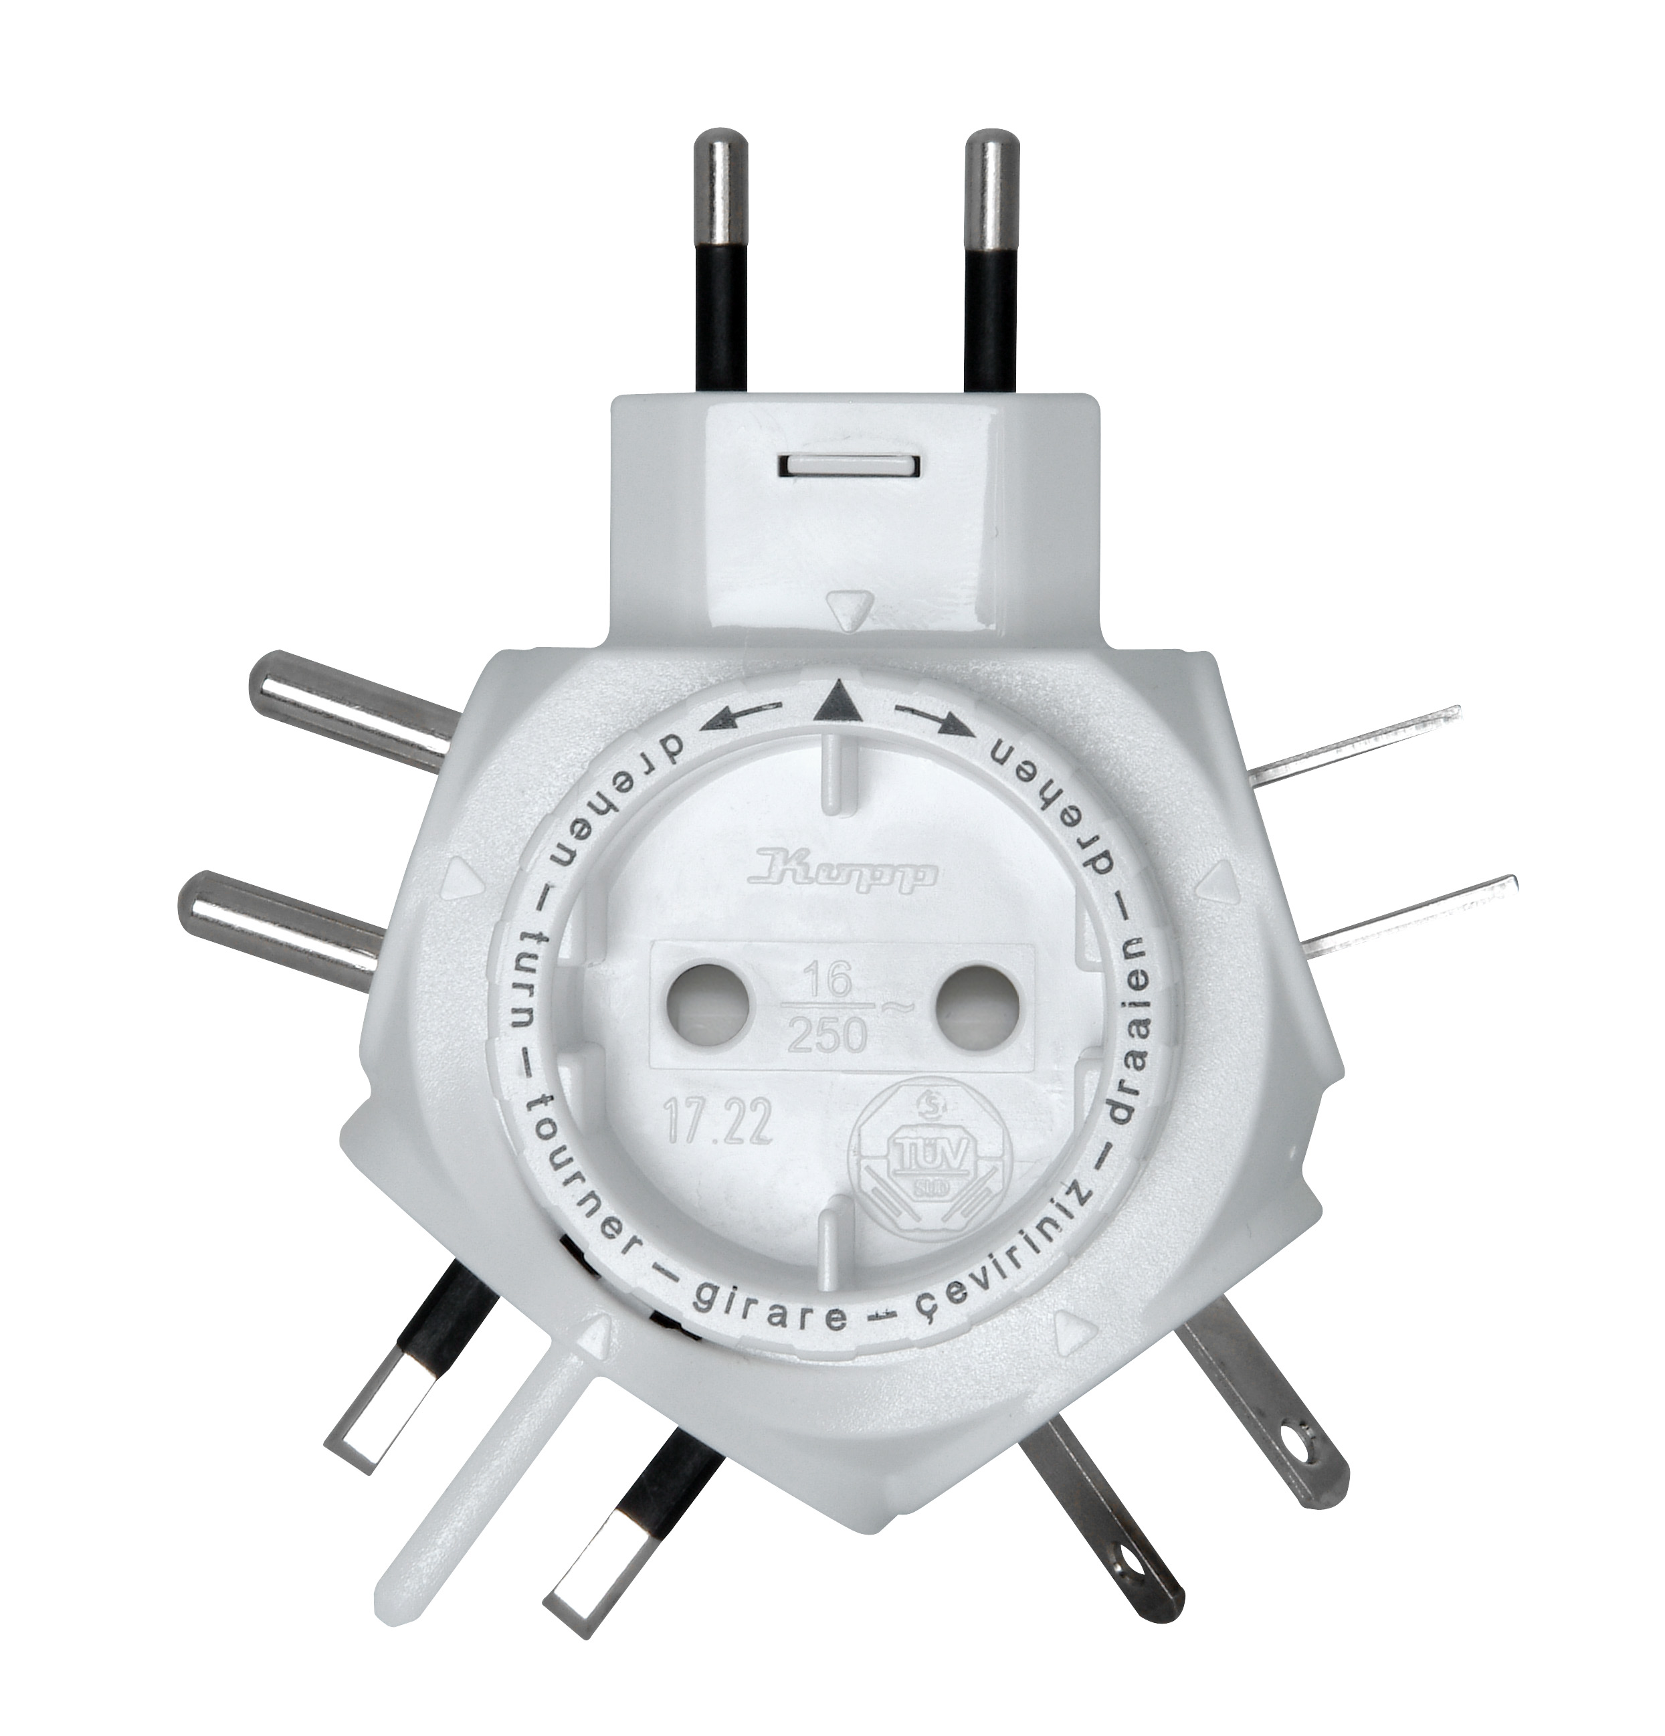
Multi-vendor capabilities will lower operational costs
Full overview about all of the customer's imaging devices with only one system because of standards-based integration methods (DICOM)
Limit the complexity of handling different tools for different vendors
Lower operational cost by using only one system

Slide 12

How teamplay tackles the department manager's challenges
“How can I benchmark with the best in my League”?

Slide 13
How teamplay tackles the department manager's challenges
“We just acquired two more Hospitals.
How do I make sure I have a consolidated overview on the same platform?”
Notes:
Then there is “Dose”, which monitors imaging dose with tools that are easy to setup and use.

Slide 14

How teamplay tackles the radiologist's challenges
“How can I get a second opinion?”

Slide 15
How teamplay tackles the radiologist's challenges
“How can I manage the patient dose in my department?”

Slide 16



teamplay
Connect
compare
collaborate
Note: Please refer to your sales representative whether the product is available for your country

