Slide 1

Optimização em radiologia
– uma abordagem pragmática –
Ana Pascoal
(ana.pascoal@nhs.net)
Medical Physicist
Medical Engineering & Physics - Radiation Protection
King’s College Hospital, London, UK
Lisboa, 10-12 Set 2015

Slide 2
Outline
Optimisation - Why, What, When and How?
Six steps for optimization
Examples
Take home messages
References

Slide 3
Optimisation – Why?

Slide 4
Optimisation
Optimisation is about the quality of medical exposures
avoiding unnecessary exposures and
for justified exposures, reducing radiation risks to the minimum compliant with clinical needs.
Net
benefit
Residual collective dose
Notes:
Objectivo da proteccao radiologica e minimizar o perigo decorrente da exposição do corpo humano à radiação ionizante. Estes efeitos podem ser estocasticos ou deterministicos dependendo da dose
A optimizacao tem por objectivo determinar qual e a dose de radiação que maximiza o beneficio versus o risco.

Slide 5
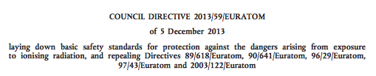
Radiation Protection Framework
EU BSS 2013/59 EURATOM lays down basic principles for for radiation protection of patient, staff, public and the environment against the hazards of ionising radiation.
Revokes 89/618/Euratom, 90/641/Euratom, 96/29/Euratom, 97/43/Euratom and 2003/122/Euratom
Entered into force on 6/02/2014
EU countries must review national legislation to ensure compliance by 6/02/2018.
Notes:
The directive is binding, as to the result to be achieved, upon each member state to which it is addressed, but shall leave to the national authorities the choice of form and methods.
Revokes Directives
89/618/Euratom - informing the general public about health protection measures to be applied and steps to be taken in the event of a radiological emergency
90/641/Euratom – outside workers in controlled areas
96/29/Euratom – permits to set installations and staff protection
97/43/Euratom – patient doses
2003/122/Euratom - radioactive substances

Slide 6
EU BSS 2013/59 EURATOM
Highlights on the topic of optimisation
Practitioner (e.g. radiologist) has responsibility
Should address organ/tissue doses as well as overall E
Shall include staff exposures
Shall include the selection of equipment
Shall implement/use diagnostic reference levels
Team approach involving practitioner, medical physics and operators
Notes:
clinical responsibility" means responsibility of a practi­ tioner for individual medical exposures, in particular, justification; optimisation; clinical evaluation of the outcome; cooperation with other specialists and staff, as appropriate, regarding practical aspects of medical radio­ logical procedures; obtaining information, if appropriate, on previous examinations; providing existing medical radiological information and/or records to other practi­ tioners and/or the referrer, as required; and giving information on the risk of ionising radiation to patients and other individuals involved, as appropriate;

Slide 7
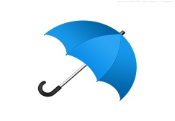

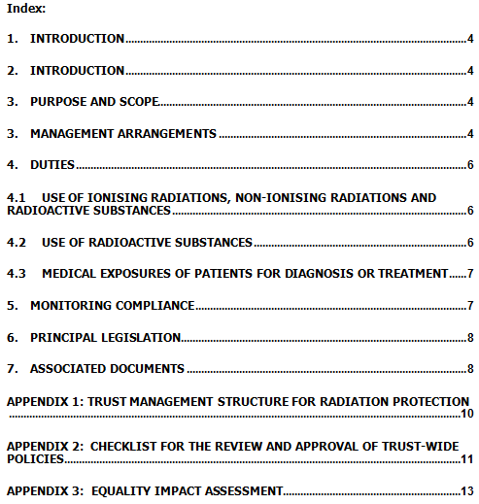

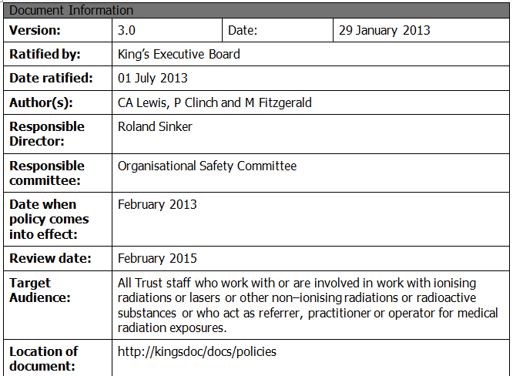
Radiation Protection Framework
Hospital Policy on Radiation Safety Management
Radiation protection team
Chief Executive
Notes:
Available on king´s docs.
King's has a radiation safety polity that aims to achieve compliance with the relevant legislation.
This legislation comes from European Directive Requirements.
The relevant directives have been reviewed – a new basic safety standards has been published in - and currently WIP to update the UK regulations accordingly. This needs to be done by
By February 2018.

Slide 8

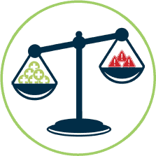

Radiation Protection Framework
effective and safe use of
radiation in medicine
Staff, Patients and Public
Staff, Patients and Public
Staff and Public
Justification
Optimization
Limitation
Practitioner
and operator
practicioner
Guidance for implementation (practical and targeted to users)
National Regulatory Framework
Notes:
Optimise what?
>> Radiation risk (dose) and Benefit (image quality)
To whom it applies?
>> Patients, Staff and Public

Slide 9
Optimise What?

Slide 10
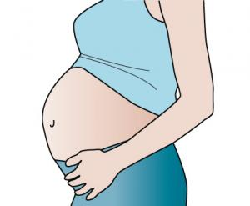
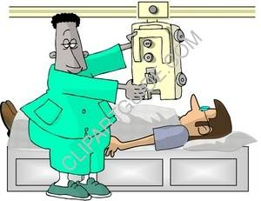

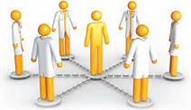


Optimisation in Radiology
Patient Radiation Exposures
Staff radiation Exposures

Slide 11
Optimise When?

Slide 12
Optimisation
Optimisation might be particularly appropriate when
  New protocols/procedures are adopted
  New equipment is installed
  Following dose audits
  Following risk assessment
  New scientific evidence
Processes in place should be audited periodically and reviewed as deemed necessary.

Slide 13
Optimise How?

Slide 14
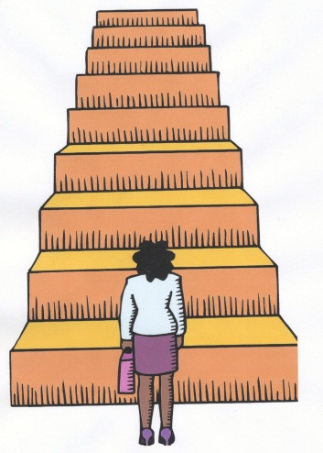
Six Steps for Optimisation

Slide 15

Step 1
Set up a multidisciplinary team

Slide 16
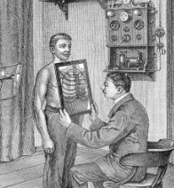
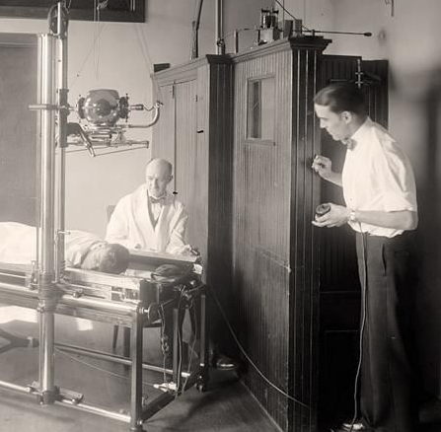
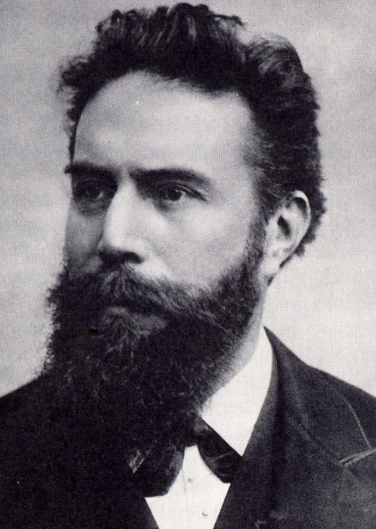
Step 1 - Set up a multidisciplinary team
Involve the key personnel
Radiologist
Radiographer
Physicist/Scientist
Notes:
Identify key people
Agree roles and responsabilities

Slide 17



Step 1 - Set up a multidisciplinary team
Involve people who will make it work!
  Willing
  Organised
  Responsive
  Knowledgeable
No experience? Get help from experts/external collaborators
Create/Join online forums
Draft a preliminary work plan – and a timetable!
Agree roles and responsibilities
Use your network!

Slide 18
Step 2
Identify procedures that require optimization

Slide 19
Step 2 - Identify procedures for optimisation
Sources of useful information include
Dose audits
Reports of sub-standard clinical image quality
Repeats
Observation
Adverse incidents
Guidelines and scientific literature.
Other

Slide 20
Step 2 - Identify procedures for optimisation
Sources of useful information include
Dose audits
Reports of sub-standard clinical image quality
Repeats
Observation
Adverse incidents
Guidelines and scientific literature.
Other

Slide 21
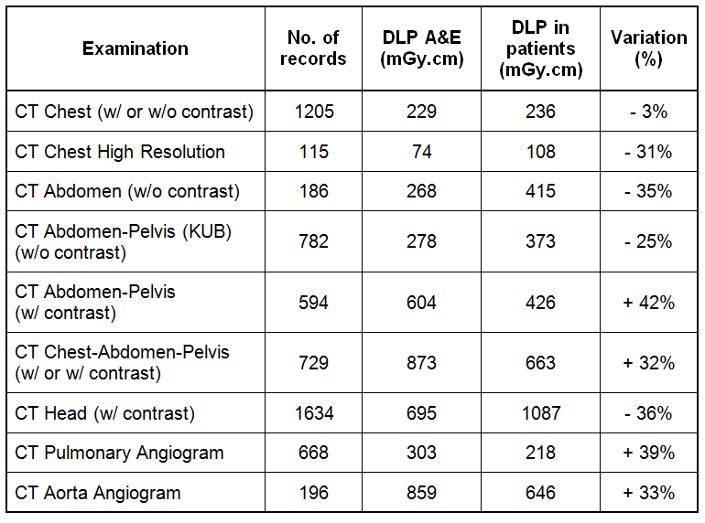
Step 2 - Identify procedures for optimisation
Dose audits
Notes:
Further investigation is required to understand the observed variations between doses for the same examination codes performed on different CT scanners within the Trust and adjust protocols as appropriate and where necessary.

Slide 22
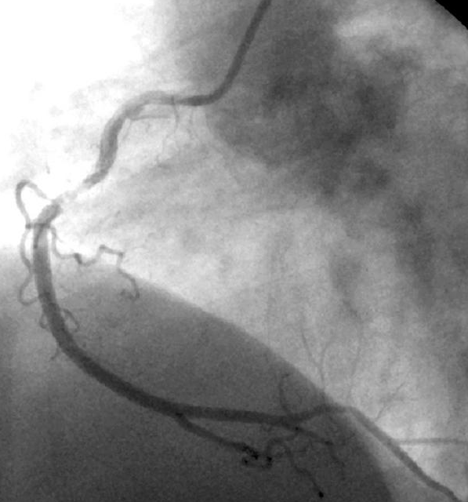
Step 2 - Identify procedures for optimisation
Report of sub-standard image quality from an interv, cardiologist
“I have just finished a complex PAMI (primary angioplasty in acute myocardial infarction) in the new cardiac 5, we have just managed to do the case safely. Had the patient not been unstable I would have abandoned the case and moved to another lab.”
There are a number of problems. Most pressing is the quality of the imaging. This is really sub-standard.
I am not sure whether the sharpness of the image can be changed but at times it was even a struggle to see the radio-opaque components of the stent (patient was not overweight) (…).
Can this be rectified asap ?

Slide 23
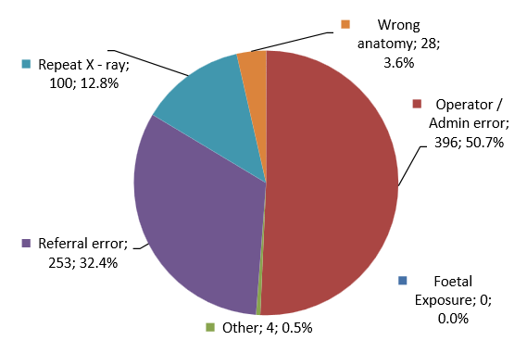

Step 2 - Identify procedures for optimisation
Key IRMER findings, inspection reports and annual activity reports available on the CQC website.
Notes:
CQC provides bespoke analysis to trust on request, to help them compare local notification rates against the national (England) notification data set (IRMER annual report 2013).

Slide 24

Step 3
Establish priorities for optimisation

Slide 25
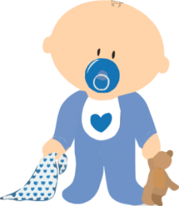
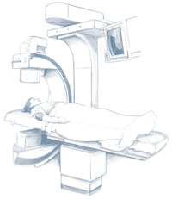
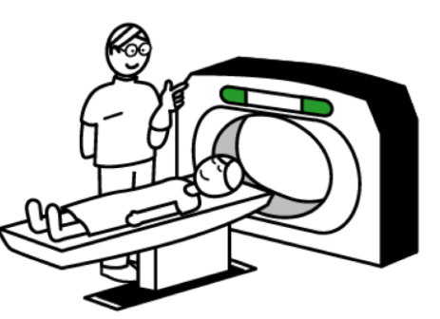
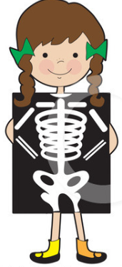
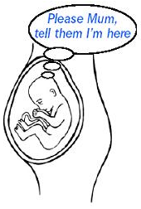
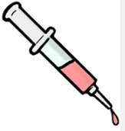
Step 3 - Establish priorities for optimisation
Examples of prioritization criteria
Higher dose examinations
Higher risk groups (neonates, paediatric, pregnant)
Patients that require frequent imaging (cancer, chronic)
Procedures associated with adverse incidents

Slide 26
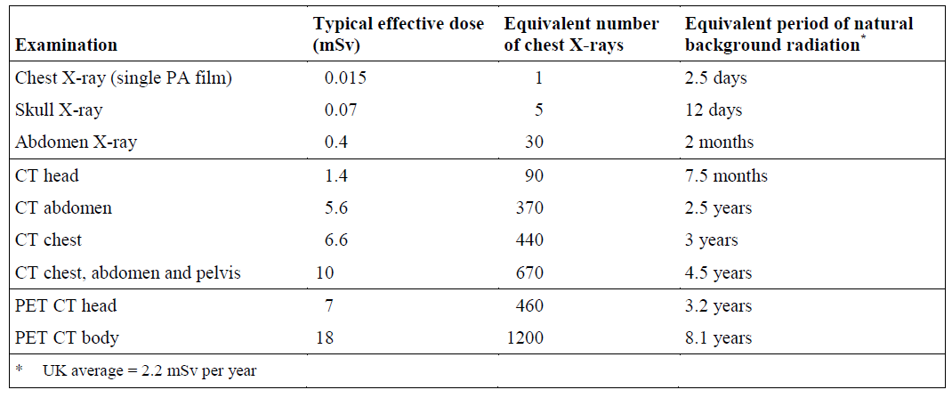
Step 3 - Establish priorities for optimisation
How doses compare?
Source: Royal College of Radiologists, 2012

Slide 27
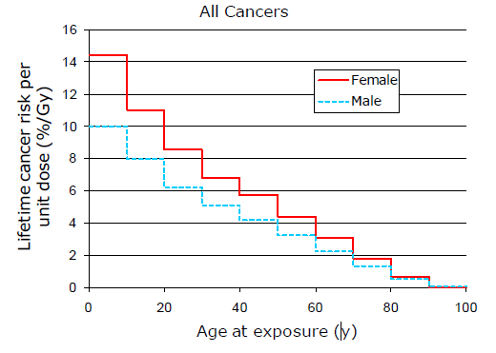
Step 3 - Establish priorities for optimisation
How do risks compare?
The stochastic radiation risks for a specific sex/age can vary by more than 10x
Cancers have long latency periods
Children have longer to live and potentially + sensitive tissues
The current average (all ages and both sexes) risk proposal for total harm caused is 5.5% per Sievert.
(Total harm = combined detriment: fatal cancer, non fatal cancer and heritable effects)
5.5%
ICRP Publication 103 (2007)
(all cancers; uniform whole-body exposure).
Notes:
The risk for a particular age band, sex and examination can vary from the nominal risk coefficient by more than a factor of 10.
ICRP reviews t.
The total harm caused is the combined detriment. This includes:
Fatal cancer
Non-fatal cancer
Heritable effects (with weighting by life lost and severity)
Corresponds to a lifetime additional risk
he evidence and updates this risk factors

Slide 28
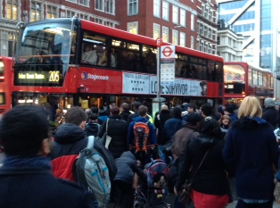
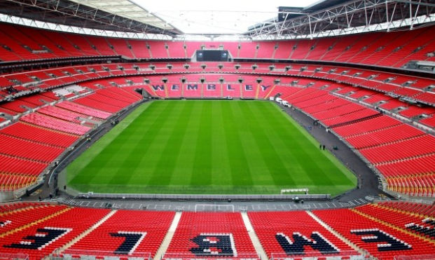
What does 5% per Sievert means?
5 people from every 100 exposed to 1 Sv of radiation (i.e. a packed double decker) will develop cancer*
or
5 people in every 100,000 (Wembley stadium) exposed to
1 mSv will develop cancer*
*due to the radiation exposure
Notes:
The International Commission on Radiological Protection (ICRP) evaluate the evidence every few years
Wembley stadium capacity is 90,000

Slide 29

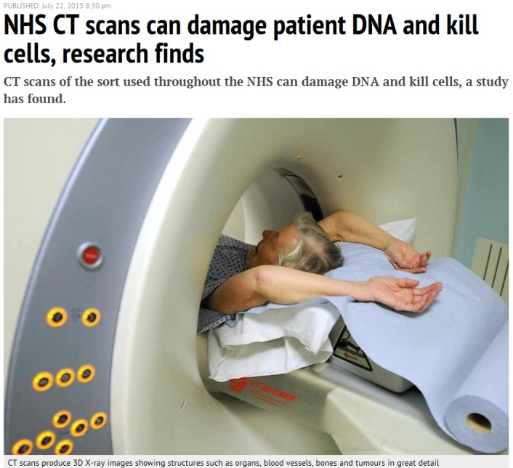
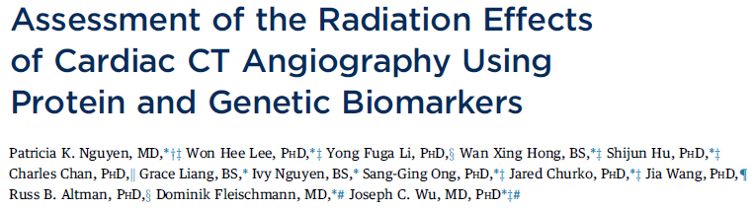
Step 3 - Establish priorities for optimisation
New evidence on the effects of radiation
Some findings - Patients exposed to >7.5 mSv of radiation from cardiac CTA had evidence of DNA damage, which was associated with programmed cell death and activation of genes involved in apoptosis and DNA repair.

Slide 30
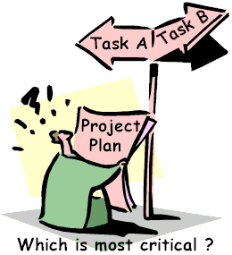
Step 4
Develop and implement an optimisation plan

Slide 31
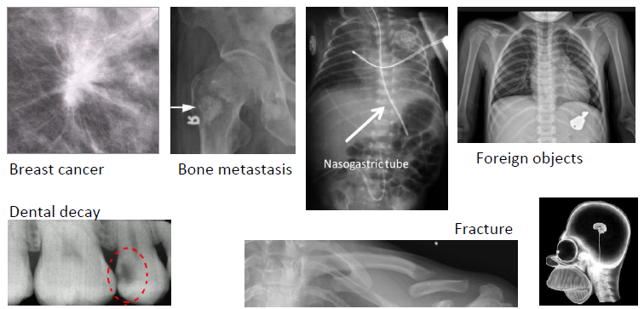
Step 4 – Implement an optimisation plan
Define the required imaging task
Image quality is a subjective concept best described within the context of a clinical task

Slide 32
Step 4 – Implement an optimisation plan
Examples of imaging tasks that require different levels of image quality
Task | Purpose | Contrast resolution | Spatial resolution | Temporal resolution
Localization (PET-CT) | Anatomical overlay | Medium | Low | Low
Diagnosis (CT c/ contrast) | Tissue characterization | High | High | High
Intervention (cardiac) | Localization /Intervention | Medium/High | Medium/High | Medium/High

Slide 33
Step 4 – Implement an optimisation plan
Use suitable metrics to assess patient dose
General
Radiography
Dose-Area Product (DAP); kV and mAs;
Effective dose (E); Dose to critical organs (H)
Fluoroscopy
(angio, cardiac)
Dose-Area Product (DAP)
Skin Dose (mGy); Dose to critical organs (H)
Mammography
Average Glandular Dose (AGD)
Entrance Surface Dose (ESD)
Computed Tomography
Computed Tomography Dose Index (CTDI)
Dose-Length Product (DLP)
Dose to critical organs (H)

Slide 34
Step 4 – Implement an optimisation plan
Methods for optimisation in radiology
Objective methods
  Quantitative (e.g. Contrast-to-Noise Ratio, MTF, NPS, DQE)
Subjective methods
  Quantitative (e.g. ROC analysis, phantoms)
  Involve human judgment
perception

Slide 35
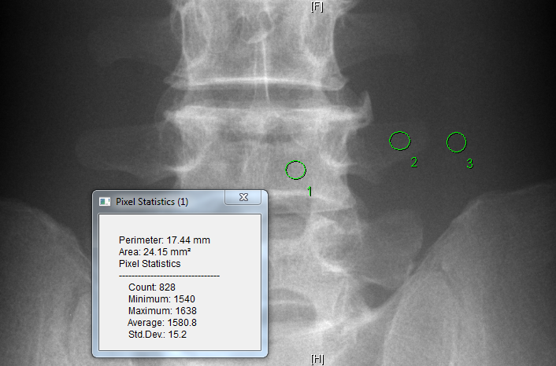
Optimisation of CNR for spine radiography
Contrast to Noise Ratio (CNR)
Notes:
The relation between signal-to-noise ratio and image quality has been described in the past and is well accepted therefore this is a parameter commonly used for IQ metrics.
For medical imaging purposes, more important than the signal itself is he difference between 2 signals corresponding adjacent regions in the image, here represented by a brighter square region and the surrounding noisy background.
The graphs shows the signal in each individual region, the difference between the 2 signals and it is visible the variability in the background signal which represents the noise and plays an essential role in the ability discriminate the signal difference from the background.
These quantities can be used to calculate the so called signal difference-to-noise ratio which then can be used as an IQ indicator.
Higher S_{d}NR are associated with better image quality.

Slide 36
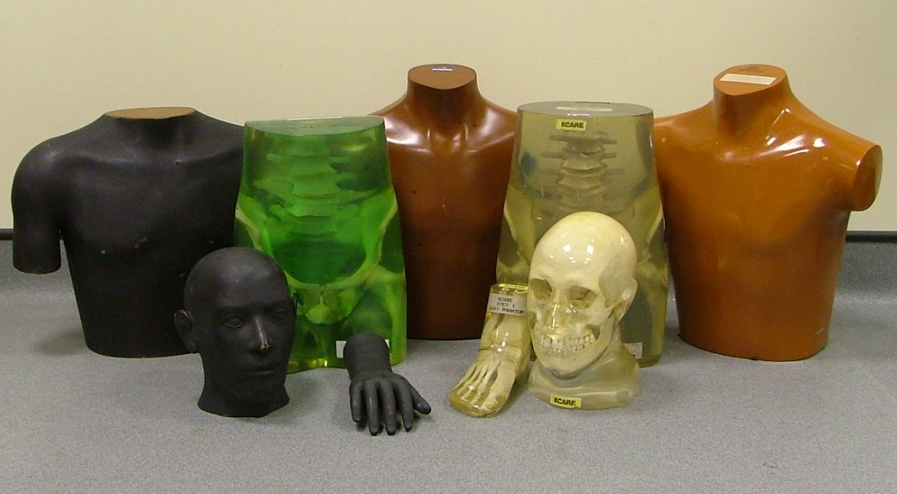
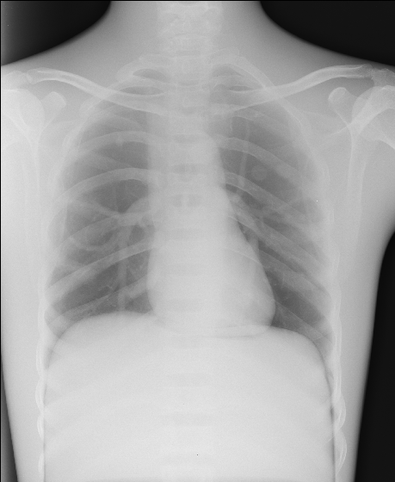
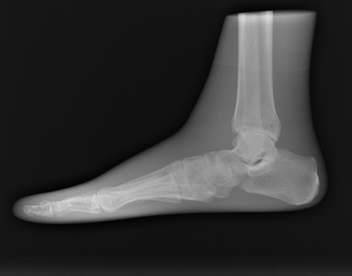
Phantoms and test objects
Phantoms and test objects are useful tools in optimisation
Notes:
Anthropomorphic phantoms are extremely useful since they provide clinical-like images of various parts of the human anatomy that can be used to measure absolute image quality using established image quality criteria or to measure relative image quality as in comparative studies.
Those phantom images can be assessed in terms of normal anatomy or can contain simulated details to mimic pathologic conditions.
An important advantage of assessing image quality using anthropomorphic phantom images is that they because they are acquired and processed using the clinical algorithms they reflect the image processing capabilities of the imaging system.

Slide 37
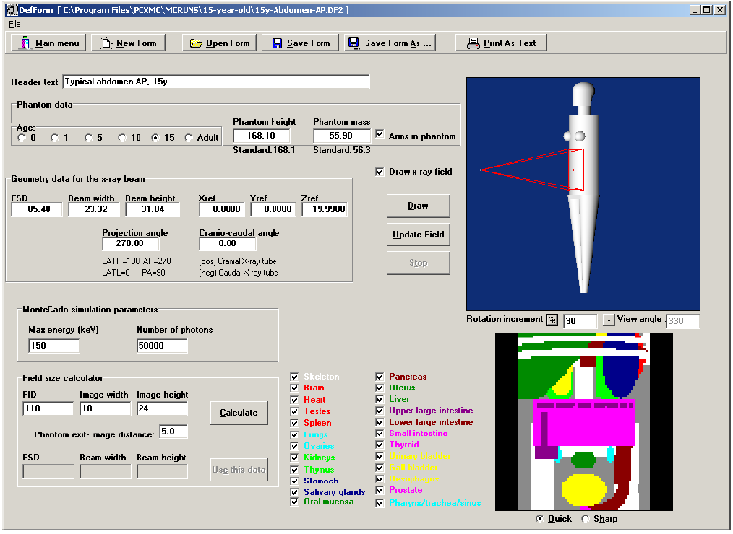
Dose calculation software – Radiography
PCXMC v.2.0

Slide 38
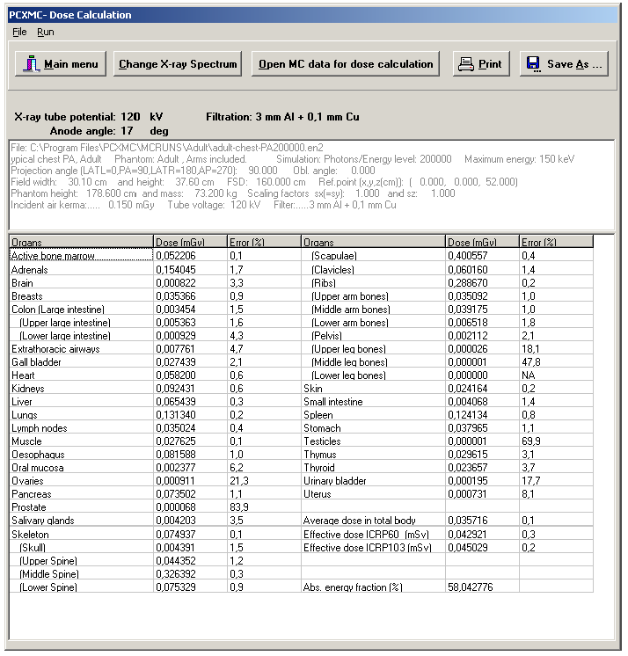
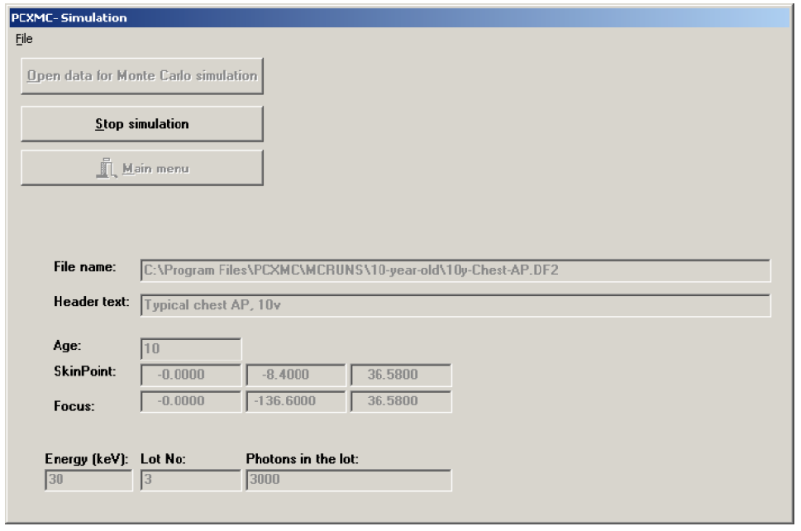
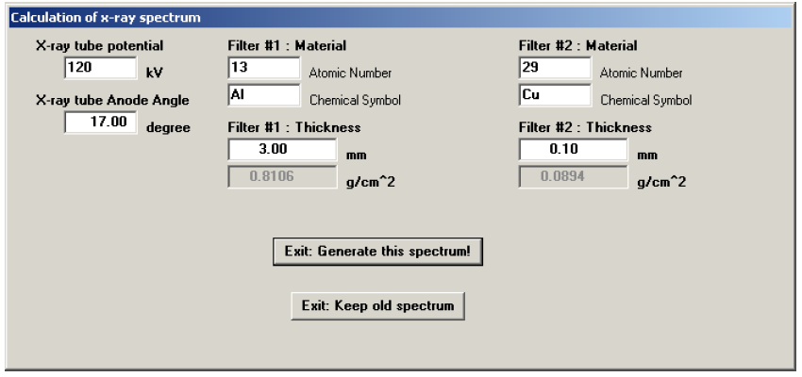
Dose calculation software – Radiography

Slide 39
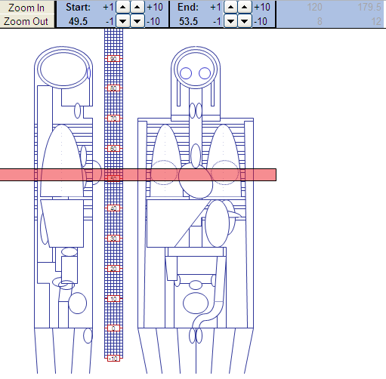
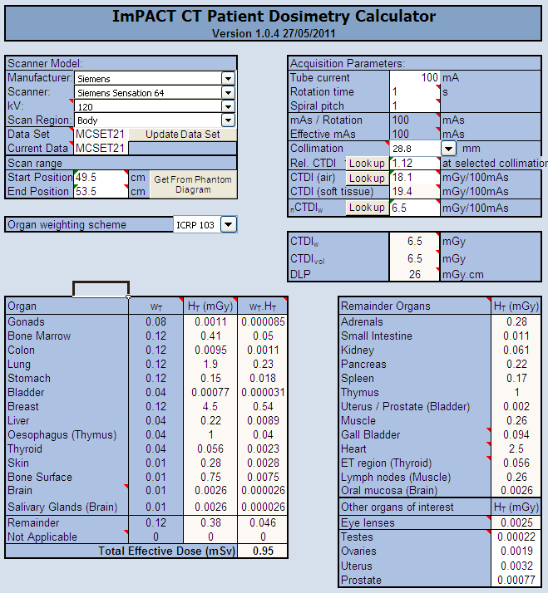
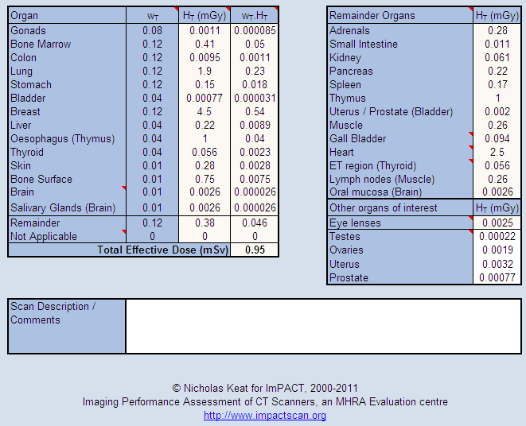
Dose calculation software - CT
Impact Dose v.1.0.4, ImPACT (27.05.2011)

Slide 40
Step 5
Disseminate results and findings

Slide 41
Step 5 – Disseminate results and findings
Examples of changes that may result from optimisation studies
Protocols adapted for patient groups (adult, children pregnant patients)
Protocols adapted to IQ requirements (e.g. localisation, tissue characterisation)
Important! Optimised protocols should not be transferred between equipment unless same model and software versions are considered - still, validation study should be performed.

Slide 42
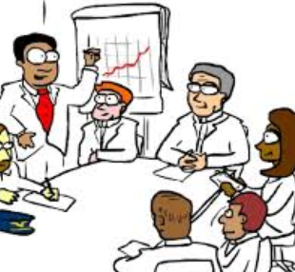
Step 5 – Disseminate results and findings
Staff meeting
Quality meetings
Risk/Adverse incident meetings
Seminars and training sessions
Collect feedback and use it to improve future optimization exercises – review periodically.

Slide 43

Step 6
Assess impact of optimisation
(and repeat periodically)

Slide 44
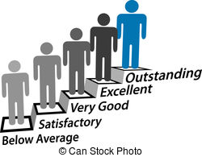
Step 6 – Assess impact of optimisation
Compare results before and after
Analyze trends
  DRLs
  Staff personal exposure records
  Repeated examinations
  Radiation incidents

Slide 45
Example 1
Optimisation of staff dose
(interventional cardiology)

Slide 46
Optimisation of staff dose (interv. cardiology)
High monthly personal dose record for a member of staff
an established dose investigation level (DIL) (extremity monthly dose) was exceeded.
This required investigation.
What is the role of the member of staff? Brief profile.
  Consultant interventional cardiologist.
  Experienced in complex procedures.
  Joined the hospital/team four 4 months ago.
How does his personal dose compare with his colleagues?

Slide 47
Optimisation of staff dose (interv. cardiology)
How does his personal dose compare with his colleagues?
Finger dose is 4x higher (on average) compared with colleagues
Extremities dose investigation level exceeded in March 2014
Chest dose (under lead apron) - ok
Collar dose higher than colleagues (for whom the dose was frequently below the minimum detectable quantity)
Inv. Level
(1 month monitor.)
Inv. level
Inv. level

Slide 48
Optimisation of staff dose (interv. cardiology)
Investigation – continuation.
Workload higher than his colleagues? No. Comparable.
Different patient cohort (e.g. obese patients)? No.
Incidence of complex cases? No.
Is adequate personal protective equipment available for use? Yes.
Does he comply with radiation safety practices? No evidence >> investigate.

Slide 49
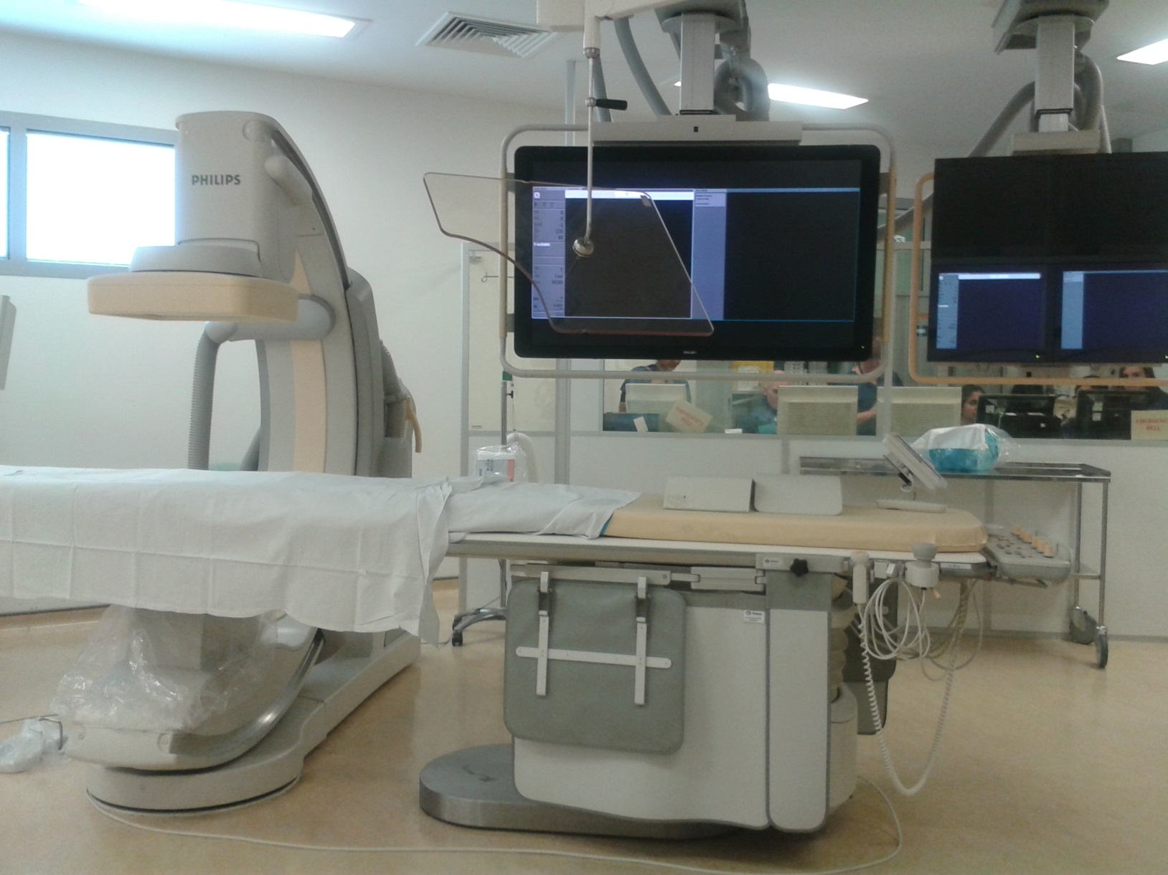
Interventional cardiology lab
Digital image
receptor
Ceiling Suspended Shield
Controls
Large shield
X-ray tube
Small shield

Slide 50
Case 1 – High staff dose (interv. cardiology)
Investigation – continuation.
Does he comply with radiation safety practices?
  Not fully.
  The lead shield provided is not routinely used.
  The cardiologist frequently keeps his hands in the vicinity within the X-ray field when the beam is on.
Recommendations from the RPA
Use of the ceiling suspended and the table shielding routinely.
Move hands away from the screening area, when possible, to reduce exposure to scatter radiation.
Attend radiation safety training for cardiac interventional staff.

Slide 51
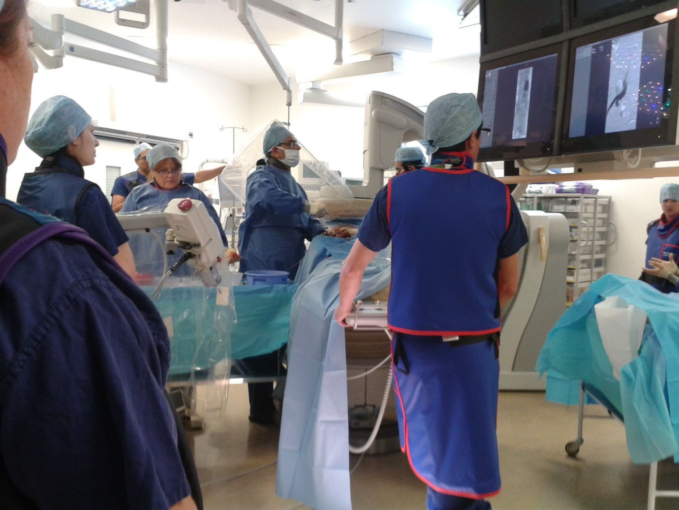
Optimisation of staff dose (interv. cardiology)

Slide 52
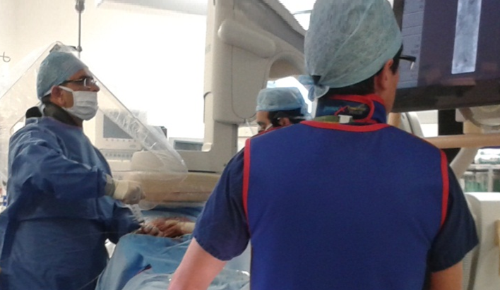
Optimisation of staff dose (interv. cardiology)
Cardiologist wearing
personal protective equipment
(collar shield and vest)
Leading suspended screen positioned
to block scatter from the patient
Operator hands away from
primary beam during exposure.

Slide 53
Optimisation of staff dose (interv. cardiology)
Impact of change in practice
Finger doses and collar doses recorded in the subsequent months were reduced indicating compliance with good radiation safety practices.

Slide 54

What to do when staff do not comply…
Approach the member of staff to discuss the matter and understand the causes of the non compliance
Offer chocolates!!!
If this still doesn’t work,
…might need to escalate.
Dr
Stubborn

Slide 55

What to do when doctors do not comply
Dear Dr Stubburn
The most recent framework for radiation protection recommended by the ICRP (report 103, 2007) is the basis of current radiation protection legislation in the UK, the Ionising Radiations Regulations 1999, that our Trust are obliged to implement.
Thus our Local Rules specify that lead aprons must be worn in theatre when X-ray imaging is undertaken. Should we fail to implement our own rules for safety we run the risk of prosecution by the Health and Safety Executive.
Part of my role as Radiation Protection Adviser to the hospital is to minimise that risk. (…)
Notes:
May add that current ICRP guidance is revised and will follow closely to update radiation users of changes that might occur in UK regulations and trust policies.

Slide 56
Example 2
Optimisation of patient dose
(interventional cardiology)

Slide 57
Step 2 - Identify procedures for optimisation
Skin dose in cardiac interventional procedures
Optimisation work in progress
Notes:
Deterministic effects for skin exposur
Total interventional cases in 2015?
Cath labs 1-3

Slide 58
Step 6 - Assess impact
Example 3
Accidental exposure of a
pregnant patient

Slide 59
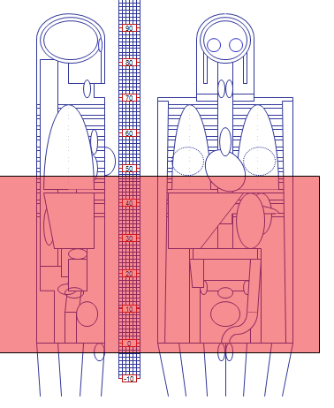
Example – Exposure of pregnant patients
Pregnant patient (5 weeks)
Biphasic scan (CT liver + CT abdomen/pelvis)
Anatomy covered - above liver to symphysis pubis
What are the risks?
Increased risk of childhood cancer of approximately 25% the natural risk
(1 in 500) due to the accidental irradiation.
a) Risk factor for a female adult (age 30-39) HPA CRCE-028 b) Guidance by the RCR (RCE-9)
Dose | Dose | Risk factor (% per Sv) | Risk
Effective dose (mother) | 3.2 mSv | 6.2%ª | 1 in 5000
Uterine dose (foetus) | 5 mGy | 10%^{b} | 1 in 2000

Slide 60
Optimisation of patient dose in CT
Example of a possible approach to optimisation
Reduce the area irradiated (avoid pelvic area where possible)
Discuss with the apps specialist setting up a low dose protocol for pregnant patients
Use software to investigate effect of parameters on dose to the organs/region at risk (uterus) and explore oportunitise to optimise technical factors.
Follow up future cases to monitor impact.

Slide 61
Take Home Messages

Slide 62
Take Home Messages
Optimisation is essential to deliver safe and good quality imaging
It is a requirement of the new BSS
Shall consider exposure of patients, staff and public.
A 6-Step pragmatic approach to optimisation is proposed
  Step 1 - Set up a multidisciplinary team
  Step 2 - Identify procedures that require optimisation
  Step 3 - Establish priorities
  Step 4 - Prepare and develop a protocol
  Step 5 – Disseminate results and findings
  Step 6 – Access impact and review periodically

Slide 63
Take Home Messages - practical tips
Planning phase
  Prepare a task plan with set milestones
  Agree roles and responsibilities (identify a project manager!)
  Define a realistic timeframe for the project
  Identify resource needs (equipment, staff/time)
Implementation phase
  Document relevant data/protocols appropriately
  Use electronic/web resources (e-mail, PACS, etc)
General
  Meet regularly with the team to discuss progress
  Be prepared – challenges will come. Persevere!

Slide 64








Take Home Messages
Cooperation is a valuable tool to promote and facilitate the implementation of optimisation projects.
T OGETHER
E VERYONE
A CHIEVES
M ORE

Slide 65

References
Basic Safety Standards
http://www.ensreg.eu/nuclear-safety-regulation/eu-instruments/Basic-Safety-Standards-Directive
EU guidelines for CT http://www.drs.dk/guidelines/ct/quality/index.htm
Image Wisely
http://www.imagewisely.org/imaging-modalities/computed-tomography/medical-physicists/articles/diagnostic-reference-levels
DRLs in CT
https://rpop.iaea.org/RPOP/RPoP/Content/InformationFor/HealthProfessionals/1_Radiology/ComputedTomography/diagnostic-reference-levels.htm
IAEA – DRLs
https://rpop.iaea.org/RPOP/RPoP/Content/Documents/Whitepapers/conference/S5-Vano-Diagnostic-reference-levels.pdf
National survey of DRLs in the Netherlands http://www.ncbi.nlm.nih.gov/pmc/articles/PMC3675255/
FDA public health notification on reducing rad dose in CT for paeds and small adult patients http://www.fda.gov/MedicalDevices/Safety/AlertsandNotices/PublicHealthNotifications/ucm062185.htm
Raman et al, CT Dose Reduction Applications: Available Tools on the Latest Generation of CT Scanners J Am Coll Radiol 2013;10:37-41.
ICRP, 2006. The Optimisation of Radiological Protection - Broadening the Process. ICRP Publication 101b. Ann. ICRP 36 (3).
ICRP, 2007. Radiological Protection in Medicine. ICRP Publication 105. Ann. ICRP 37 (6)
ICRP, 2007. 2007 Recommendations of the International Commission on Radiological Protection (Users Edition). ICRP Publication 103 (Users Edition). Ann. ICRP 37 (2-4).
ICRP, 2013. Radiological protection in cardiology. ICRP Publication 120. Ann. ICRP 42(1).
ICRP, 2013. Radiological protection in paediatric diagnostic and interventional radiology. ICRP Publication 121. Ann. ICRP 42(2).

