Slide 1
Justification and Optimization of Medical Exposure to Radiation
Mitsunori Suzuki
FUJIFILM Europe GmbH
Wim Van Riet
Senior Product Specialist - QAELUM N.V.
QÆLUM,
10.09.2015 : Justificação e Optimização das Exposições Médicas a Radiações Ionizantes

Slide 2
FUJIFILM Medical Product Portfolio
Radiology
Women’s Healthcare
Cardiology
Fujifilm Computed
Radiography
Fujifilm Digital
Radiography
Endoscopy
UltraSound
endoscopy
VNA
Notes:
FUJIFILMS Product Portfolio is designed to work in Harmony to ADD VALUE everywhere along the DIAGNOSTIC CHAIN
Synapse 3D and Synapse Mobilityis the newest Product line in our Medical IT Portfolio. It has completed the FDA review and is now available
Clinical applications for Radiology, Cardiology and Surgery.

Slide 3
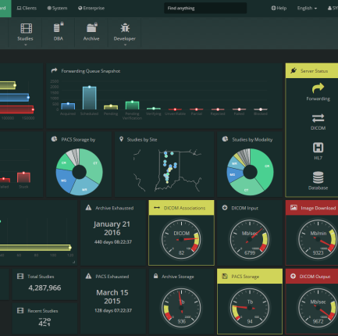
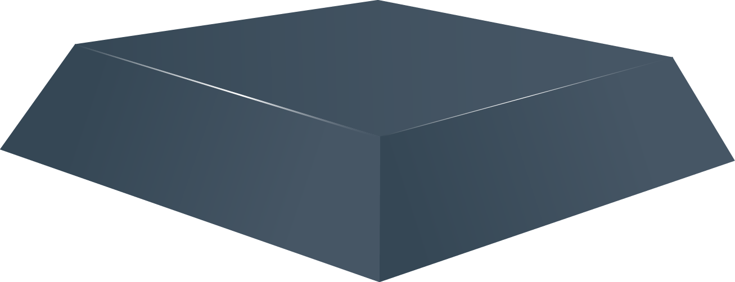
FUJIFILM’S CONTINUED COMMITMENT TO A MEDICAL INFORMATICS IMAGING PLATFORM
Synapse VNA – Foundation Technology Stack

Slide 4
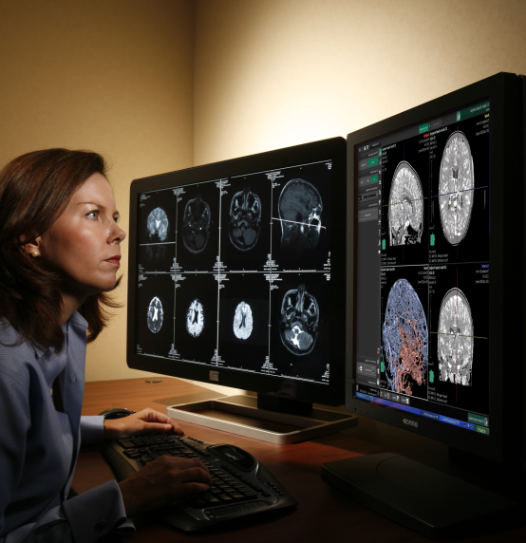
FUJIFILM’S CONTINUED COMMITMENT TO A MEDICAL INFORMATICS IMAGING PLATFORM
Synapse PACS
Synapse VNA – Foundation Technology Stack

Slide 5
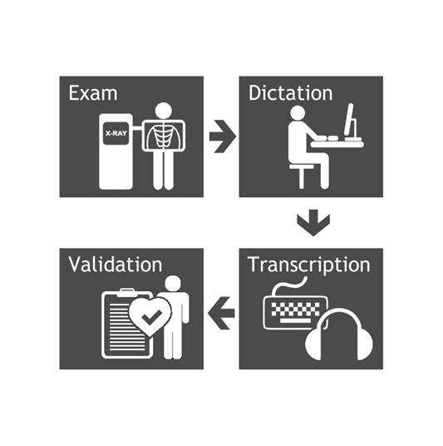
FUJIFILM’S CONTINUED COMMITMENT TO A MEDICAL INFORMATICS IMAGING PLATFORM
Synapse Clinical Workflow Manager
Synapse PACS
Synapse VNA – Foundation Technology Stack

Slide 6
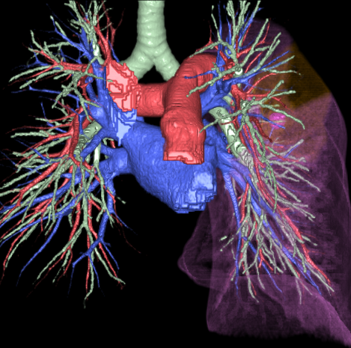
FUJIFILM’S CONTINUED COMMITMENT TO A MEDICAL INFORMATICS IMAGING PLATFORM
Synapse 3D Advanced Visualization
Synapse Clinical Workflow Manager
Synapse PACS
Synapse VNA – Foundation Technology Stack

Slide 7
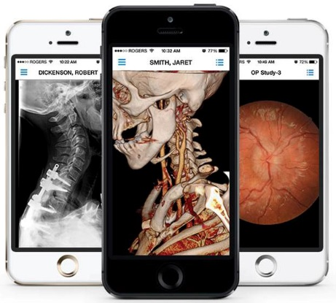
FUJIFILM’S CONTINUED COMMITMENT TO A MEDICAL INFORMATICS IMAGING PLATFORM
Synapse Mobility
Synapse 3D Advanced Visualization
Synapse Clinical Workflow Manager
Synapse PACS
Synapse VNA – Foundation Technology Stack

Slide 8
FUJIFILM’S CONTINUED COMMITMENT TO A MEDICAL INFORMATICS IMAGING PLATFORM
Synapse Mobility
Synapse 3D Advanced Visualization
Synapse Clinical Workflow Manager
Synapse PACS
Synapse VNA – Foundation Technology Stack

Slide 9
Justification and Optimization of Medical Exposure to Radiation
Why is Quality Control and Dose Optimization becoming important?
FUJIFILM/QAELUM Solution
Site Use-Cases including Wales Nation Wide project

Slide 10
Topics
Why is Quality Control and Dose Optimization becoming important?
FUJIFILM/QAELUM Solution
Site Use-Cases including Wales Nation Wide project

Slide 11
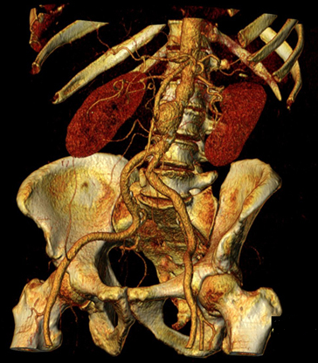
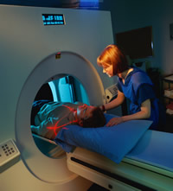
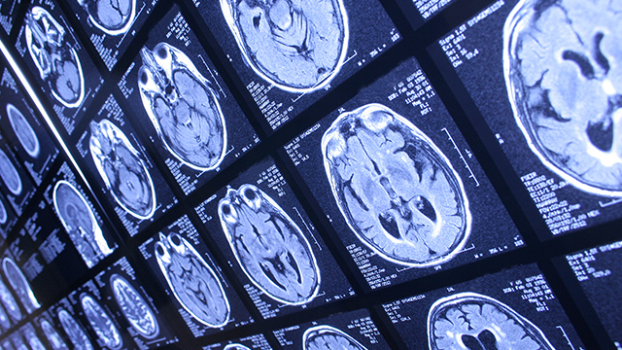
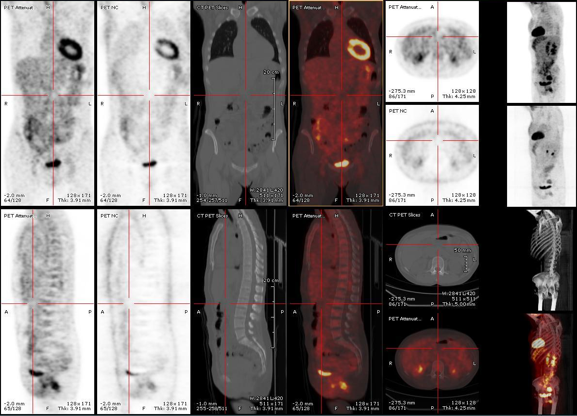
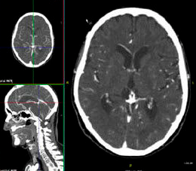
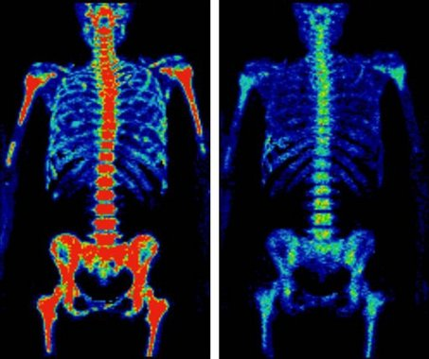
New Sources of Ionizing Radiation
Notes:
The advances in medical imaging technology over the past 30 years have transformed medical care and led to more rapid and accurate diagnoses. As a result, there is an improvement in patient outcome and an increase in simple, noninvasive cross-sectional imaging.
But, with increased access to these medical imaging exams, there’s been a profound rise in their use and reduced threshold for ordering them which has led to overuse.

Slide 12
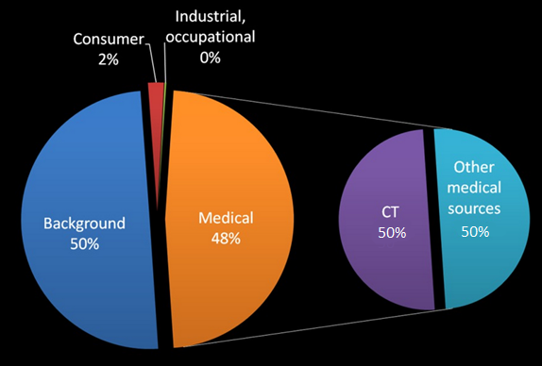
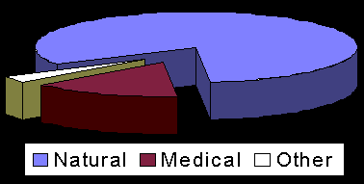
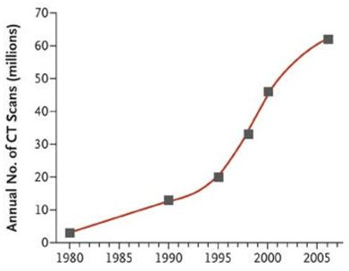
NRCP Report No. 160 Ionizing Radiation Exposure of the Population of the United States
Early 80’s
2006
83%
15%
Notes:
CT has become a major workhorse of diagnostic medicine, but it is a procedure that uses higher levels of ionizing radiation than other x-ray modalities, and x-rays are known to be a carcinogen.
As you can see in this graph, there is a clear jump in the use of CT in the past 20 years. In the US, nearly 1 in 5 patients undergoes a CT each year.
While imaging counted for only 15% of ionizing radiation sources in the early 80’s in the US,
this amount has more than tripled in 2006 to 48%.
Half of these ionizing radiation exams can be attributed to CT

Slide 13
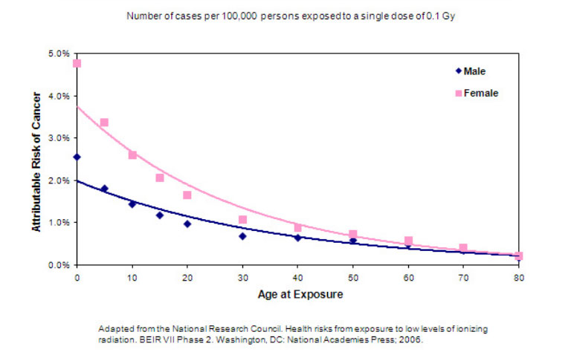
Lifetime Attributable Risk of Cancer from Exposure to Radiation
x 5
x 7
Notes:
Question is, will this have an impact on the lifetime risk of having cancer due to exposure radiation?
It depends if you are male or female, but more important, notice that children, especially girls,
are at the most risk from radiation-induced cancer.
In fact a 5 year old girl has 5 times greater risk and a female infant has 7 times greater risk of getting a radiation-induced cancer than does a 30 year old man.

Slide 14
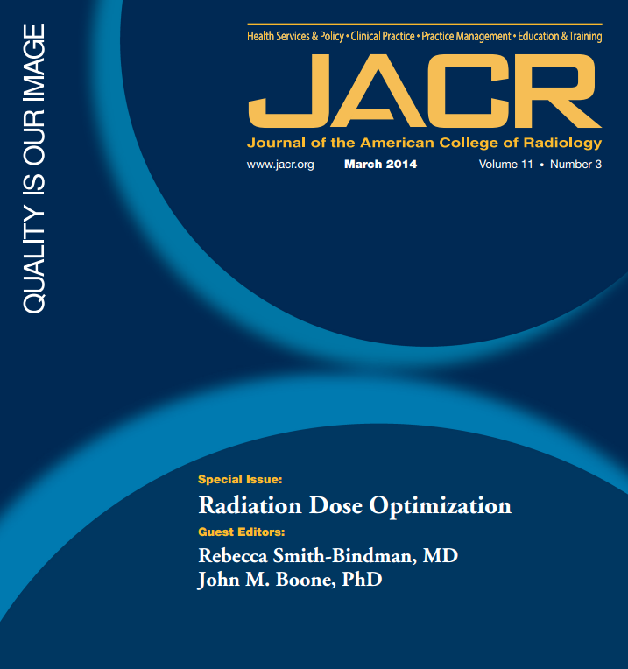
In the future, CDS should avoid CT scans which are not medically necessary or easily be replaced by a test without ionizing radiation
Notes:
the Journal of the American College of Radiology released a special issue entitled “Radiation Dose Optimization”.
In the same volume, an article came out on CDS or Clinical Decision Support. Clinical Decision Support (CDS) provides clinicians, staff, patients or other individuals, with knowledge and person-specific information.
In the future, CDS should avoid CT scans which are not medically necessary or easily be replaced by a test without ionizing radiation.

Slide 15
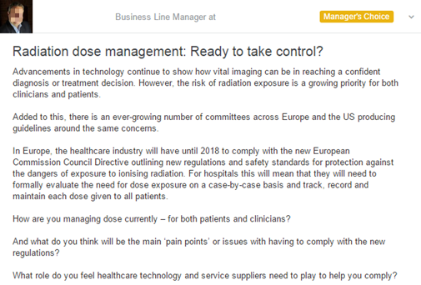
https://www.linkedin.com/grp/post/2308956-6022292027184553987
Notes:
On Linked in, somebody posted questions regarding radiation dose management which started an interesting discussion.
This man stated that imaging can be vital in reaching a confident diagnosis or treatment decision, but the risk of radiation exposure is a growing priority for both clinicians and patients.
He also added the remark that there is an ever-growing number of committees across Europe and the US, producing guidelines around the same concerns.
Important to know also is that in Europe, the healthcare industry will have until 2018 to comply with the new European Commission Council Directive outlining new regulations and safety standards for protection against the dangers of exposure to ionizing radiation.
For hospitals this will mean that they will need to formally evaluate the need for dose exposure on a case-by-case basis and track, record and maintain each dose given to all patients.

Slide 16
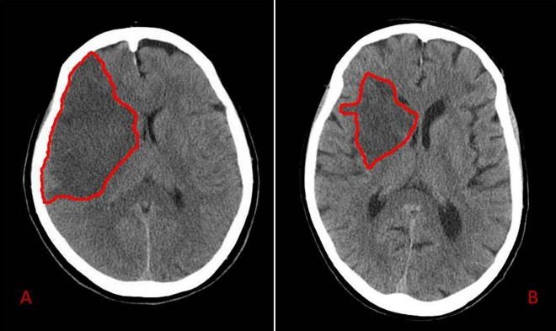
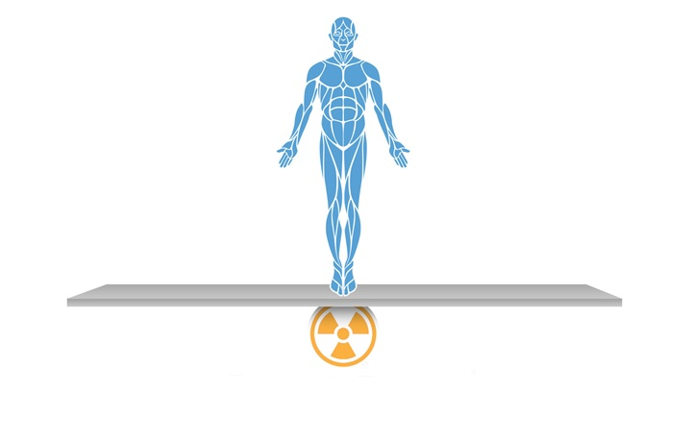
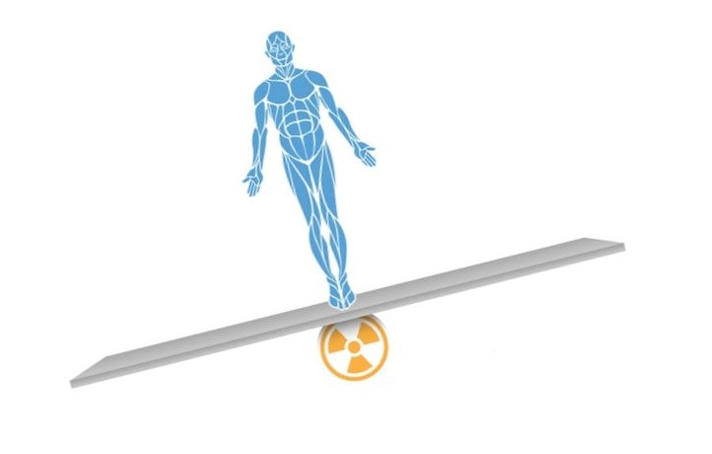
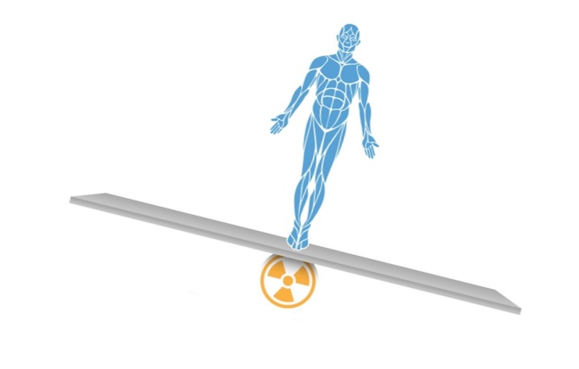
Cost-Benefit
CT scan is clearly indicated and well ordered:
benefit-to-risk ratio is high
CT scan is not medically necessary or could easily be replaced by a test without ionizing radiation:
benefit-to-risk ratio is low
Dose monitoring is required
Notes:
The consequence of this discussion is that we have to think twice before ordering a CT scan.
If a CT scan is clearly indicated and well ordered,
the benefit-to-risk ratio is high.
However, if a CT scan is not medically necessary or if it could easily be replaced by a test that does not use ionizing radiation,
the benefit-to-risk ratio is low.
Unfortunately, while dose optimization is a priority in some institutions, it is not the case at all institutions.
That’s why there is a consensus that dose monitoring is required.

Slide 17
Topics
Why is Quality Control and Dose Optimization becoming important?
FUJIFILM/QAELUM Solution
Site Use-Cases including Wales Nation Wide project
Notes:
I will now present the Qaelum solution. Qaelum has solutions for dose registration, but also automatic tools for the new European Commission Council Directive, to which hospitals need to comply to in 2018.

Slide 18
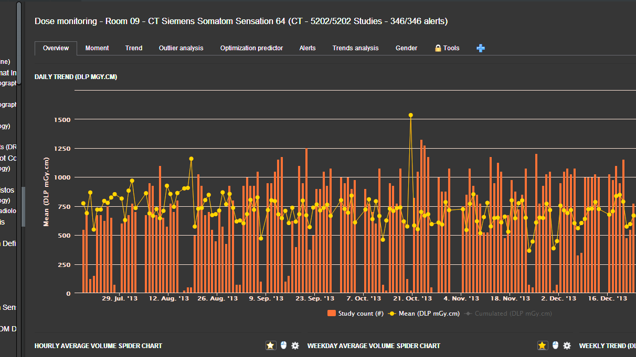
tqm|DOSE

Slide 19
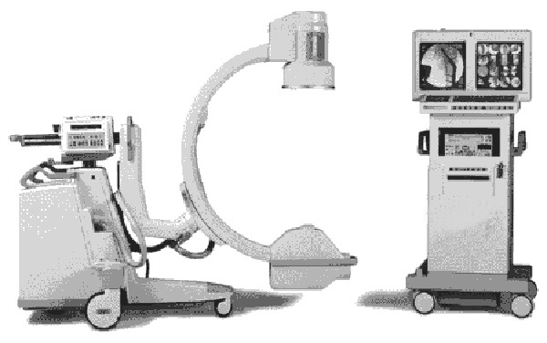
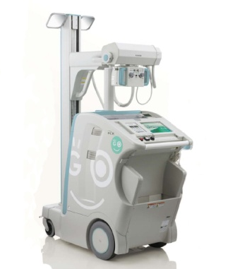
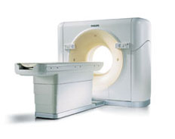
Technical overview
Database
Analysis engine
PACS
PACS integration
Report engine
Web application
Notes:
TQM is taking its information from the PACS. This makes life easy since all modalities are connected with PACS.

Slide 20
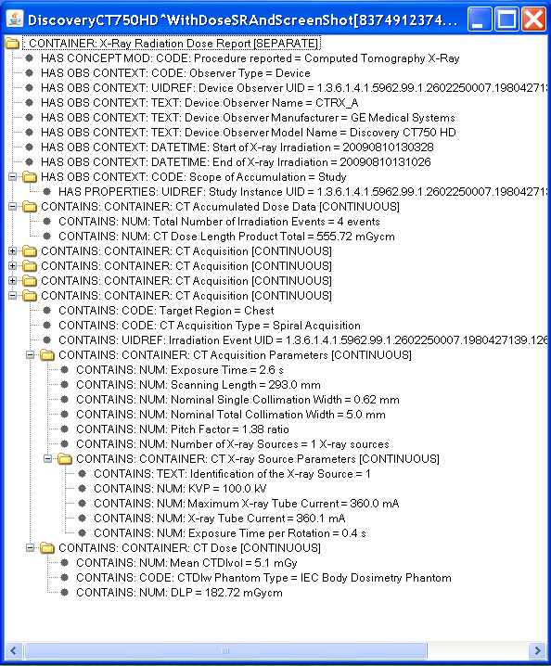
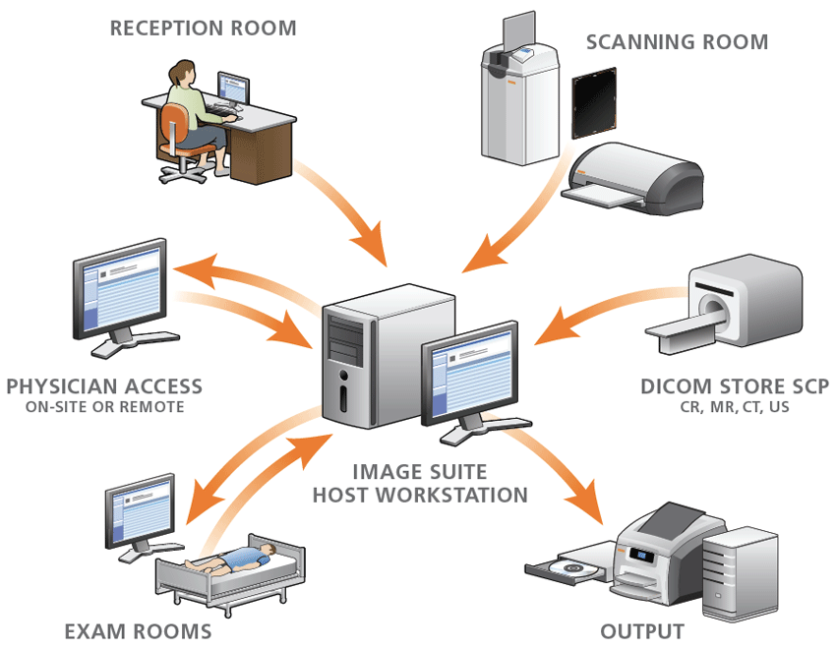
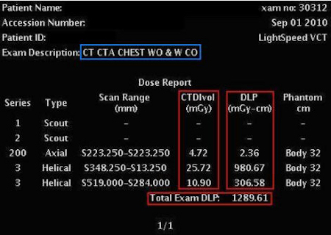
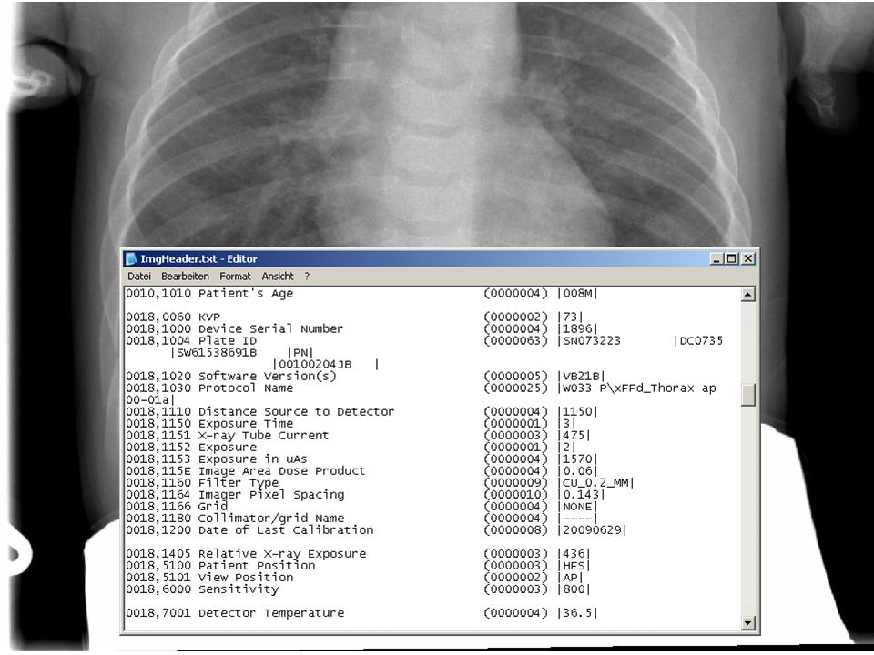
Typical analysis
Depending on modality, we use…
RDSR objects
DICOM header information
MPPS
DoseReports (using vendor specific OCR modules)
REM compliant
CE class IIb certified
Notes:
RDSR: Radiation Dose Structured Report
MPPS: Modality Performed Procedure Step
OCR: Optical Character Recognition

Slide 21
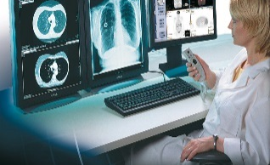
tqm|DOSE™ main components
Built in tools for data analysis
Built in tools for quality control
Automated reporting to key users

Slide 22
Built in tools for data analysis
Data analysis

Slide 23
Built in tools for data analysis: personalized dashboard
Data analysis
User depended
Role depended
Favorite
graphs
Notes:
Each modality has over 500 graph’s.
In order not to loose focus on the important things, a personal dashboard is made available for your favorite graphs.
Compare it with the 100 applications your smartphone has, but the most important once you put on page 1

Slide 24
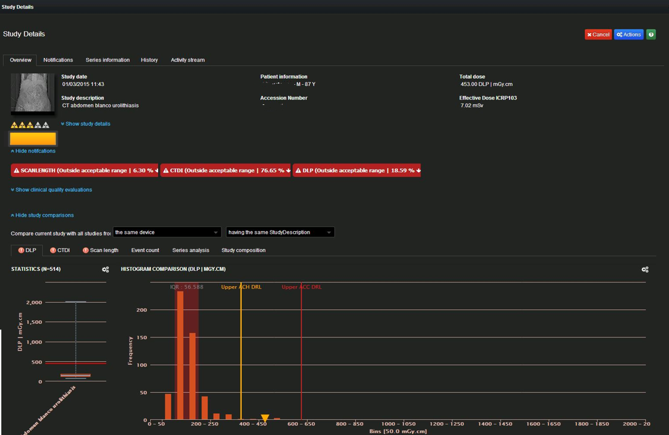
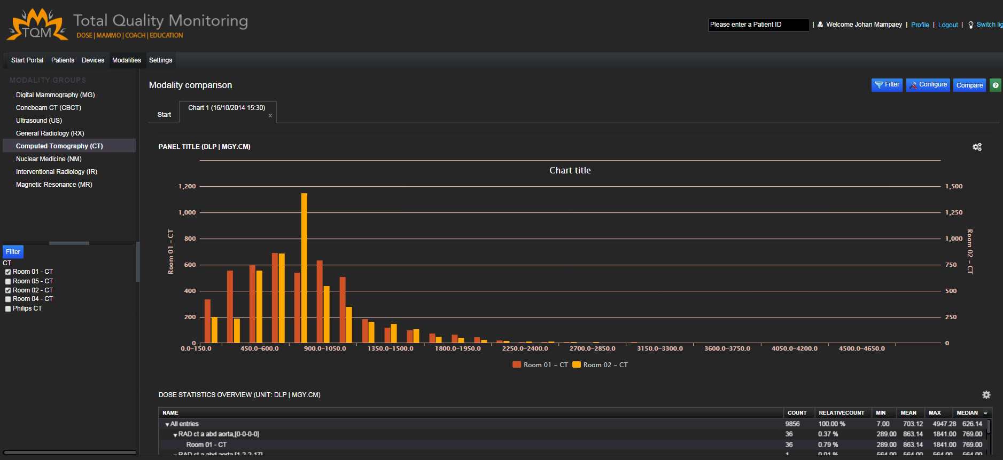
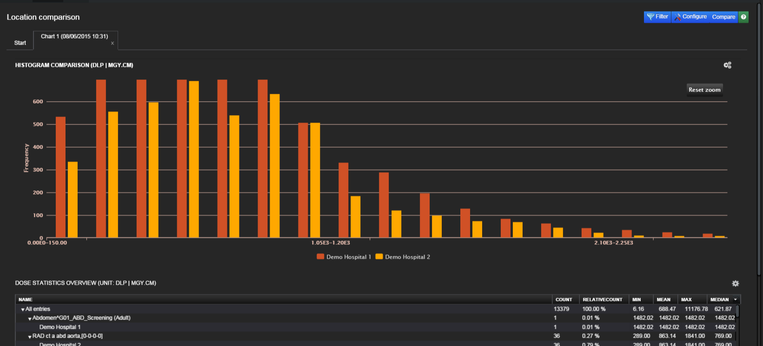
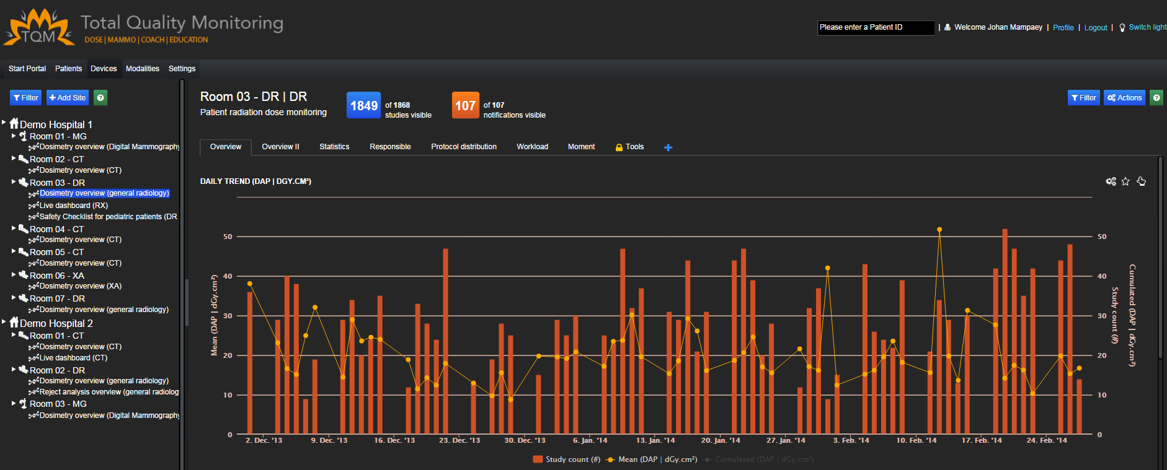
Built in tools for data analysis : 4 analysis entry levels
Data analyse
Patient level
Device level
Modality level
Location level

Slide 25
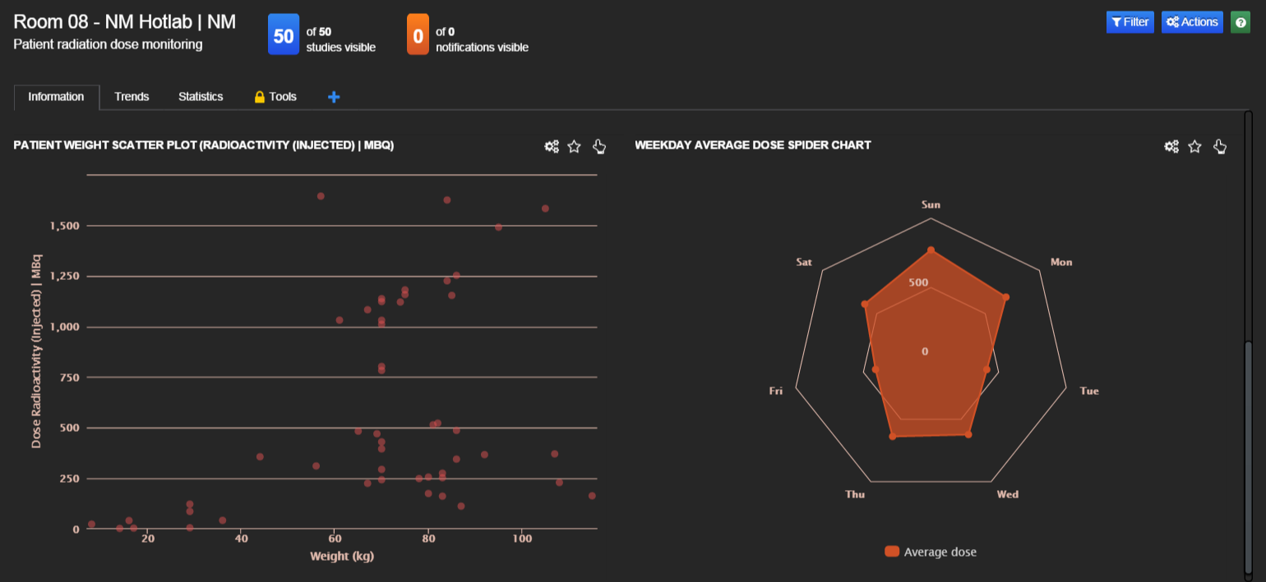
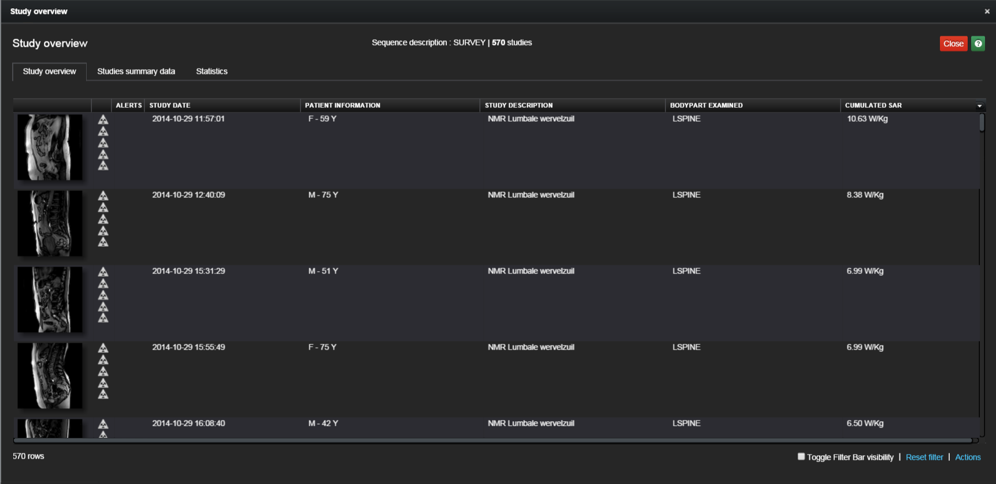
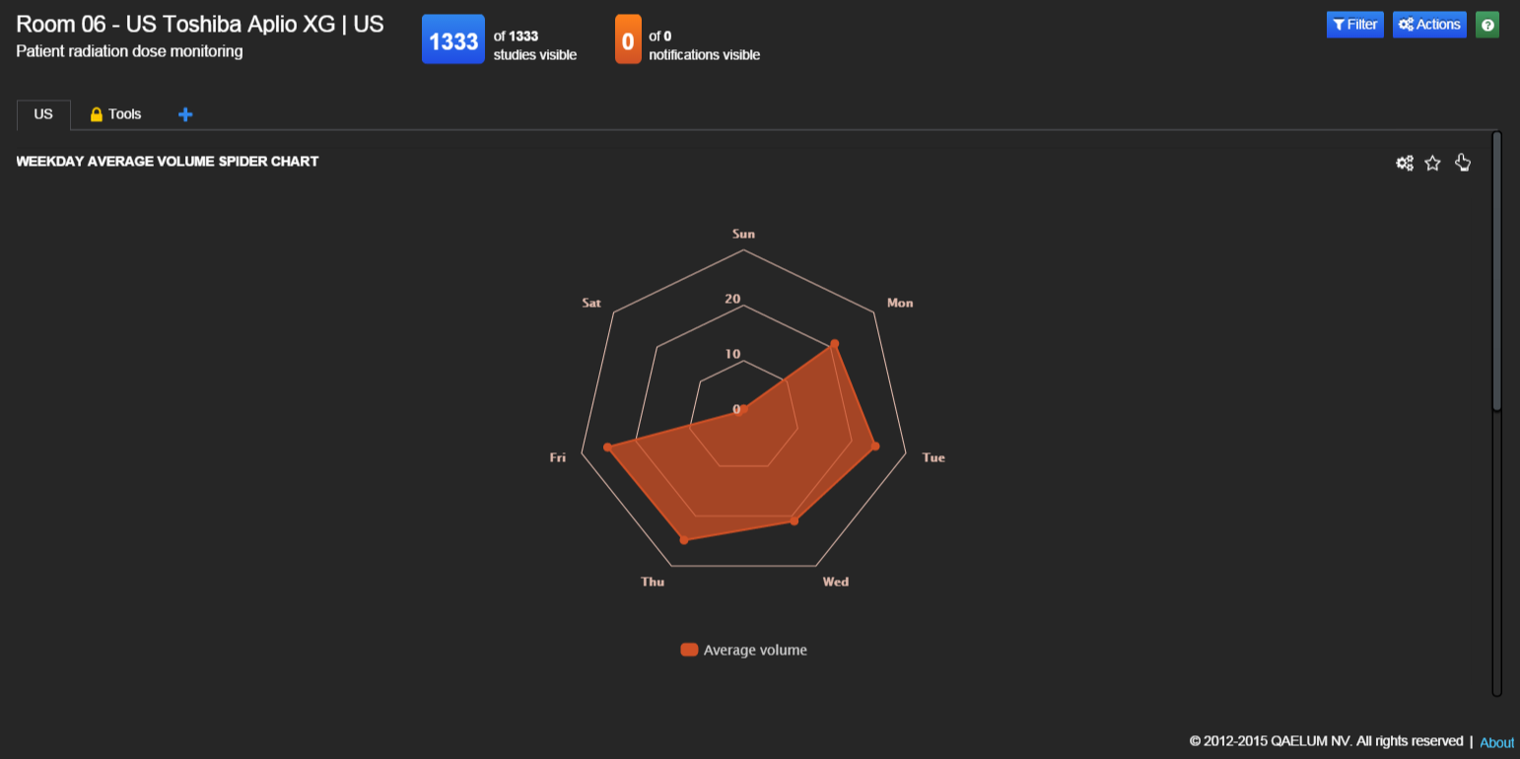
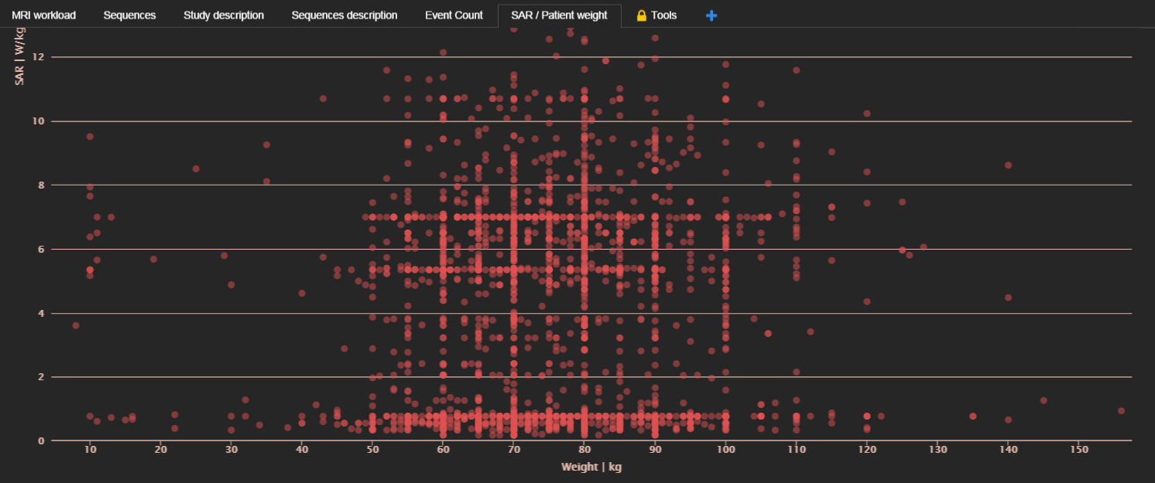
Built in tools for data analysis : included MR/NM/US
Data analysis
Data analysis: all MR details like SAR/Patient weight, US workflow and NM details

Slide 26
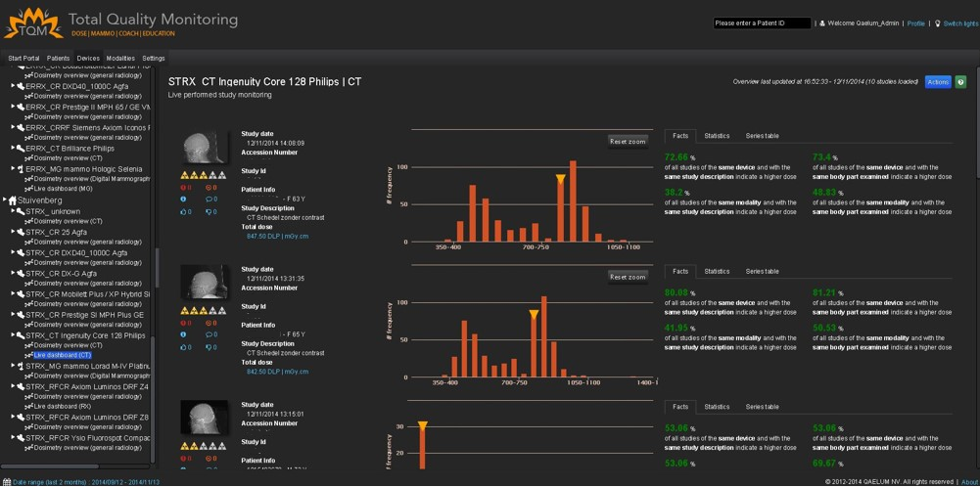
Built in tools for data analysis : Live monitoring tool
Data analysis
Instant feedback for radiographers

Slide 27
Built in tools for data analysis : Outlier analysis
Data analysis
Outlier per category
Outlier timestamp
Outlier details

Slide 28
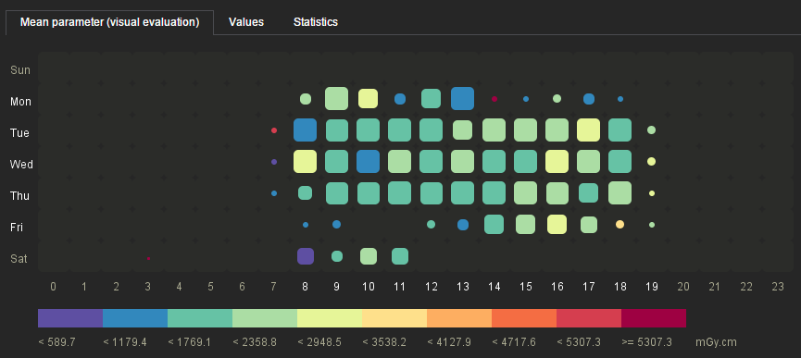
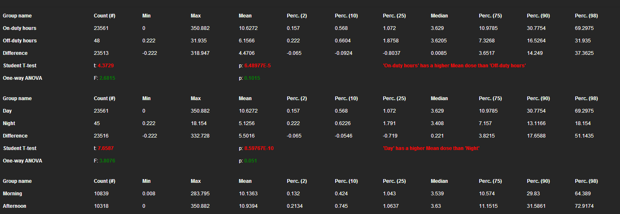
Built in tools for data analysis : Moment analysis
Data analysis
Visual overview
Statistical overview
Notes:
Statistiek bijvoegen

Slide 29
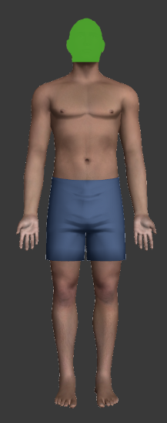
Built in tools for data analysis : Full integration
Data analysis
Study depended PACS integration
Study and patient dose info
Available on your workstation

Slide 30
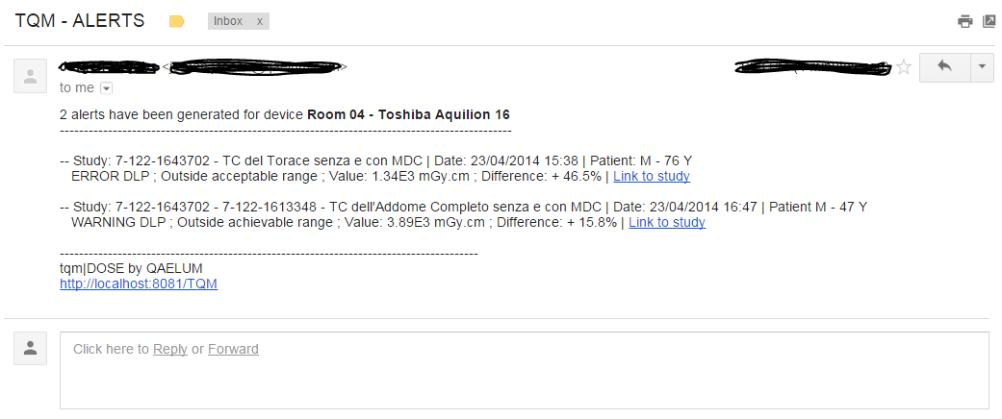
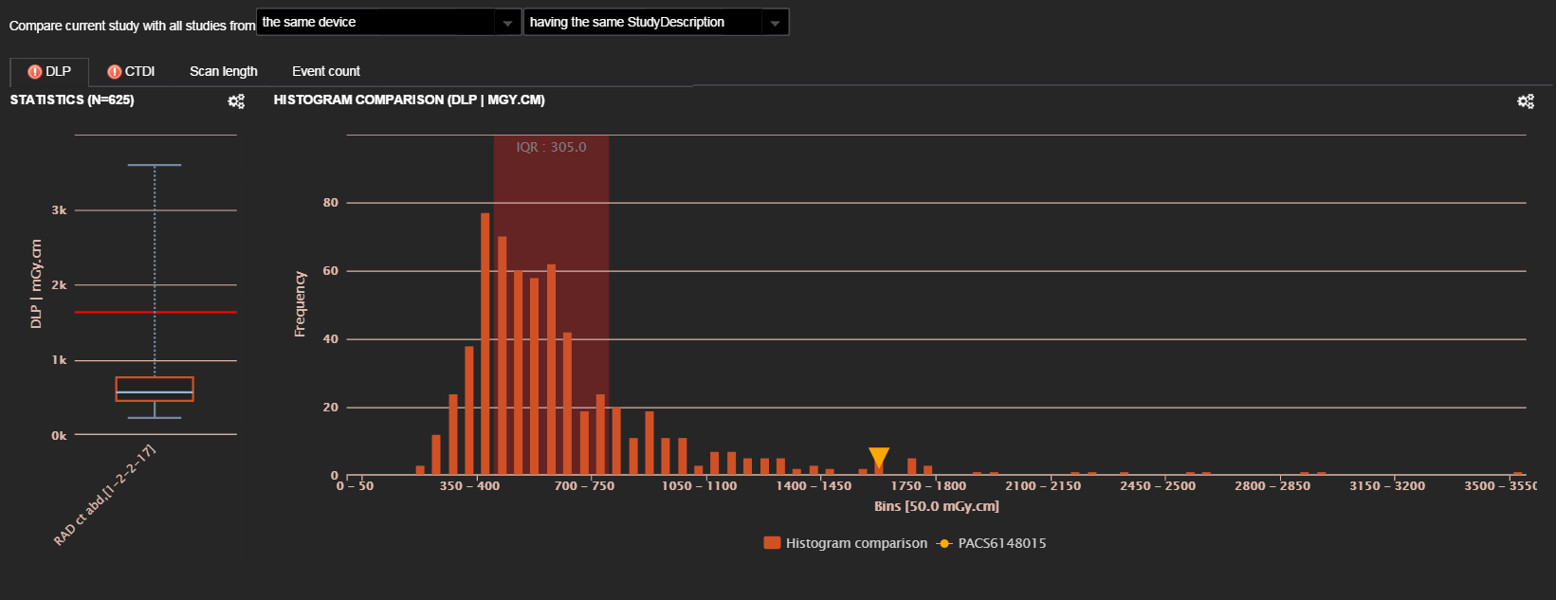
Built in tools for data analysis : Alerts via e-mail
Data analysis
Notes:
Alert due to incorrect multiple studies in a single study description

Slide 31
Build in tools for quality control
Quality control tools

Slide 32
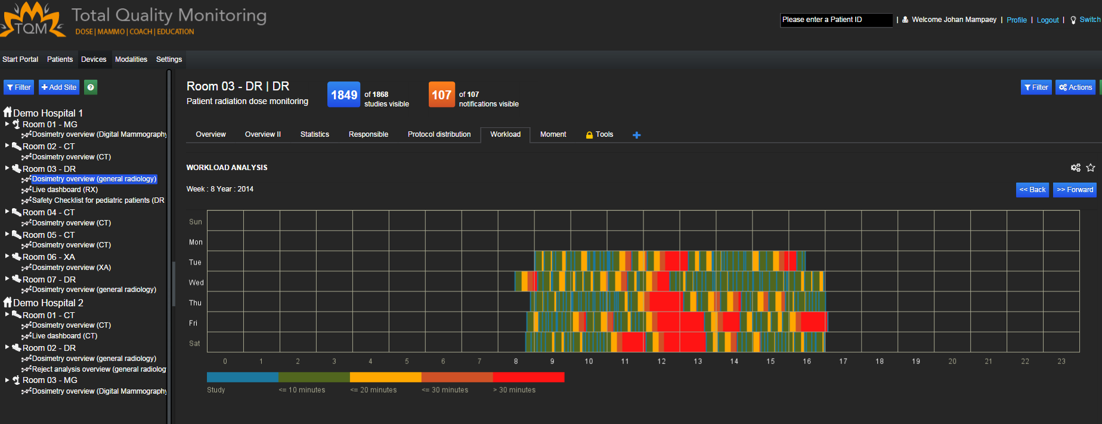
Built in quality control : workflow analysis
Quality control
Detailed workflow analyses
Not only dose related
Also MR* US* and NM**

Slide 33
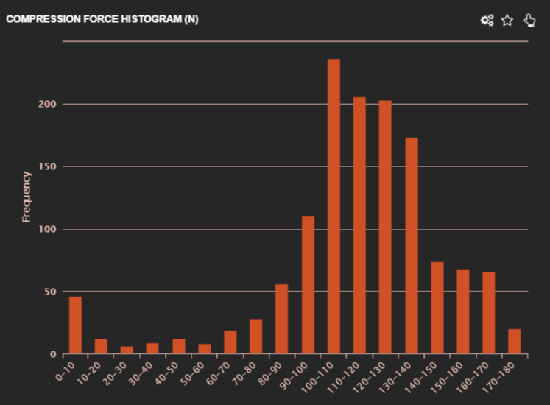
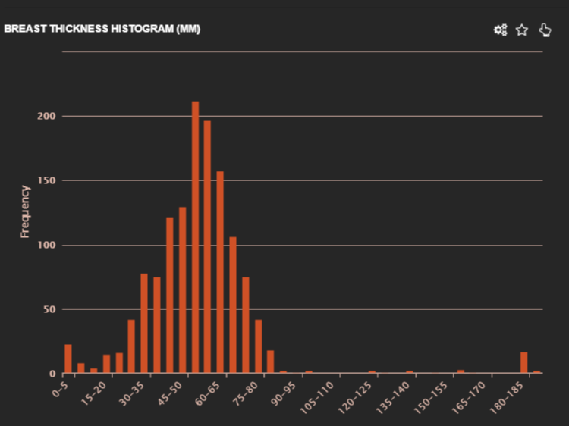
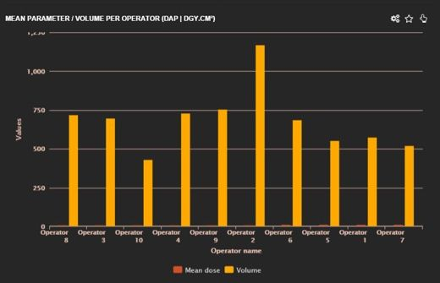
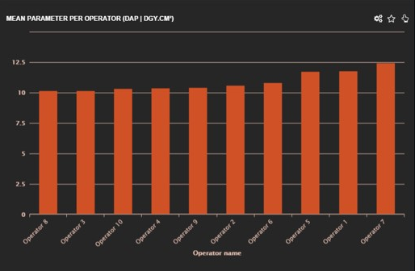
Built in quality control : mean fluoro time per operator, analysis of compression force
Quality control
Detailed operator dose analyses
Compression force
Breast thickness
Volume/ operator
Mean Fluoro time/ operator

Slide 34
Built in quality control: SSDE
Size Specific Dose Estimate
Quality control
On 1 or 2 scoutviews
Notes:
According to AAPM standards

Slide 35
Built in quality control: SSDE
Analysis of patient positioning
Quality control
Using device spec. dimenions
Use segmentation result to define loc of patient
1 scoutview-> only one direc. shown
IF OFF-CENTER→ MESSAGE
Notes:
boodschap unique

Slide 36
Built in quality control: clinical image quality scoring
Quality control
Easy scoring from you PACS workstation
Evaluate the image quality of your modality
Scoring stored in tqm|DOSE™

Slide 37
Automated reporting to key users
Reporting

Slide 38
Automated reporting: Types of reports
Reporting
Report
Legal reporting
Dynamic reporting
Static reporting

Slide 39
Automated reporting: Legal reporting
Reporting
Compliance monitoring Sweden
RED – the studies are outside the acceptable limits
ORANGE – the studies are outside the achievable but between the acceptable limits
GREEN – the studies are between the achievable limits

Slide 40
Automated reporting: Legal reporting
Reporting
Export in a specific legal template
CONFIDENTIAL – QAELUM NV

Slide 41
Automated reporting: Dynamic reporting
Reporting
Drag and Drop
Easy to personalize
Only link is send, no heavy attachments
Notes:
Resultaat bijvoegen

Slide 42
Reject / Retake Analysis
Extensions

Slide 43
Example of contrast report
Extensions
Contrast info coming from PACS or modality
Compatible with new CSR

Slide 44
Peak Skin Monitoring XA
extensions
Detailed skin dose map
Statistics
Notes:
No Air Karma
In interventional, fluoroscopy has higher dose than stationary acquisition

Slide 45
Summary
45
The risk of radiation exposure is a growing priority for both clinicians and patients
There is an ever-growing number of committees across Europe and the US, producing guidelines around the risk of radiation exposure
In Europe, the healthcare industry and hospitals will have until 2018 to comply with the new European Commission Council Directive
For hospitals this means they will need to formally evaluate the need for dose exposure on a case-by-case basis and track, record and maintain each dose given to all patients
CONFIDENTIAL – QAELUM NV

Slide 46
Topics
Why is Quality Control and Dose Optimization becoming important?
FUJIFILM/QAELUM Solution
Site Use-Cases including Wales Nation Wide project

Slide 47
Site A: Chest room – dose doubled
Filter: CHEST
Notes:
(AEC stopped working)
Here you can see the daily trend graph of a chest room.
Problem: at one day, the average dose per patient nearly doubled. This was only seen after a certain time.
A dose comparison was performed to check the dose difference before and after the problem.
The modality vender found out that it was the AEC chamber which was not re-connected after a maintenance
Only possible to see when the trend of a “DEVICE” is monitored (and not patient)

Slide 48
Site B: Mammography – too high dose series
Notes:
(MG-Manual Mode after Implant Examination)
This site is doing quite some mammography cases.
Problem: sometimes the dose is unexplainable high (factor 3 to 5) for several patients in a row.
Physicist couldn’t find anything wrong on the device.
Modality vender was also not able to find issues
Then Qaelum suggested to look at the data.
We noticed that the problem showed up after each implant exam that was shot manually.
It was clear that somebody (in this case a radiologist) forgot to switch-on the AEC chamber after the manual exposure. Most of the time the modality was not switched off at night – which would have switched-on the AEC chamber again - , so the next morning the problem continued.
It was only because Qaelum looked at device level in the software, that the behavior of the modality became clear.

Slide 49
Site C: Dose new 128 slice CT > existing 64 slice CT
Filter: TC Colon
Notes:
The dose of a new 128 slice CT was compared with the existing 64 slice CT. It turned out that the dose of the new CT was substantially higher, when TC colon exams were performed.
So what happened? After the installation of the CT, the TC colon protocol of the 64 slice CT was just copied to the 128 slice CT which of course was not optimal for this machine.
After optimization of this protocol, the dose of the new CT was substantially lower than the existing one.

Slide 50
Wales Nation Wide project

Slide 52
Wales Nation Wide project

Slide 53
Wales Nation Wide project
Health Board | Major Hosp. | Minor Hosp. | Studies per year (2013)
Velindre | 1 | 0 | 10.000
Betsi Cadwallader | 3 | 19 | 300.000
Cwm Taff | 2 | 5 | 210.000
Hywel Dda | 3 | 14 | 190.000
Cardiff and Vale | 1 | 8 | 390.000
Abertawe Bro Morgannwg | 4 | 11 | 480.000
Aneurin Bevan | 3 | 11 | 330.000
Total |  |  | 1.910.000

Slide 54
Wales Nation Wide project
Hospital external
Patient ID
Unique Identification… or …
Translation (mapping of user id – HASH-code)
(using patient name, birthdate, …)
Code is created
Dose passport all over the region
Compare modalities and locations (hospitals)
All hospital data (images, thumbnails…) is stored locally
No data transfer necessary
Safe
Less bandwidth
Database (analysis results, calculations, α-num data) is central
Fast

Slide 55
How much is too much?
2.000.000
3500
26
13
Notes:
In the UK, 2 million women are screened annually for breast cancer.
Of these 2 million women, 3500 lives are saved every year due to screening.
26 per year will die due to radiation of screening.
With half the dose and the same cancer detection, “only” 13 women would die or 13 more lives would be saved.

Slide 56
Feel free to contact us ! we are friendly and social
FUJIFILM Europe GmbH – Sucursal em Portugal
Rotunda Eng.º. Edgar Cardoso, nº23, 10º, Edifício Tower Plaza 4400-676 Vila Nova de Gaia
+351 22 619 42 77
Kapeldreef 60, 3000 Leuven
Belgium
+32 472 801293
QAELUM
@ QAELUM
QAELUM
info@qaelum.com
Notes:
Tqm logo boven

Slide 57
Fujifilm Thanks You!
Notes:
ご清聴有難うございました。

