Slide 1
How Radiological Protection Decisions are Made
Dr Ted Lazo
OECD Nuclear Energy Agency
Workshop of Portuguese-Speaking Countries on Justification and Optimisation
10 – 12 September 2015, Lisbon

Slide 2
Who Takes Protection Decisions?
Protection decisions are generally NOT taken by RP specialists
Protection decisions are taken by stakeholders:
Governments: policy and regulation
Licensees: procedures and resources
Workers: safety culture
Affected Populations: lifestyle

Slide 3
What does this Imply?
In order to make an RP recommendation that will be accepted and sustainable it is necessary to:
Understand RP science
Understand prevailing circumstances: scientific, social and economic
Listen to the RP, social and economic concerns of affected (or concerned) stakeholders
Then formulate recommendation or explanation in plain language, address the decider’s questions, and let the decider decide

Slide 4
Changes to Consider
Prevailing Circumstances
Framework for Radiological Protection
Individualising Risk
Integrated Protection

Slide 5
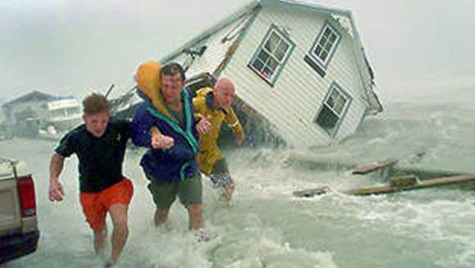
Prevailing Circumstances

Slide 6
The Aim of Radiological Protection
Contribute to an appropriate level of protection for people and the environment…..for a variety of radiation exposure situations
Achieve a consistency across a wide range of applications through a formal system of radiological protection

Slide 7
What does this mean?
Appropriate Level
Variety of Situations
Consistency
Subjective Judgement
Prevailing Circumstances
Framework
Prevailing circumstances drive radiological protection concerns
Subjective protection decisions are made within the framework of the system of protection to best address prevailing circumstances

Slide 8
What does this Imply?
The assessment of prevailing circumstances is a key element of the RP system
Prevailing circumstances condition the choice of framework elements to be applied to achieve optimised protection
Emergency and Existing Situations could use occupational dose limits rather than reference levels
Criteria for release from regulatory control is driven by prevailing circumstances
The elements of the RP system used to achieve accepted and sustainable protection decisions will be driven largely by the prevailing circumstances
Circumstance | Dose Criteria
Clearance of materials | 10 µSv/a
Release of sites | 300 µSv/a
Release of operational effluents | 300 µSv/a
Release of NORM installations | 300 µSv/a
Management of legacy sites | 1000 µSv/a

Slide 9
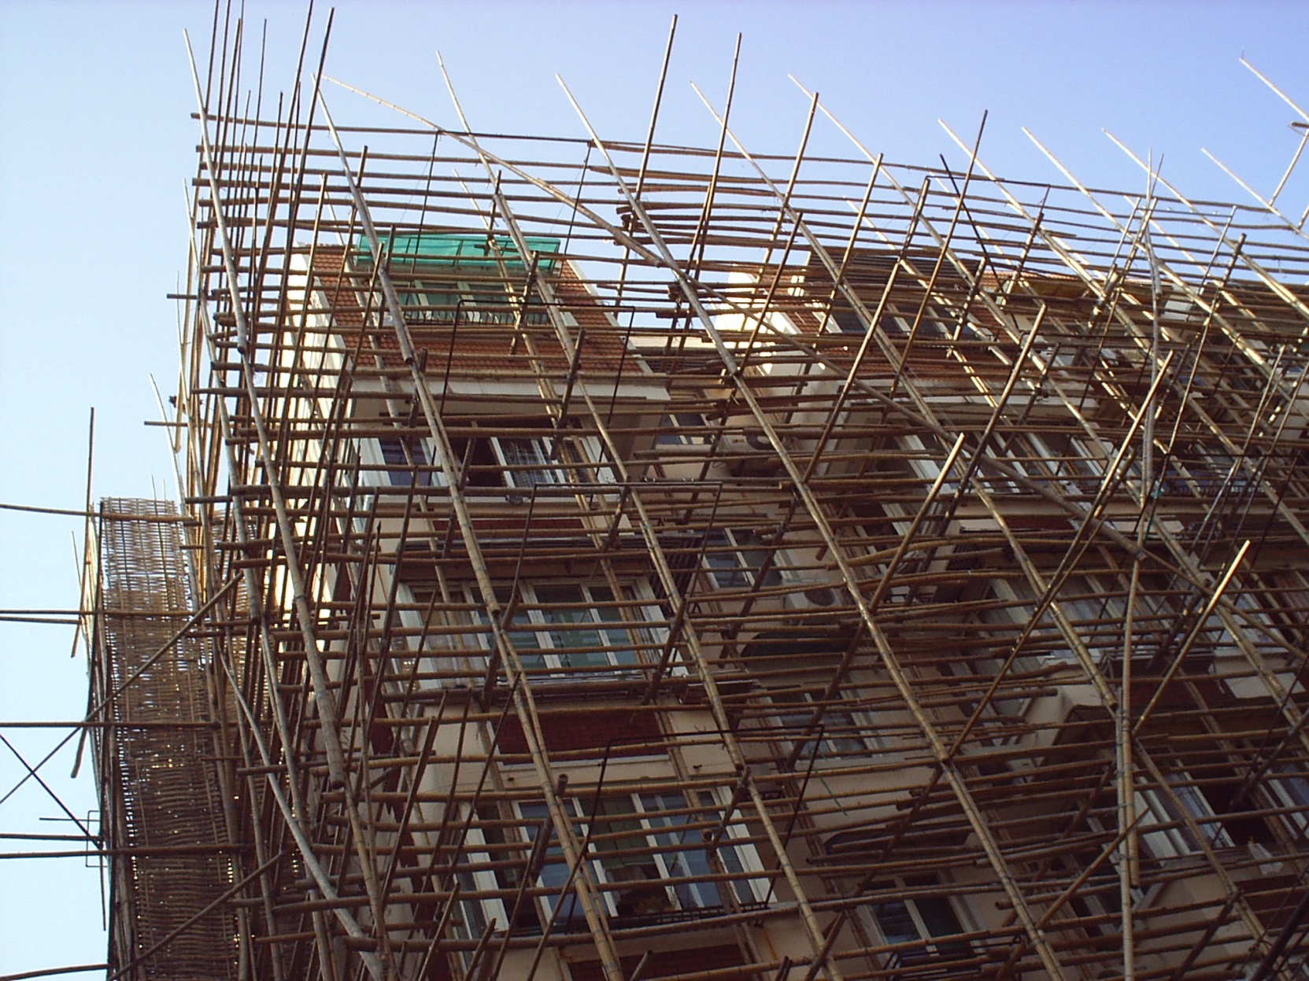
Framework for Radiological Protection

Slide 10
Key Elements of the ICRP System of RP
ICRP Principles
Justification
Optimisation
Application of Dose Limits
Exposure Situations
Planned
Existing
Emergency
Types of Exposure
Occupational
Medical
Public
Dose Limits
Optimisation
Medical
Justification
Public
Planned
Occupational
Existing
Emergency

Slide 11
Key Elements of the ICRP System of RP
ICRP Principles
Justification
Optimisation
Restriction of Dose
Exposure Situations
Planned
Existing
Emergency
Types of Exposure
Occupational
Medical
Public
Restriction of Dose
Optimisation
Medical
Justification
Public
Planned
Occupational
Existing
Emergency

Slide 12
For Planned Situations
Application
Of Dose Limits

Slide 13
For Planned Situations
Dose Limits
And
Dose Constraints

Slide 14
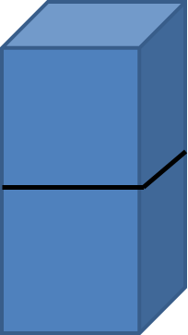
For Existing Situations

Slide 15
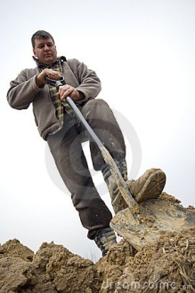
For Existing Situations
Reference Levels
And
Dose Limits

Slide 16
For Emergency Situations

Slide 17
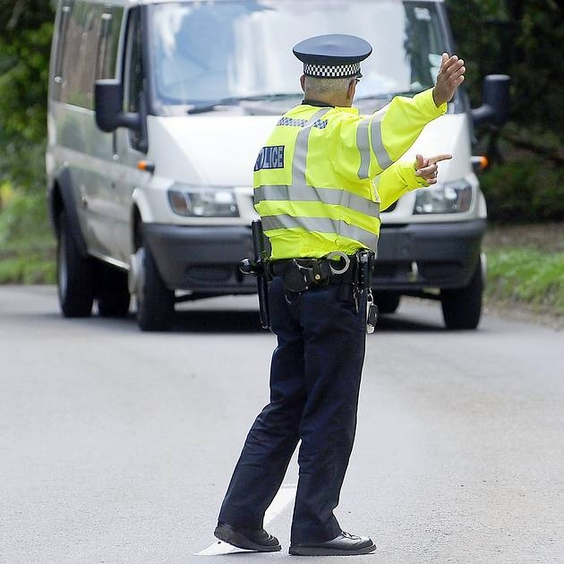
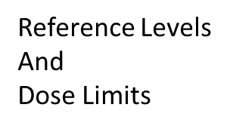
For Emergency Situations

Slide 18
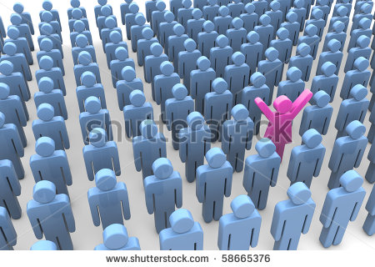
Individualising Risk

Slide 19
Individualising Risk
The ICRP system uses gender and age averaged weighting factors to calculate effective dose.
This represents the risk of generalised radiological detriment (5% per Sievert) to humans.
An individual’s risk is currently impossible to determine, and extremely difficult to estimate
However, the risk to an individual’s child is a (the) leading value consideration in terms of stakeholder concern
The RP Toolbox currently has no specific tool to estimate an individual’s risk

Slide 20
RP Toolbox
As a first step, study of the variability of organ dose from an external source with age, gender and BMI
The results of the study could be useful for discussions with individuals, such as parents, in post-accident situations.
Study results could also be of use, if adapted appropriately, for discussions with patients.

Slide 21
New UF/NCI Phantom Library - Children
Phantom for each height/weight combination further matching average values of body circumference from CDC survey data
85 pediatric males
73 pediatric females

Slide 22
New UF/NCI Phantom Library - Adults
Phantom for each height/weight combination further matching average values of body circumference from CDC survey data
100 adult males
93 adult females

Slide 23
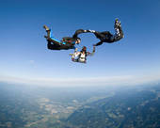
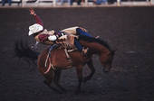
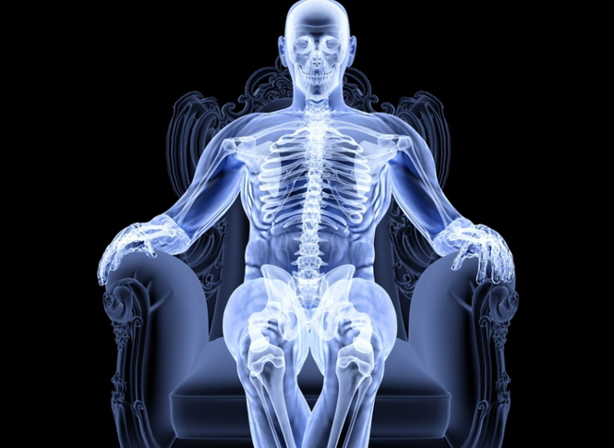
Integrated Protection
Occupational
Public
Medical

Slide 24
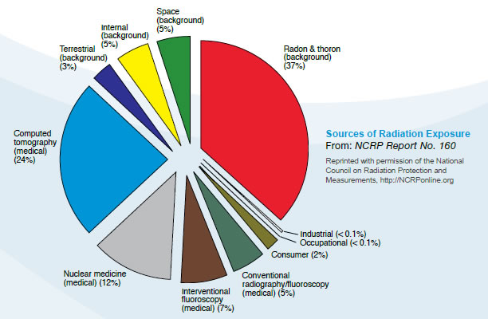
Integrated Protection
Occupational, Medical and Public exposures are managed separately
With medical doses increasing rapidly, statistically significant detriment may increase
Managing all doses in an integrated fashion may keep detriment in perspective
Integrated management could include:
Occupational: current dosimetry approach
Medical: dose passports
Public: Radon????

Slide 25
Linear Development of the System
UNSCEAR
Radiological Protection Science
ICRP
Radiological Protection Principles
IAEA
Radiological Protection Standards
National Authorities
Radiological Protection Regulations

Slide 26
Modern Approach to Standards Development
Stakeholder Involvement
Values
UNSCEAR
ICRP
SCIENCE
ICRU
NCRP
PRINCIPLES
IARC
BEIR
NEA/CRPPH
IRPA
EC
IAEA
ISO
EAN
Implementation
ILO
STANDARDS
IEC
ISOE
WHO
FAO
EURADOS
PAHO
UNEP
Social
Drivers

Slide 27
Modern Approach to Standards Development
Stakeholder Involvement
Values
UNSCEAR
ICRP
Science
ICRU
NCRP
Framework
Principles
IARC
BEIR
NEA/CRPPH
IRPA
EC
IAEA
ISO
EAN
Implementation
ILO
Standards
IEC
ISOE
WHO
FAO
EURADOS
PAHO
UNEP
Social
Drivers

Slide 28
Conclusions
Change Happens – Be Ready!
Science and society are evolving
How RP decisions are made is following scientific and social evolution

