Slide 1
JUSTIFICATION AND OPTIMISATION
FACTS AND SOLUTIONS
GUY FRIJA
CHAIR,EUROSAFE ALLIANCE
ESR PAST-PRESIDENT
LISBON,SEPT 2015

Slide 2
REGULATION
2013 : Basic Safety Standards
- Optimisation:ALARA-DRLs
- Justification:Guidelines
- Clinical audits

Slide 3
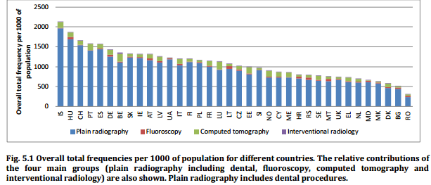
CHALLENGE 1: JUSTIFICATION
Radiological examinations should be performed only if they are doing more good than harm (“clinically justified”)
CHALLENGE 1: JUSTIFICATION
DOSE DATAMED 2

Slide 4
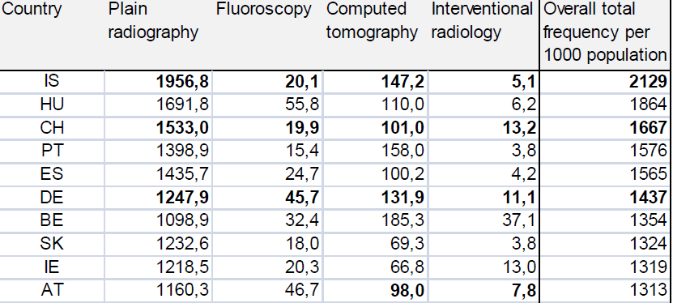
CHALLENGE 1: JUSTIFICATION

Slide 5
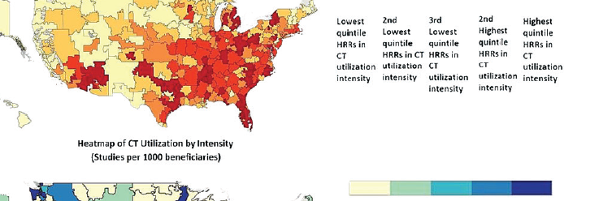
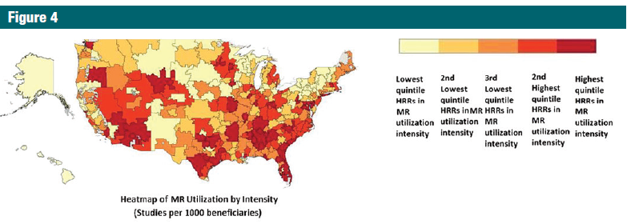
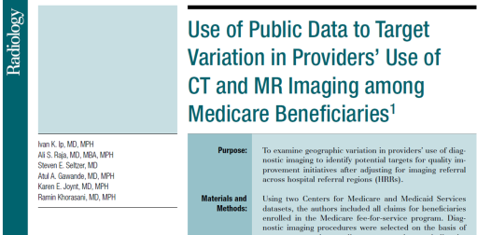
USA: 30 % of inappropriate tests
CT
MRI

Slide 6
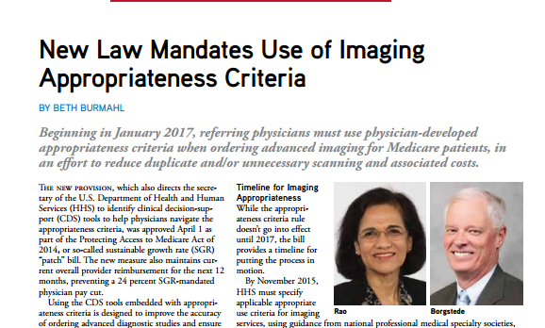


The clinical justification is established through evidence-based Clinical Guidelines
European BSS Directive
2013/59/EURATOM
MUST HAVE CIG
MUST USE CDS
CHALLENGE 1: JUSTIFICATION

Slide 7
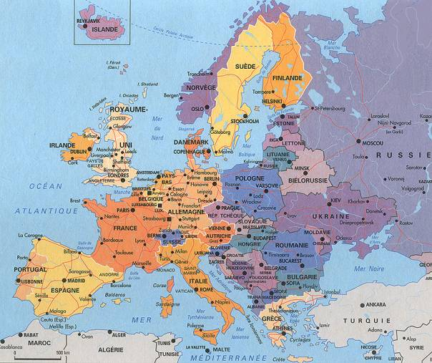
REFERRAL GUIDELINES
European survey by the European Society of Radiology (ESR)
Availability of Referral Guidelines (~ 70%)
Production: UK and France
Adopted and adapted: others
CHALLENGE 1: JUSTIFICATION

Slide 8
“In Belgium we have referral guidelines; in fact, nobody really takes them into account ”…
“Referral guidelines for diagnostic imaging in general are not in use in Hungary ”…
“They are not used in the Netherlands ”…
“Although we have several official referral guidelines published (in Spain), they are not used generally speaking ”
“In Italy the referral guidelines were published in 2004 by the Ministry of Health. Unfortunately they are not always followed in clinical practice ”…
“There is no official guide line enforcement in the State service in Ireland ”…
“In Germany, the guidelines are note routinely used ”…
“In France, there are guidelines, but they are not used ”…
CHALLENGE 1: JUSTIFICATION

Slide 9
CHANGE IN PARADIGM
Producing
Guidelines
Using
Guidelines
CHALLENGE 1: JUSTIFICATION

Slide 10
CHANGE IN PARADIGM
Producing
Guidelines
Using
Guidelines
HOW TO PROCEED?
CHALLENGE 1: JUSTIFICATION

Slide 11


Regulation
Behaviour
Incentives
Justification
Culture
Health Policy
CDS

Slide 12
CHANGE IN PARADIGM
Producing EBM
Using EBM
CDS
CHALLENGE 1: JUSTIFICATION

Slide 13
CDS IN IMAGING
Proven efficiency in the literature
Patient centric, i.e. « personalised »
Adaptable to the practice setting
Scalable : focused or comprehensive

Slide 14
CONCEPT OF CDS
Answer to a clinical question
Provide guidance based on appropriatness criteria
Integrated in the physician workflow
Ideally integrated into the EMR

Slide 15
CONCEPT OF CDS
Content is an algorithmic format of pre existing textual guidelines
Technical platform is a sophisticated software which operates according to pre- and post-test probabilities

Slide 16
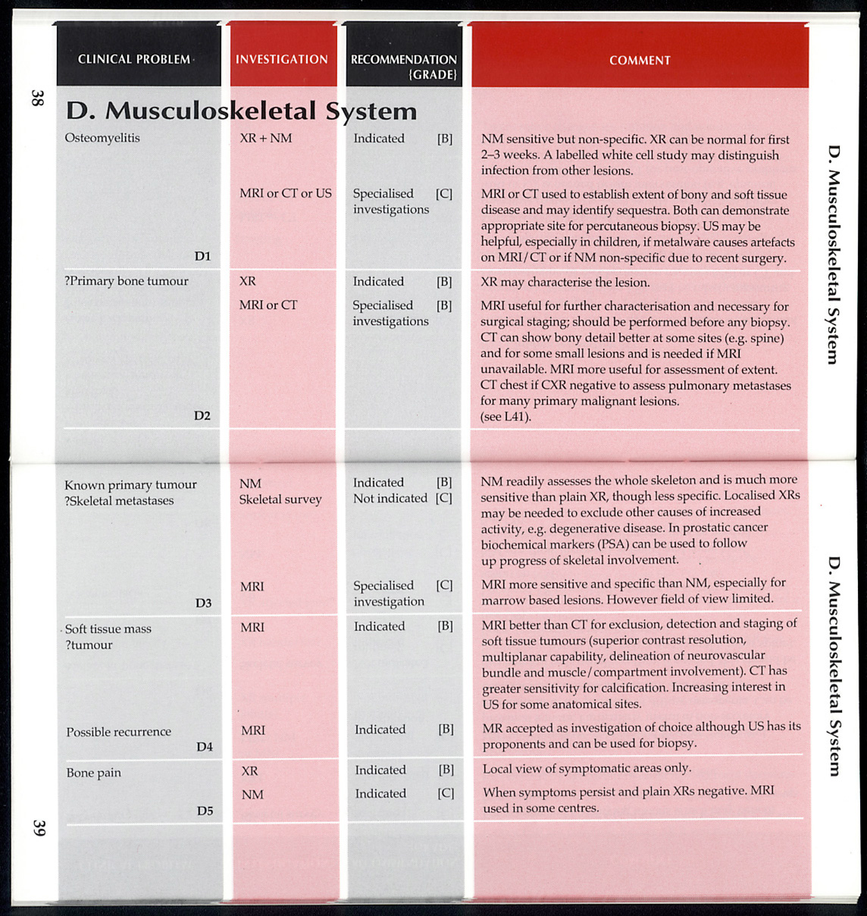
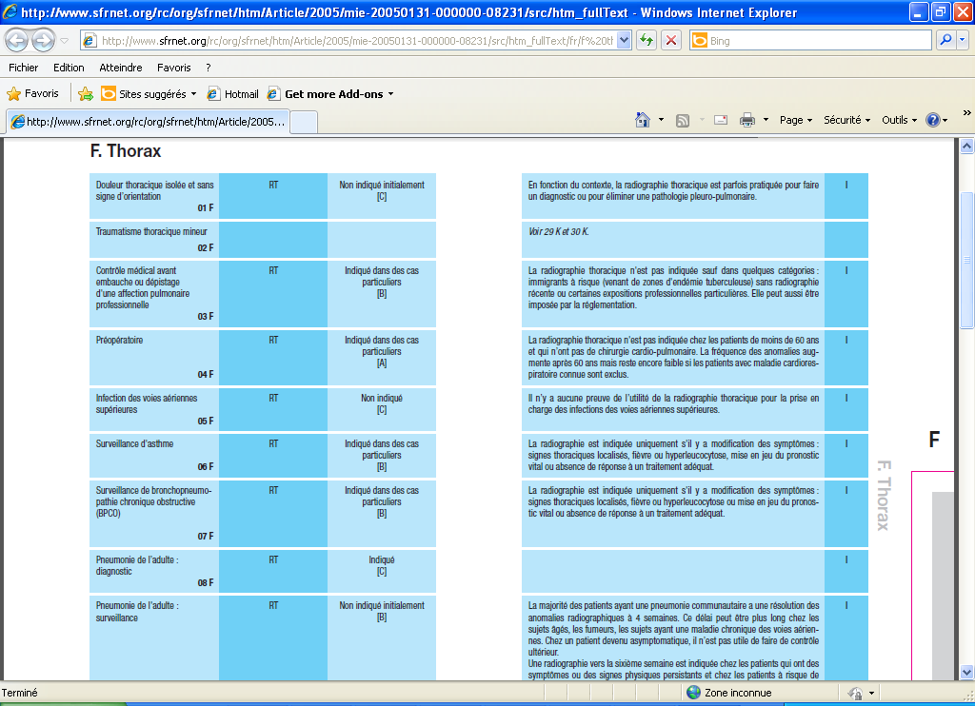
CHALLENGE 1: JUSTIFICATION

Slide 17



Referral Guidelines
DataBase
Konwledge Base
EHR/HIS/RIS
Inference Engine
CDS/CPOE
Decision support system
Point of Care DS
Timely

Slide 18
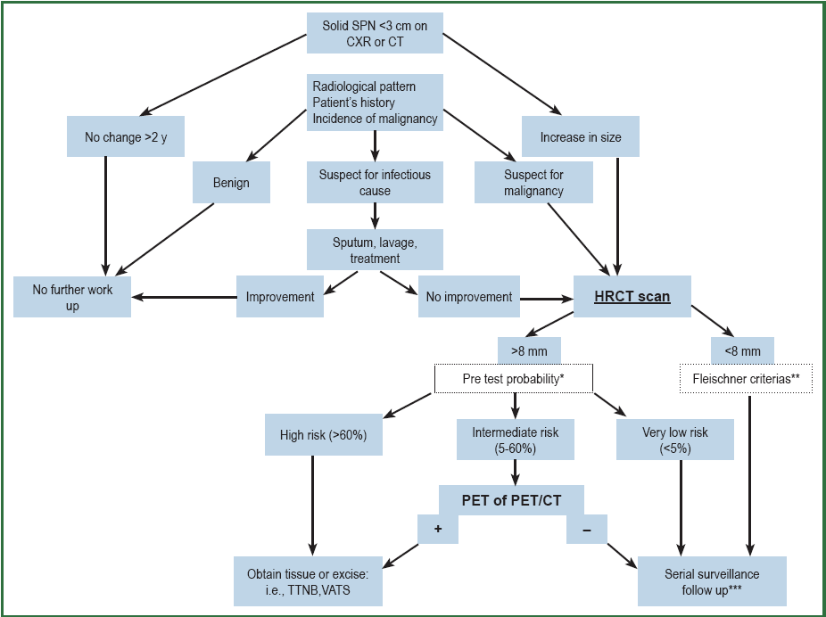

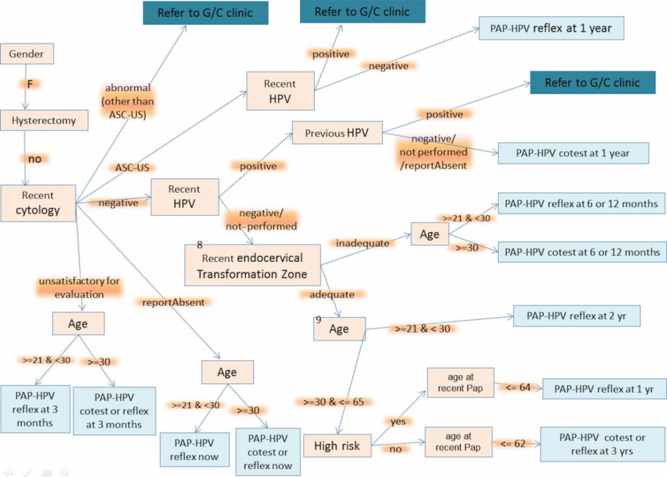

Slide 19
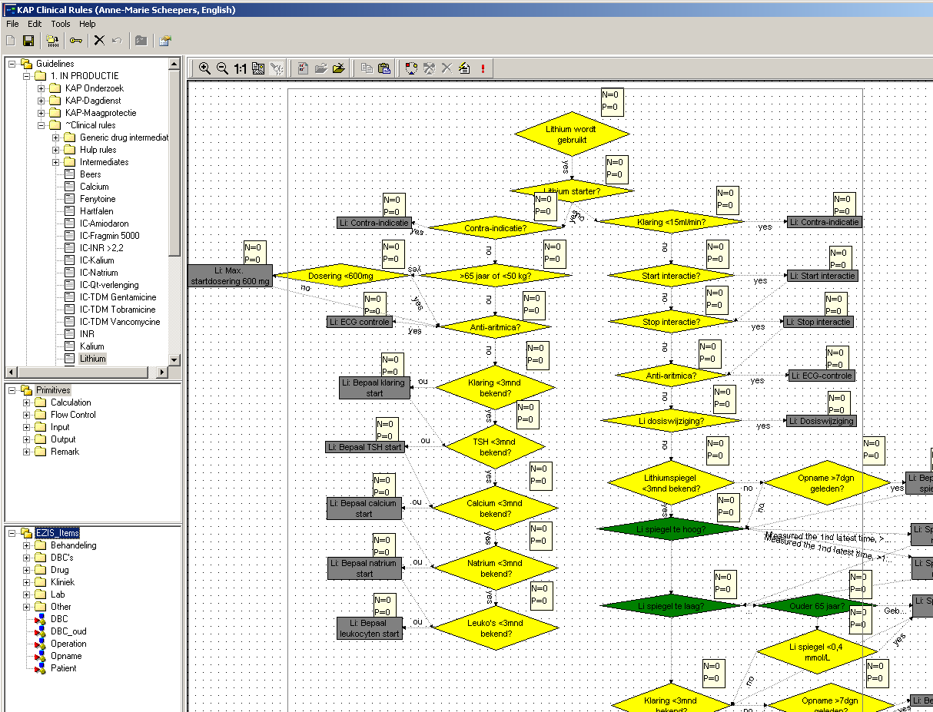

Slide 20
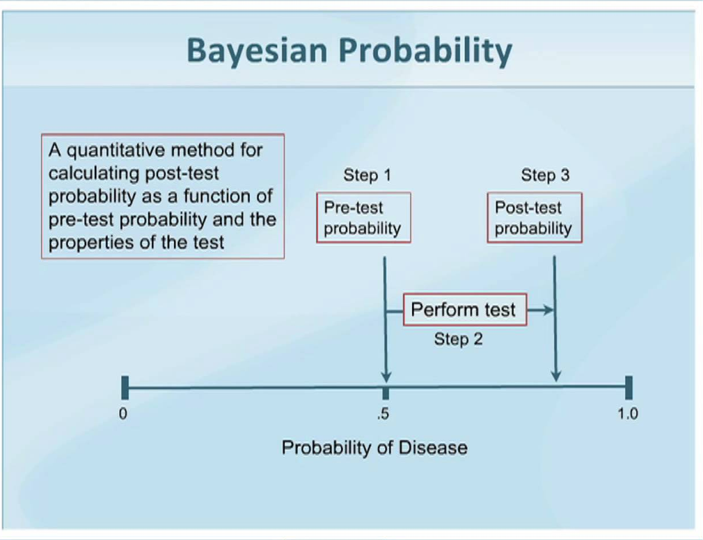

Slide 21
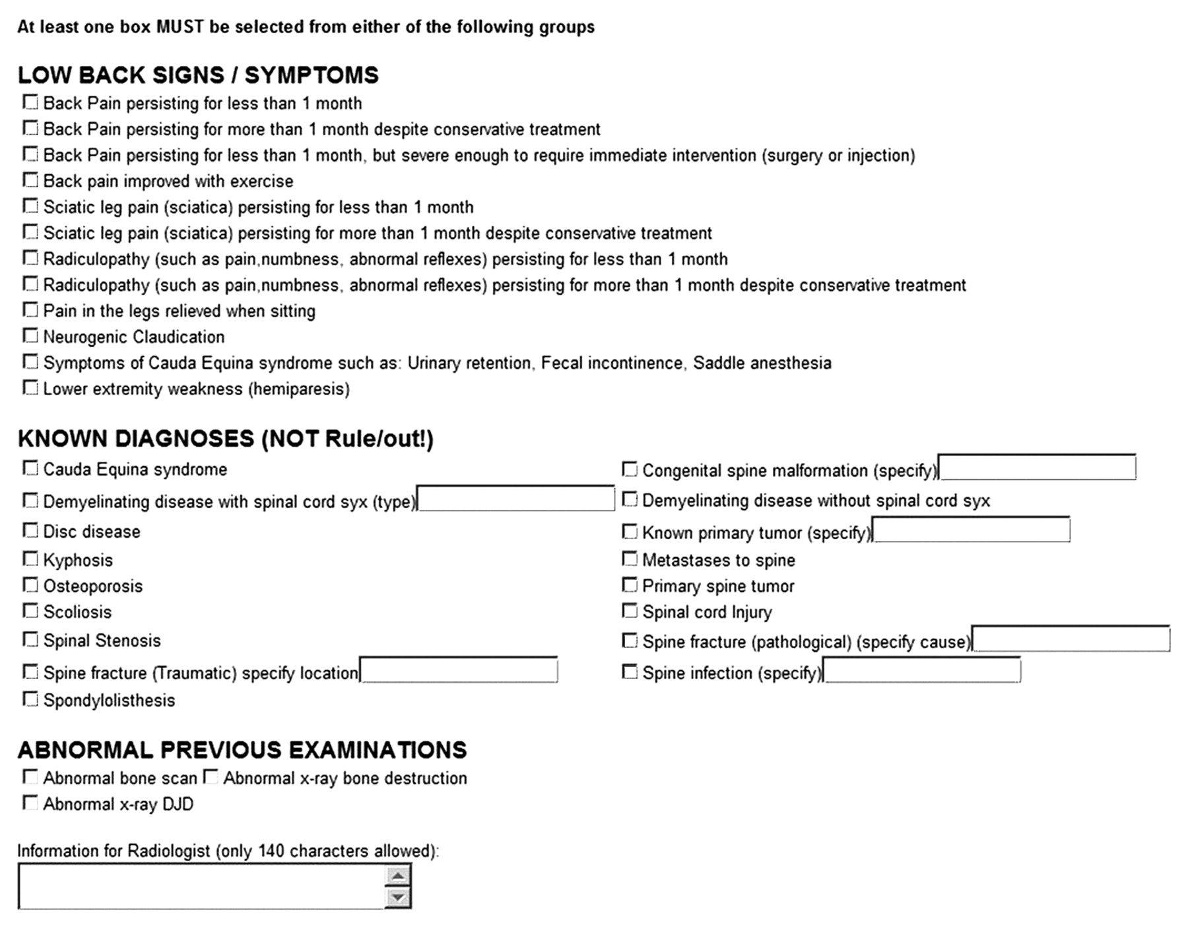
Example of ROE form displayed after provider selects MR imaging of the lumbar spine.
Sistrom C L et al. Radiology 2009;251:147-155
©2009 by Radiological Society of North America
Notes:
Example of ROE form displayed after provider selects MR imaging of the lumbar spine. DJD = degenerative joint disease, syx = symptoms.

Slide 22
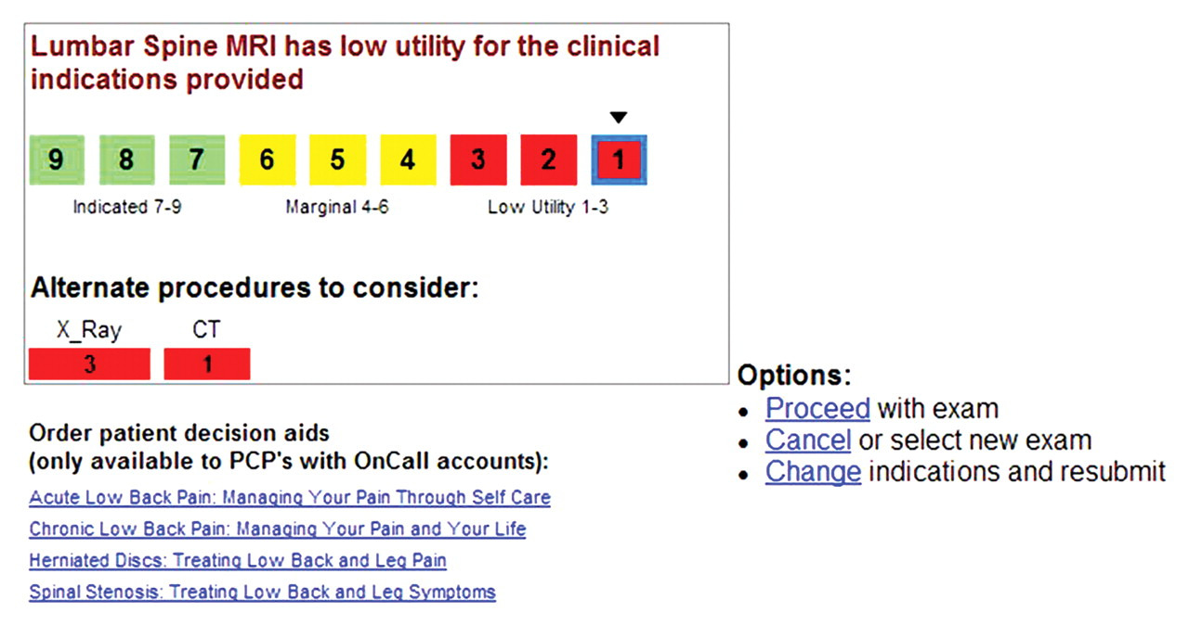
Screenshot of the DS feedback displayed after submitting a request for MR imaging of the lumbar spine with symptom of “back pain improved with exercise” and abnormal result at previous examination of “abnormal x-ray DJD [degenerative joint disease].” PCP's ...
Sistrom C L et al. Radiology 2009;251:147-155
©2009 by Radiological Society of North America
Notes:
Screenshot of the DS feedback displayed after submitting a request for MR imaging of the lumbar spine with symptom of “back pain improved with exercise” and abnormal result at previous examination of “abnormal x-ray DJD [degenerative joint disease].” PCP's = primary care physicians.

Slide 23
PROVEN CDS BENEFITS
Improve the appropriate use by a significant amount
Decrease the use by a small amount
CHALLENGE 1: JUSTIFICATION

Slide 24
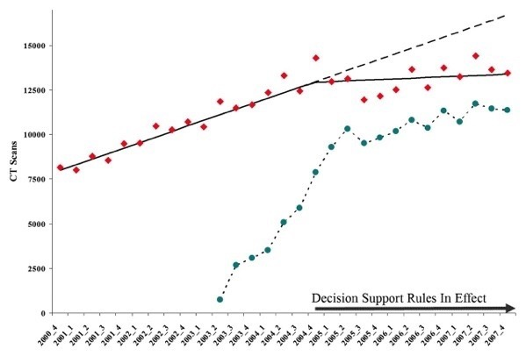
Massachusetts General Hospital
High Cost Imaging
Adjusted
Annual Compound
Growth Rate
1%
Effects of CDS
2000 - 2007
Adjusted
Annual Compound
Growth Rate
12%
Quarters 2000-2007
= Total exams
= Ordered with ROE
Sistrom C L et al. Radiology 2009;251:147-155

Slide 25
MGH EXPERIENCE
Lessons Learned
  Change Management – CDS is just the tool
  Multidisciplinary Teams - Continual process for evaluation & reassessment
  CDS is as effective as RBMs for managing inappropriate utilization
  When implemented correctly, there is a higher physician acceptance
  Need physician feedback to reduce variability and utilization
Courtesy of K.Dreyer
CHALLENGE 1: JUSTIFICATION

Slide 26
AMERICAN EXPERIENCE
ACR:CONTENT
NDSC:PLATFORM
ACR SELECT
CHALLENGE 1: JUSTIFICATION

Slide 27
TRANSATLANTIC PARTNERSHIP
MOU with ACR,and agreement with NDSC
ESR i GUIDE
Europeanisation,Pilot studies,Dissemination

Slide 28
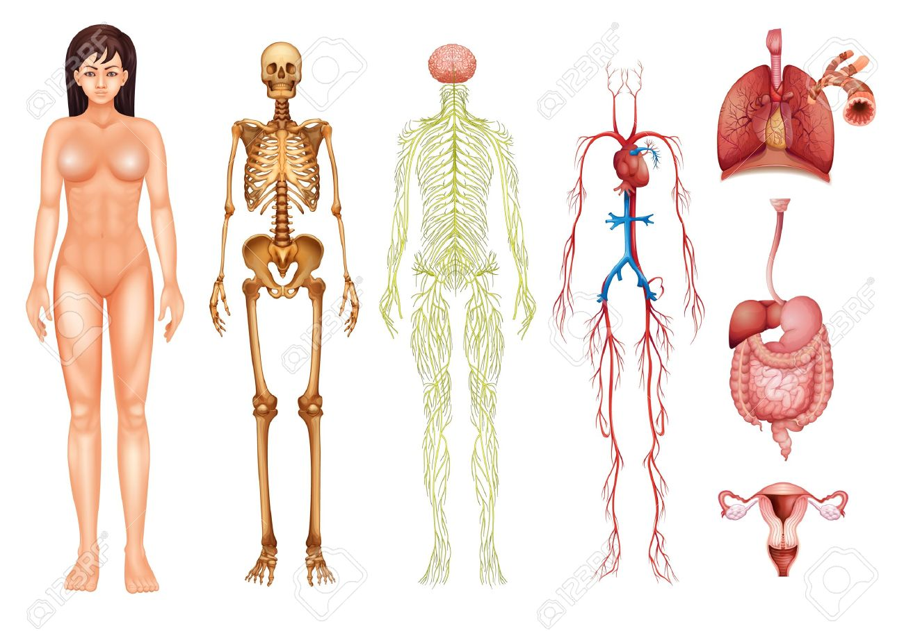
DISCREPANCIES:9%
Brain:7%
Chest:1%
Breast:2%
Cardiac:28%
Urinary:0%
Women’s:0%
GI:0.5%
Vascular:7%
MSK:4%

Slide 29
LOCALISATION
A crucial step for adoption by the physicians
Possible to add a new indication which would be reviewed by the ACR/ESR experts
-either remain local
-or incorporated to the general stock
Possible to change the rating of the tests
-Ultrasound for example probably more used in some EU countries than in the USA

Slide 30
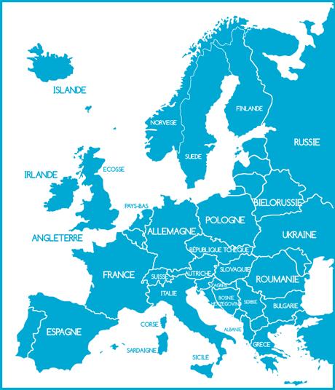
POTENTIAL SITES
  Italy
  Netherlands
  Norway
  Poland
  Spain
  Sweden
  Switzerland
  United Kingdom
  Austria
  Belgium
  Croatia
  Denmark
  France
  Germany
  Hungary
  Ireland

Slide 31
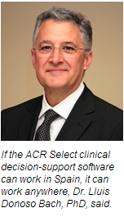
BARCELONA PILOT PHASE
Independent pilot phase
Translation and coding adaptation without any difficulty
Firstly targeted at GPs : very well received
Next expansion to emergency physicians

Slide 32
CHALLENGE 2: OPTIMISATION
“Radiological examinations must be performed with a dose relevant to the clinical question which should provide an appropriate image quality”
DRL IMAGE QUALITY
CHALLENGE 2: OPTIMISATION

Slide 33
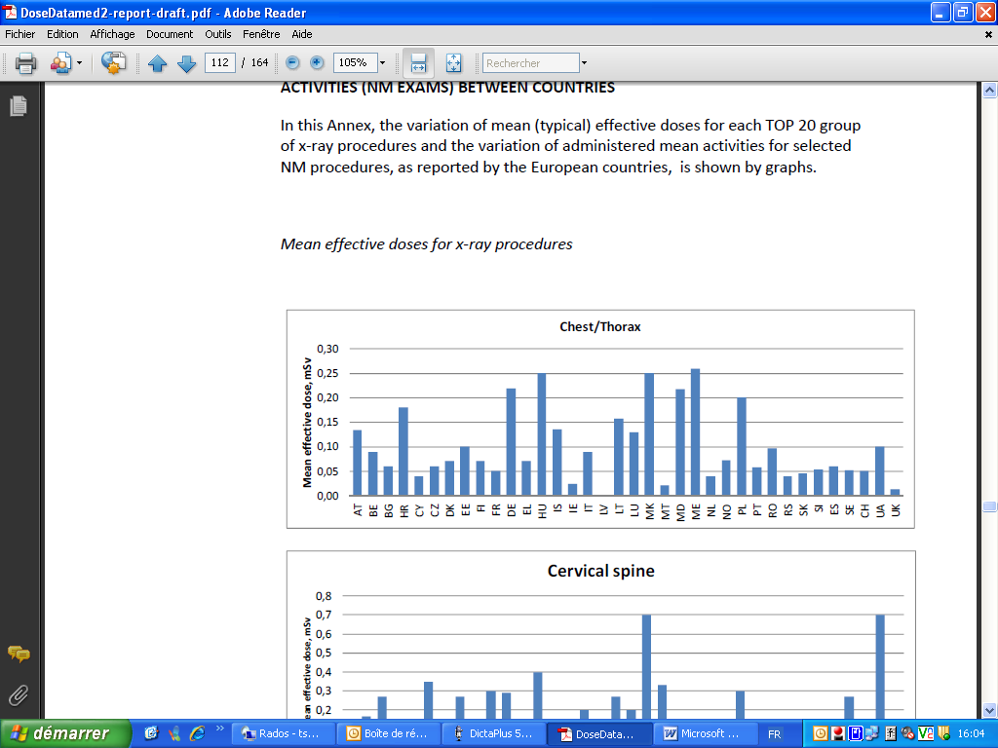
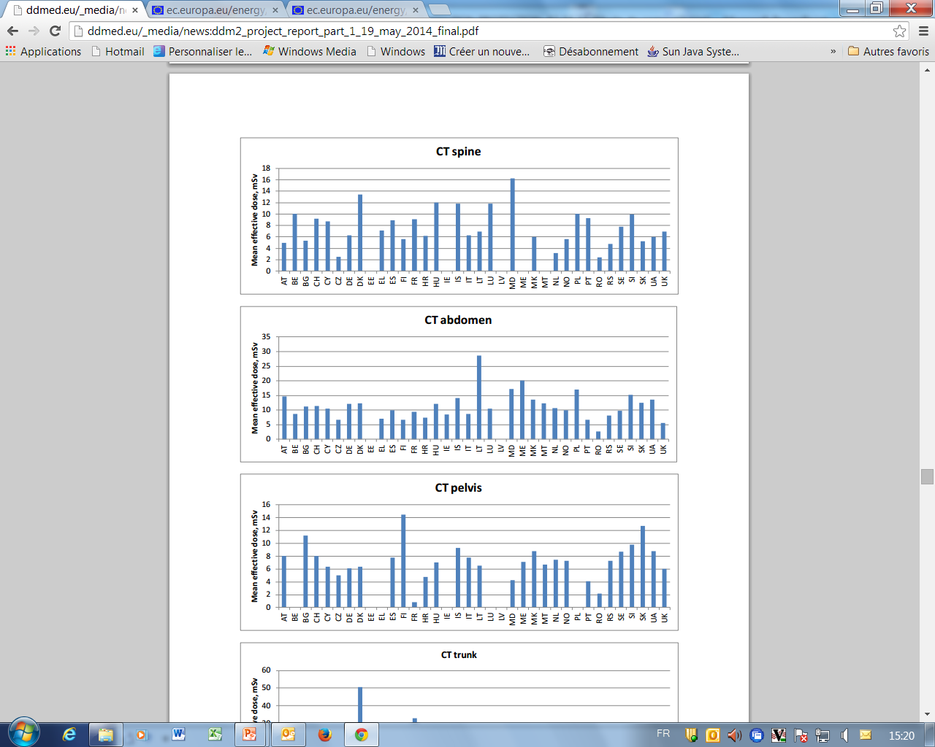
CHALLENGE 2: OPTIMISATION
CHALLENGE 2: OPTIMISATION
DOSE DATAMED 2

Slide 34
DRL
They are not « target doses »
They are not for individuals
They are for a group of patients
They serve to give a figure of the dose distribution for a given examination in a given facility
They are determined by surveys,usually at the national levels and with specific protocols
CHALLENGE 2: OPTIMISATION

Slide 35
DRL
They reflect a technical protocol and not a clinical indication
Their collection is rather complex and requires radiographers,medical physicists and radiologists cooperation
They are not following the pace of the technological progresses
CHALLENGE 2: OPTIMISATION

Slide 36

DRL:OPTIONS
Wait and see the National or the European DRLs
Proactive
- Patients are very much worry with the dose practices exposure and need to be reassured
CHALLENGE 2: OPTIMISATION

Slide 37
DRLs:OPTIONS
Wait and see the National or the European DRLs
Proactive
- It has been established that using DRLs improves the quality of the practices exposures
CHALLENGE 2: OPTIMISATION

Slide 38
CORONARY CALCIFICATION SCORING
Decrease of the mean DLP from 142.6 ± 23.2 mGy.cm to 79.5 ± 15.8

Slide 39
2009-2012

Slide 40
CHEST CT
NRD_{moy.} = 427 ± 157 mGy.cm
NRD_{réf}*. = 500 mGy.cm
2009

Slide 41
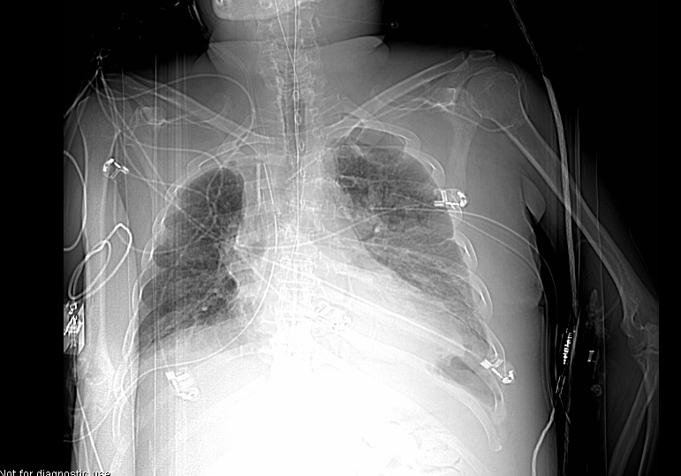
Arms along the body
DLP_{max.} = 994 mGy.cm
Notes:
Qualité d’image choisie par observateur détermine directement la réduction de dose souhaitée.

Slide 42
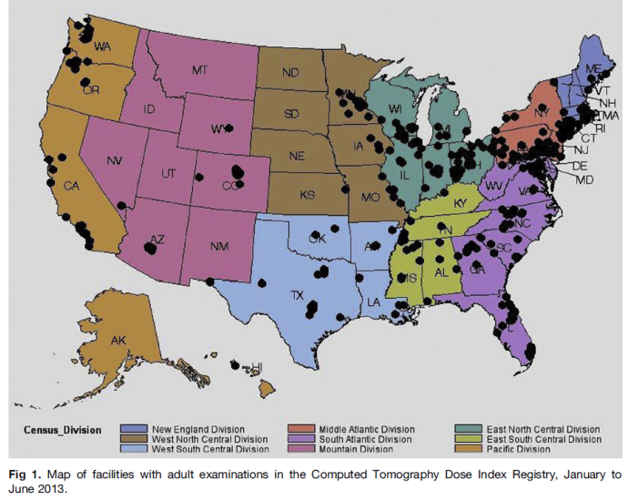
AUTOMATIC DOSE RECORDING
Automatic dose management software (10/15 available)
ACR Dose Index registry:over 800 facilities and 16 million examinations
BENCHMARKING
CERTIFICATION

Slide 43
EUROSAFE IMAGING SURVEYS
Based on clinical indications:stroke,pulmonary embolism,appendicitis…
Preliminary results are showing a strong heterogeneity in dose exposure

Slide 44
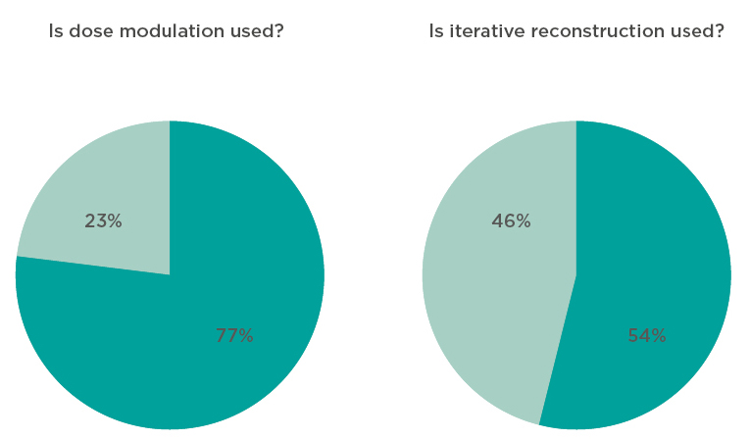
PRELIMINARY SURVEY FINDINGS
Head CT for Acute Stroke *
(*Status: 27 January 2015. As the survey is still open, the data displayed is preliminary.)

Slide 45
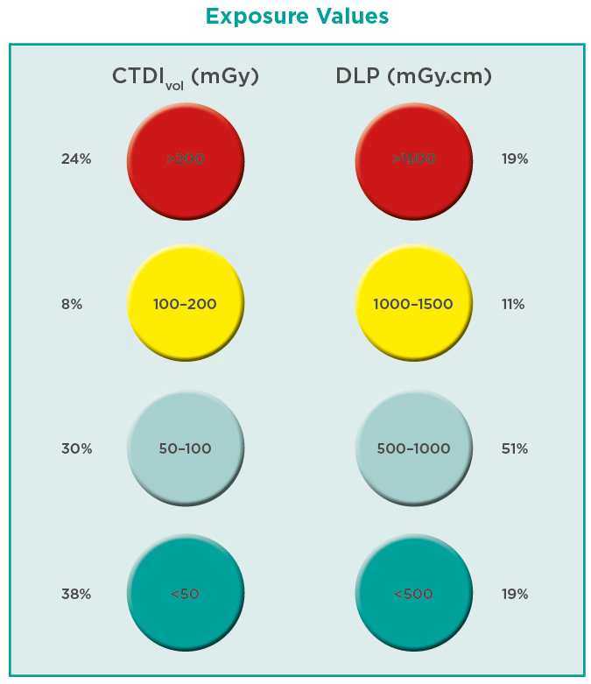
(*Status: 27 January 2015. As the survey is still open, the data displayed is preliminary.)

Slide 46
HOW IS YOUR PRACTICE??
(*Status: 27 January 2015. As the survey is still open, the data displayed is preliminary.)

Slide 47
BECOME FRIENDS OF EUROSAFE
FILL THE SURVEYS!!
AND YOU WILL SEE!!!
(*Status: 27 January 2015. As the survey is still open, the data displayed is preliminary.)

Slide 48
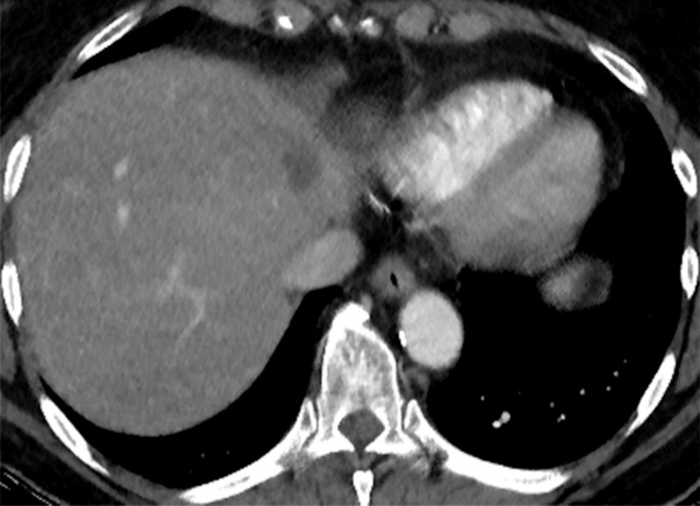
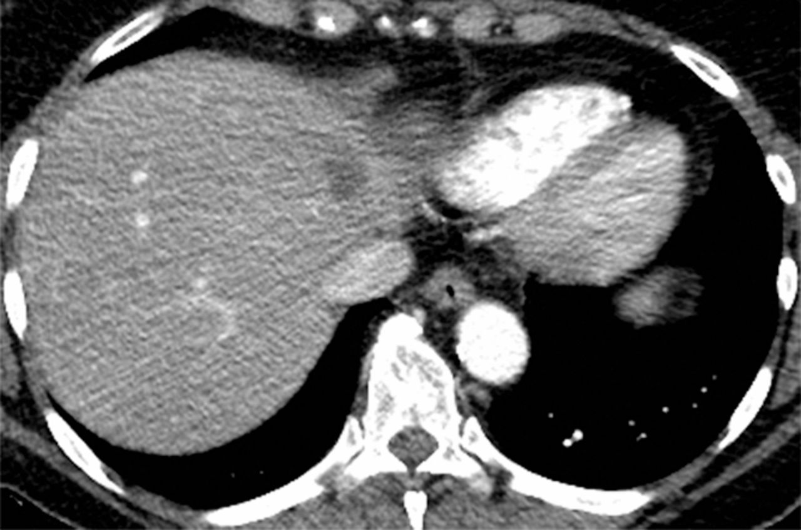
CHALLENGE 3: EQUIPMENT
Recent CT: huge decrease of the dose
Dose by 50%
CHALLENGE 3: EQUIPMENT

Slide 49
Action 4: Equipment Update Policy
    ESR paper on renewal of imaging equipment (published October 2014)
      Equipment life cycles are becoming shorter due to rapid technological advances
      Equipment older than 10 years must be replaced to avoid delays in diagnosis and safety problems
      For efficient maintenance and replacement, ESR advocates annually updated 5-year plans

Slide 50

The ESR Call for a European Action Plan for Medical Imaging
  QUALITY & SAFETY
  - Policy of equipment upgrade
  EDUCATION & TRAINING
  RESEARCH
  E-HEALTH
    - Support use of clinical decision support and referral guidelines
Brussel,2014

Slide 51

Patients
- ESR Patient Advisory Group
Regulators
Experts
- European Commission
- HERCA (radiation protection authorities)
Stakeholders
Industry
- ESPR (European Society of Paediatric Radiology)
- CIRSE (Cardiovascular and Interventional Radiological Society of Europe)
- EFOMP (European Federation of Organizations for Medical Physics)
- EFRS (European Federation of Radiographer Societies)
- COCIR (European Coordination Committee of the Radiological, Electromedical and Healthcare IT Industry)

Slide 52







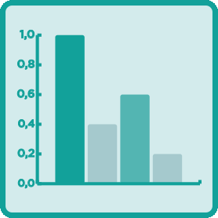


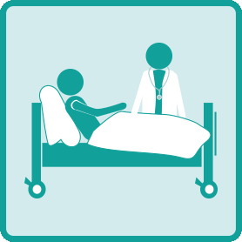

ACTION ITEMS
IAEA-WHO Bonn Call for Action
    EuroSafe Imaging
    1: Justification
    2: Justification
    3: Optimisation and Safety
    4: Optimisation and Safety
    5: Manufacturers’ role
    6: Education
    7: Research
    8: Information
    9: Safety culture
    10: Patient
    11: Globalisation
    1: Clinical Decision Support
    2: Clinical audit
    3: PiDRL project, data collection
    4: Equipment update policy
    5: Cooperation with COCIR (industry)
    6: E-courses, education projects
    7: MELODI (research platform)
    8: Data collection surveys
    9: GPS and KIQSI
    10: Website, ESR newsletters
    11: ESR Patient Advisory Group
    12: Network of campaigns
EUROSAFE

Slide 53
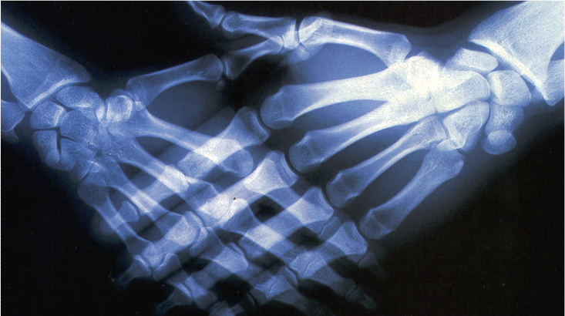
Thank you for your attention !!!

