Slide 1

Models of Health care organisation:
Barriers and solutions to effective justification
  Denis D’Almada Remedios
  Clinical Radiologist,
  London North West Healthcare Trust, UK

Slide 2
Barriers and solutions
Stakeholders
Models
  Referrers
  Radiologists
  Radiographers
  Regulators
  Patients and public
  UK
  USA
  Europe
  Canada
  Australia and New Zealand
  UAE
  South Korea
  Malaysia

Slide 3
The need for radiation protection
Diagnostic radiology in USA accounts for as much radiation than natural causes (15% in 1980 to 48% in 2006) NCRP 160 http://www.ncrponline.org/
CT exams have increased at 10% pa in USA from 3-80 million since 1980
44% of CT exams not justified in USA
Hadley JL, Agola J, Wong P. AJR 2006; 186: 937-942 http://www.ncbi.nlm.nih.gov/pubmed/16554560
Low level of knowledge of dose; only 1:3 doctors received formal training in radiation protection
Soye & Paterson. BJR 81 (2008),725-729 http://bjr.birjournals.org/cgi/content/abstract/81/969/725

Slide 4
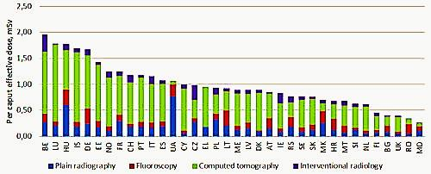
EC pan-European dose estimation project:
Per-capita effective doses in Europe

Slide 5
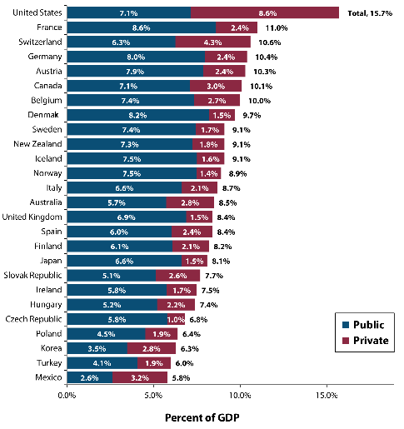
Health expenditure as % of GDP (2007) OECD http://icebergfinanza.finanza.com/files/2012/08/health_public_private_total_expenditure_gdp_oecd_4.png

Slide 6
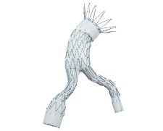
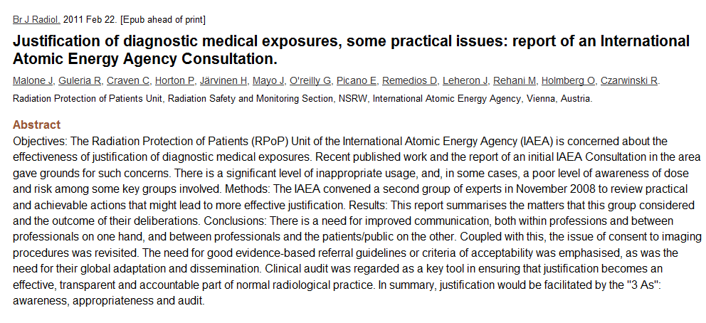
“Awareness, Appropriateness & Audit”
Triple A http://www.ncbi.nlm.nih.gov/pubmed/21343316

Slide 7
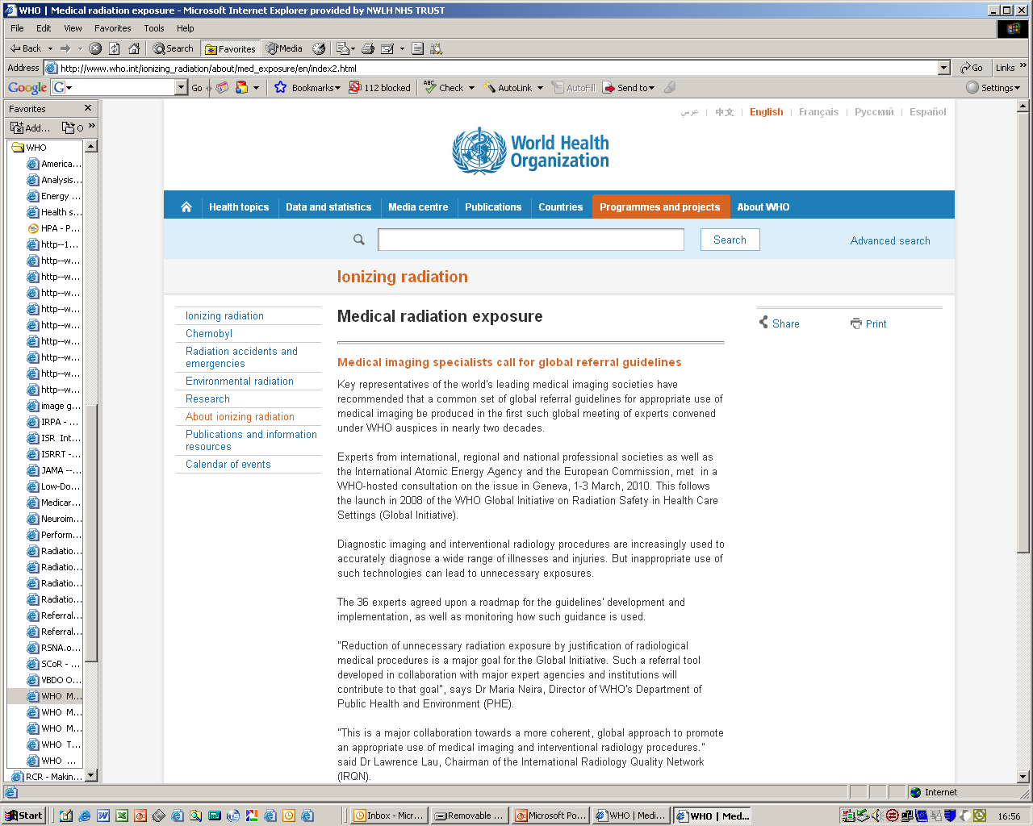

Slide 8

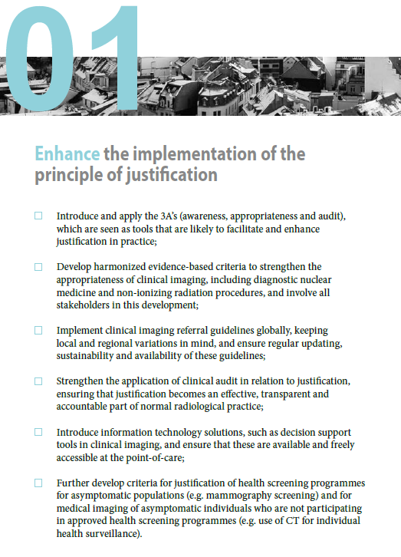
Joint Position Statement by the IAEA and WHO

Slide 9
Justification and clinician involvement : challenges
Dissemination of Referral Guidelines
  Widely and freely available to end-users
  “If they haven’t heard it you haven’t said it” McLuhan
Implementation of guidance
  decision support tools?
“We shape our tools and thereafter our tools shape us” McLuhan
Uptake
  need buy-in by users and preferably ownership
“Computers can do better than ever what needn’t be done at all. Making sense is still a human monopoly” McLuhan
Monitoring
  clinical audit, feedback and education
“We drive into the future using only our rearview mirror ” McLuhan
Notes:
9

Slide 10
Justification and clinician involvement: Issues
Overloaded knowledge base
  Medical and technical advances
  Competition for inclusion in curricula/CPD
Time challenged
  Fastest test with shortest wait best?
Mixed messages
  Different guidance from different sources?
Patient expectations
  Historical or geographical bias
  Unreliable evidence base from the web

Slide 11
Justification and clinician involvement: possible solutions
Education | Undergraduate and Continuing Professional Development. Requests not orders
Referral Guidelines | from a trusted source, in line with clinical guidance, +/- clinical decision support
Monitor with clinical audit | Local internal audit (bottom up) External audit (top down)
External control | by payers legislation

Slide 12
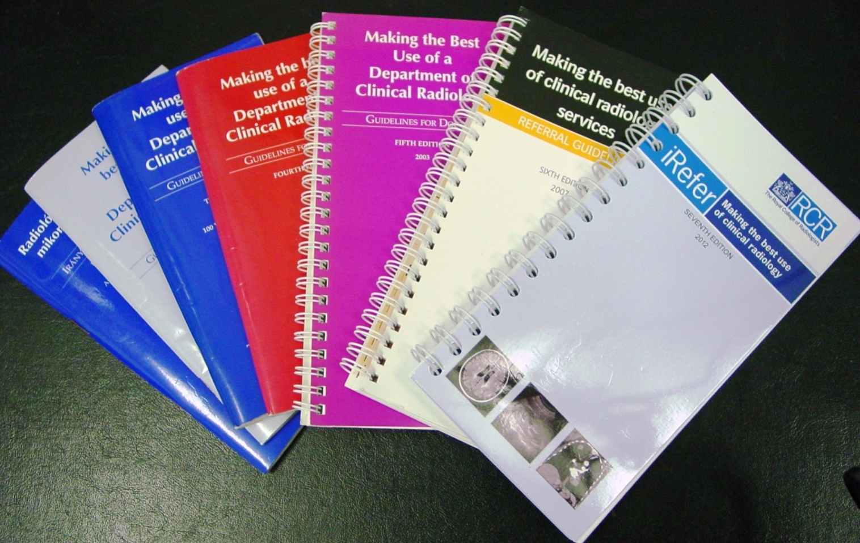

Making the best use of clinical radiology
The Royal College of Radiologists has published guidelines for 25 years since 1989. NHS Evidence accreditation for 7th edition (2012).
Notes:
12

Slide 13
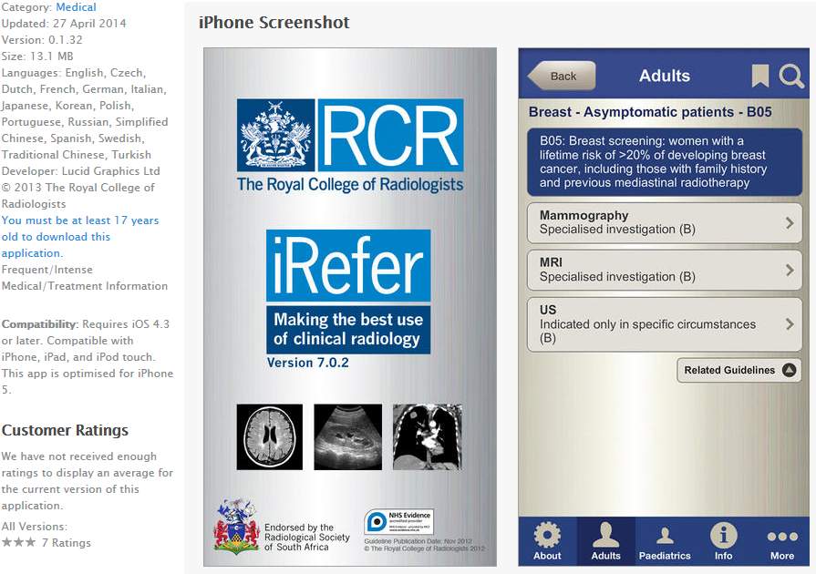
Guidelines App for smartphones and tablets

Slide 14
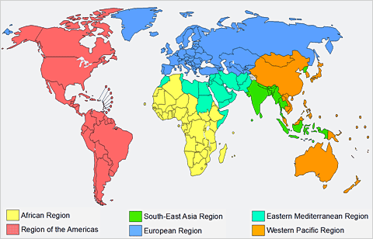
RCR iRefer App distribution
Europe: UK, Ireland, France, Norway, Sweden, Belgium, Denmark, Portugal, Spain, Switzerland, Germany, Slovakia, Netherlands, Italy, Israel
Western Pacific: Australia, New Zealand, Singapore, Hong Kong
Eastern Mediterranean: UAE, Kuwait, Saudi Arabia
Africa: South Africa
Americas: Brazil

Slide 15
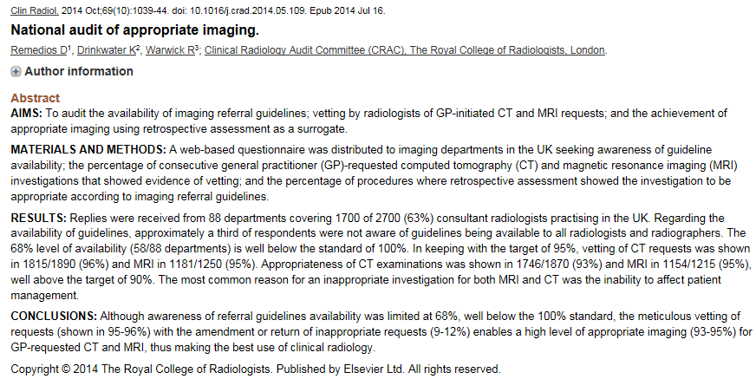
UK: Appropriate imaging through vetting (authorisation) The radiologist as gatekeeper http://www.ncbi.nlm.nih.gov/pubmed/25037149
>90% Appropriateness through radiologists’ amendment of 12% CT requests and 9% MRI requests

Slide 16

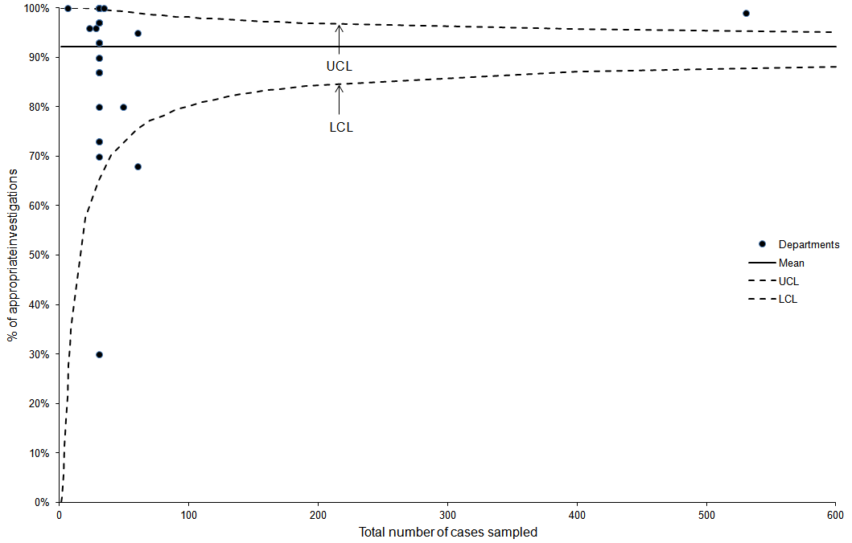
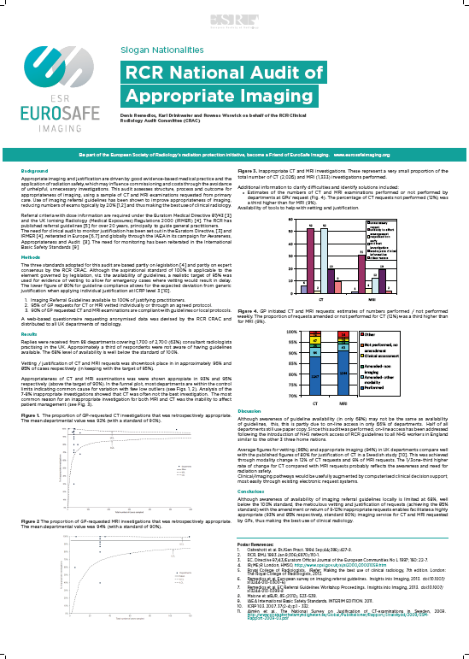
RCR National audit of appropriate imaging:
GP requested CT investigations % retrospectively appropriate
(Kind courtesy of Mr Karl Drinkwater, RCR Audit Officer)
target

Slide 17
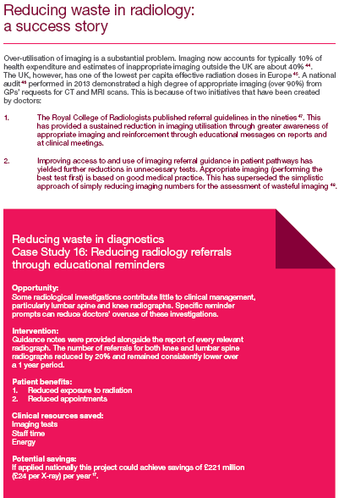
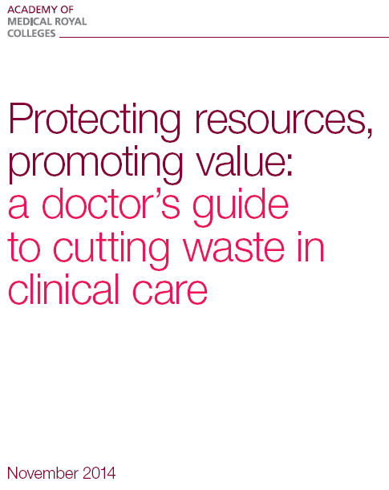
Wasteful imaging http://www.aomrc.org.uk/doc_download/9793-protecting-resources-promoting-value.html

Slide 18
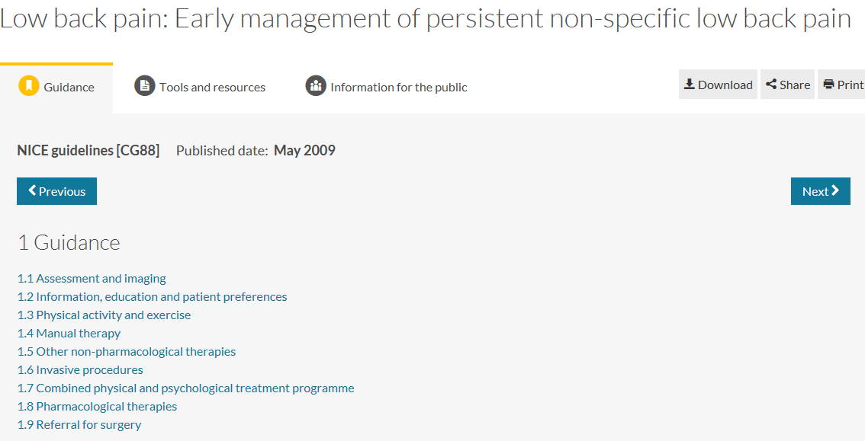
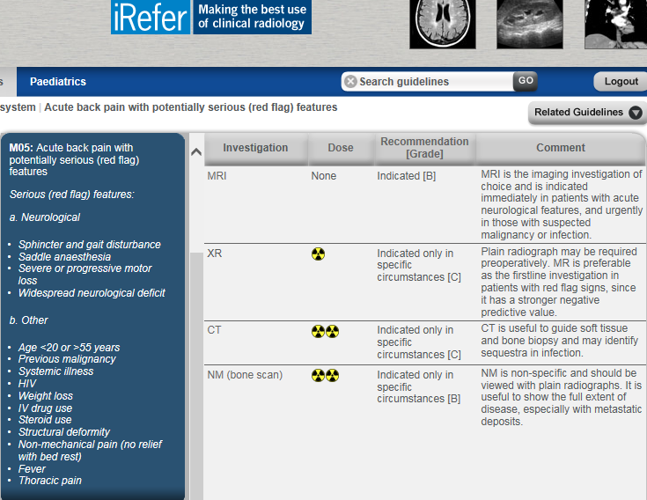
Imaging and clinical guidelines: uniformity

Slide 19
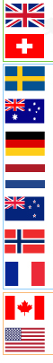
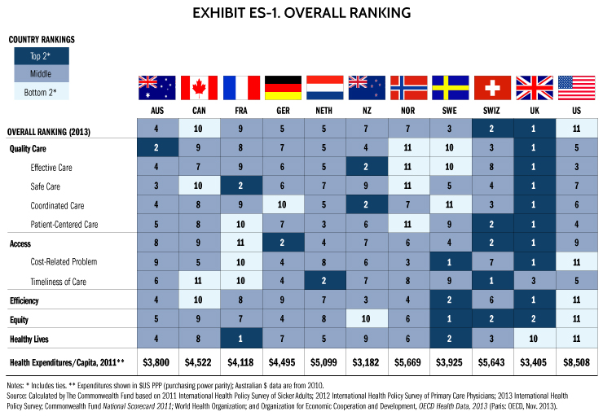
Healthcare rankings: Commonwealth fund 2014 http://www.commonwealthfund.org/~/media/images/publications/fund-report/2014/june/davis_mirror_2014_es1_for_web.jpg?h=511&w=740&la=en

Slide 20
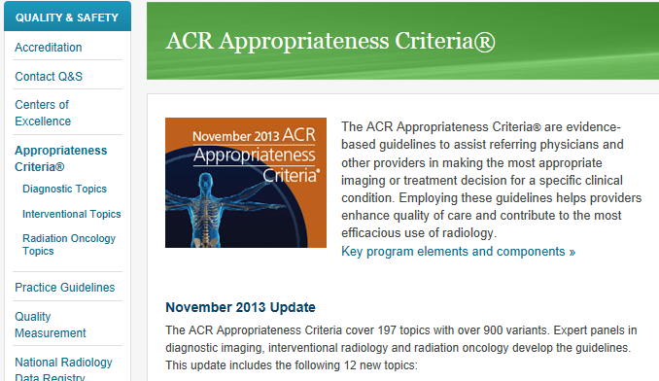
USA Guidance for appropriate imaging http://www.acr.org/Quality-Safety/Appropriateness-Criteria

Slide 21
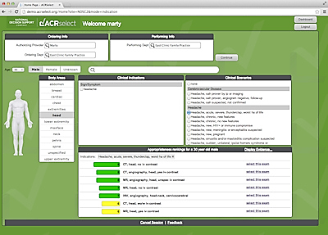
ACR- Clinical Decision Support

Slide 22
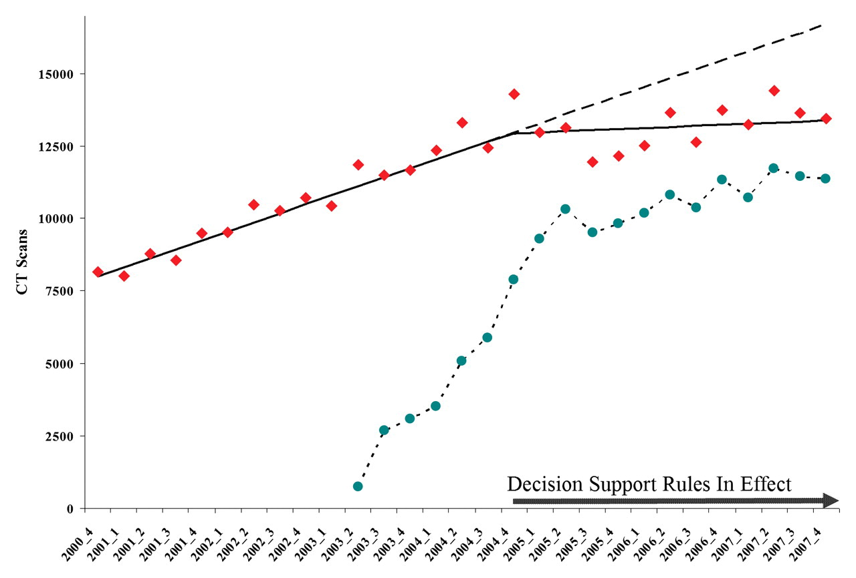
CT requests with Clinical Decision Support
Radiology, http://pubs.rsna.org/doi/abs/10.1148/radiol.2511081174
Christopher L. Sistrom; Pragya A. Dang; Jeffrey B. Weilburg; Keith J. Dreyer; Daniel I. Rosenthal; James H. Thrall; Radiology 2009, 251, 147-155.
DOI: 10.1148/radiol.2511081174
© RSNA, 2009

Slide 23
Rand report for Imaging and CDS http://www.rand.org/content/dam/rand/pubs/research_reports/RR700/RR706/RAND_RR706.pdf
Uptake
  “Approximately two-thirds of clinicians in the sample placed fewer than 20 orders”
Reduction in utilisation
  “largest decrease in the percentage of rated orders was for orders for CT and MRI of the lumbar spine, which decreased by 8 and 15%”
Coverage
  “percentage of orders that were successfully rated by DSSs ranged from as little as 17 percent for Convener D to a high of 58 percent for Convener A”

Slide 24
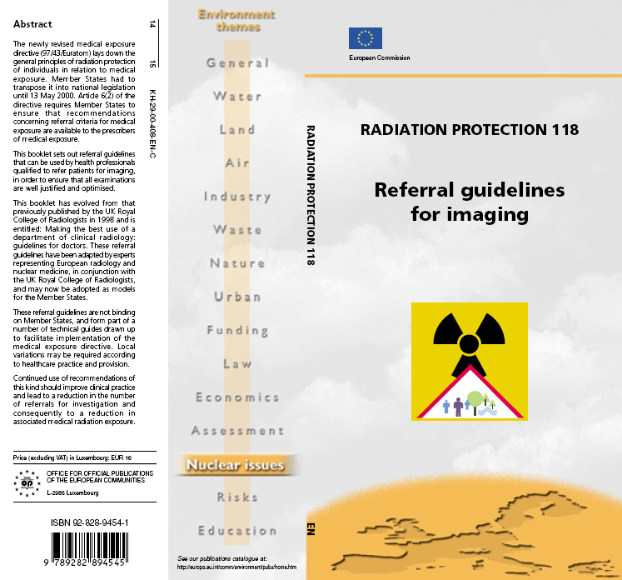
EC Referral Guidelines 2000

Slide 25

EC Guidelines study: potential barriers to distribution

Slide 26
EC Guidelines study: Suggested solutions to barriers

Slide 27
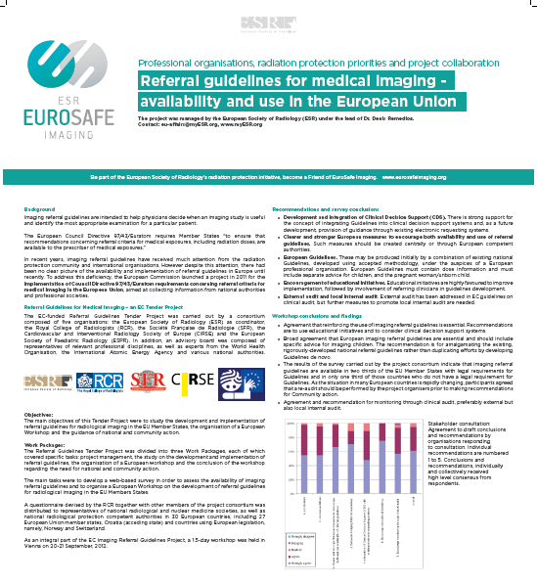
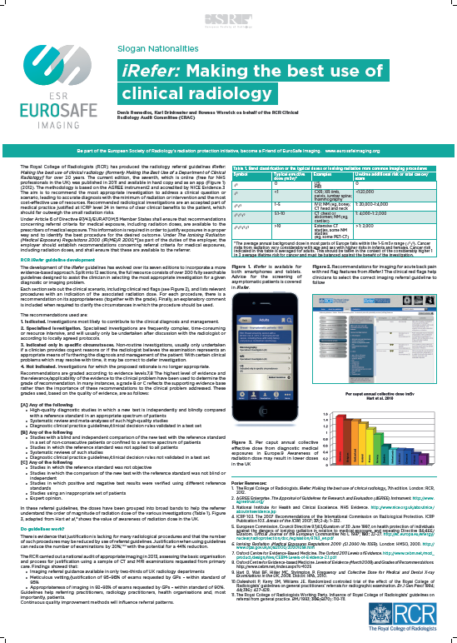
Europe: EuroSafe Imaging Campaign. Collaborative efforts for Radiation Protection

Slide 28
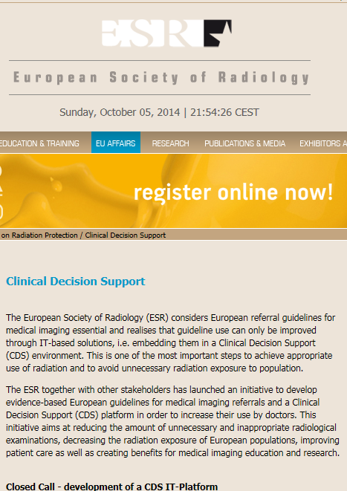
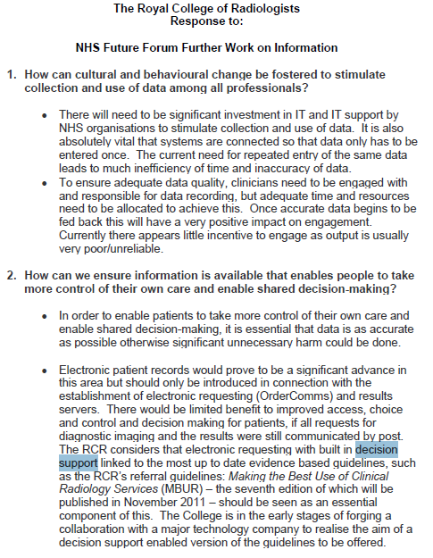
Clinical decision support in Europe and the UK: work in progress

Slide 29
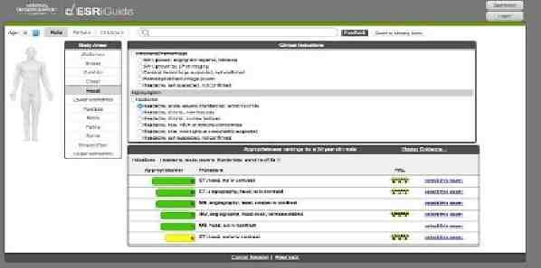
Clinical decision support for imaging referral guidelines in Europe

Slide 30

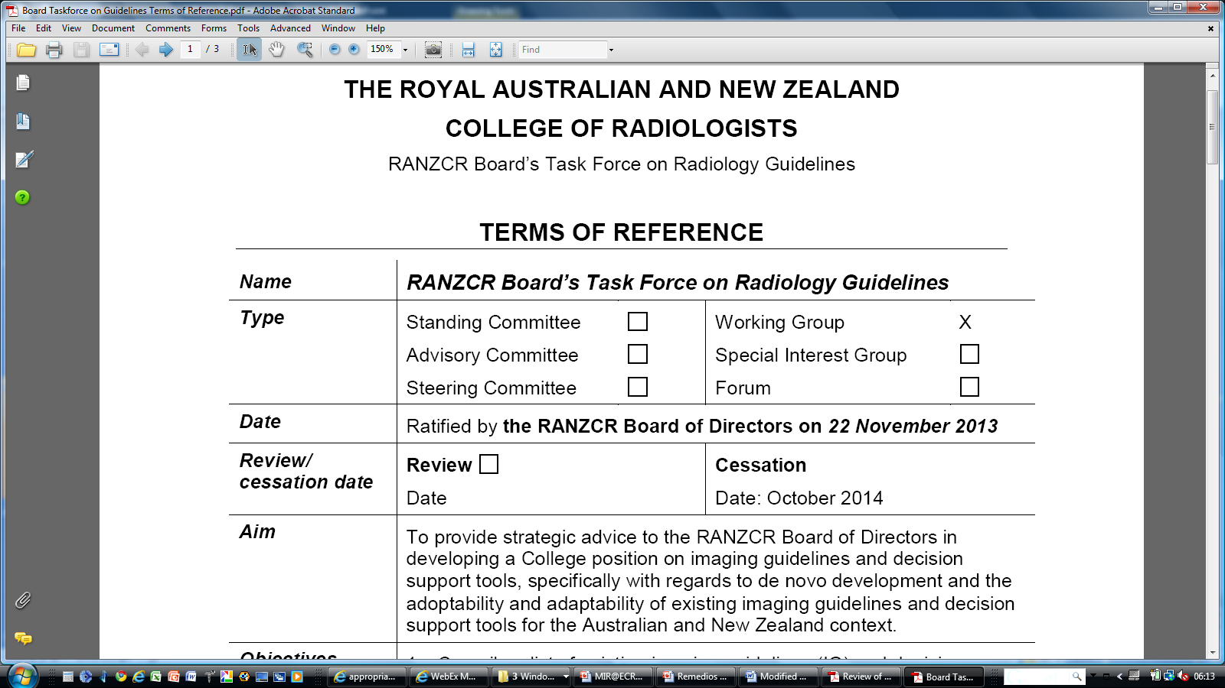
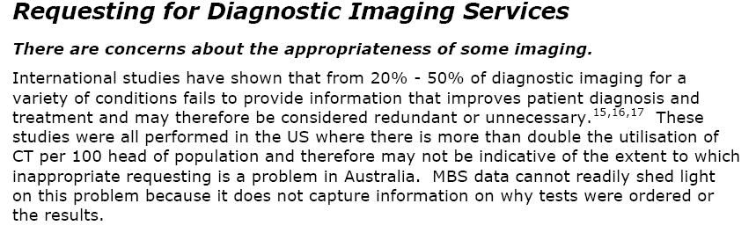
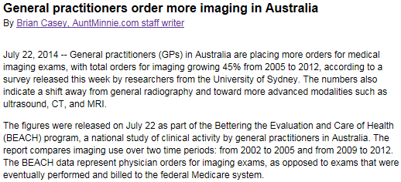

Australia & New Zealand: Inclusive approach to imaging guidelines and decision support

Slide 31

Justification Barriers (AUS) http://www.nhmrc.gov.au/_files_nhmrc/file/nics/material_resources/Identifying%20Barriers%20to%20Evidence%20Uptake.pdf
Process
Human
No system in place for justification
No place in system for justification
No requirement in department / hospital
No delegation to radiographers / technologists
No guidance
Departmental conflict of interest
Radiologist-
  Lack of time
  Inadequate knowledge
  Inadequate clinical information
  Outside specialty interest
  Conflict of interest
Patient-
  undue pressure
Referrer

Slide 32
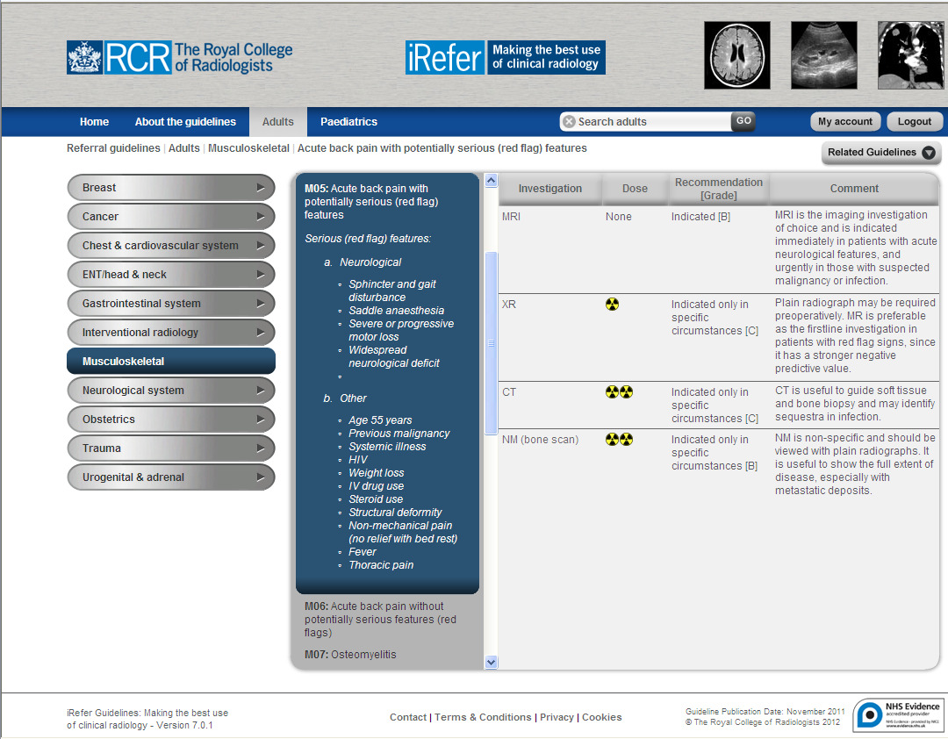

Slide 33
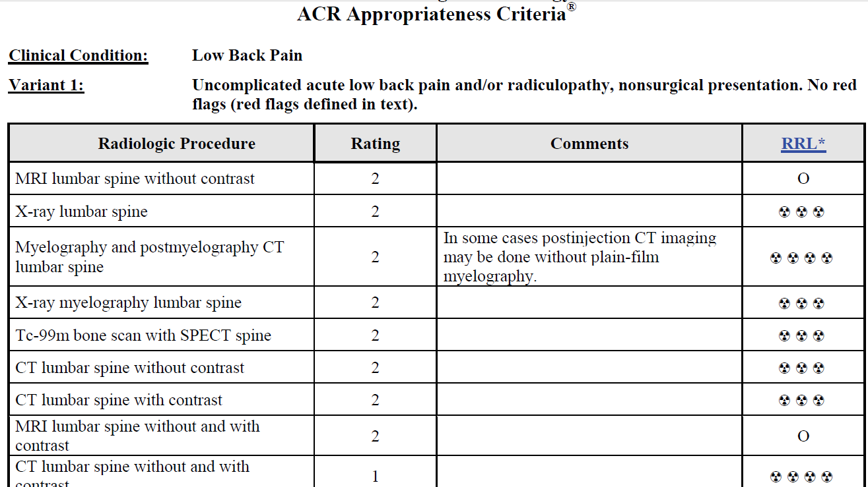
ACR Appropriateness Criteria https://acsearch.acr.org/docs/69483/Narrative/

Slide 34
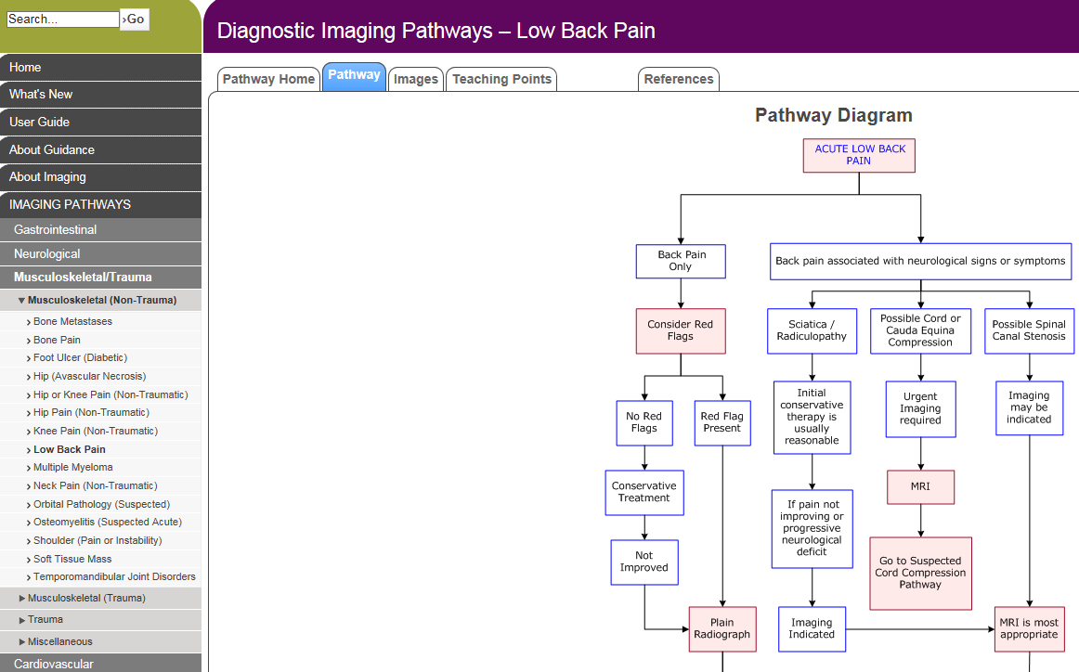
Western Australia HA: Diagnostic Imaging Pathways http://www.imagingpathways.health.wa.gov.au/index.php/imaging-pathways/musculoskeletal-trauma/musculoskeletal/low-back-pain?tab=redflags#pathway

Slide 35
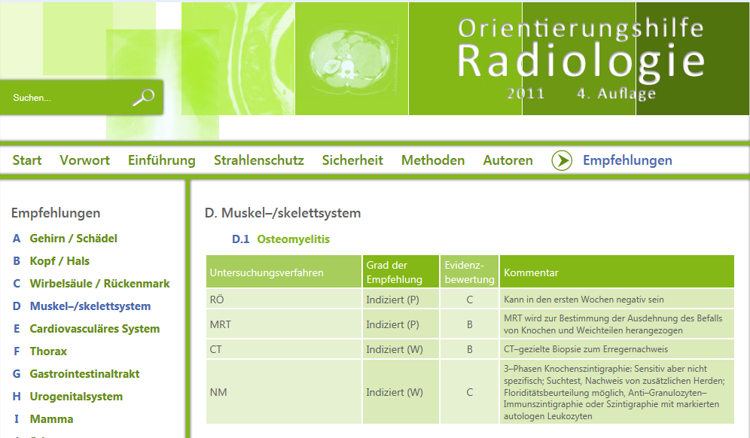



Austrian Referral Guidelines: adopt and translate http://orientierungshilfe.vbdo.at/

Slide 36
UAE: Suggestions for next steps
IAEA Workshop on Patient Referral Guidelines, Sept. 2014
Adopt and adapt Imaging Referral Guidelines for use in the UAE
Encourage Clinician Champions to promote guideline introduction & use
Governmental endorsement and support for guideline availability & use
Educational initiatives for medical under-graduates & doctors in training, also CPD*
Clinical audit facilitation and training for monitoring guideline availability and use

Slide 37

South Korea: Evidence-based referral guidelines project, 2014-
Collaboration of the Korean Society of Radiology and the National Evidence-based Healthcare Collaborating Agency

Slide 38
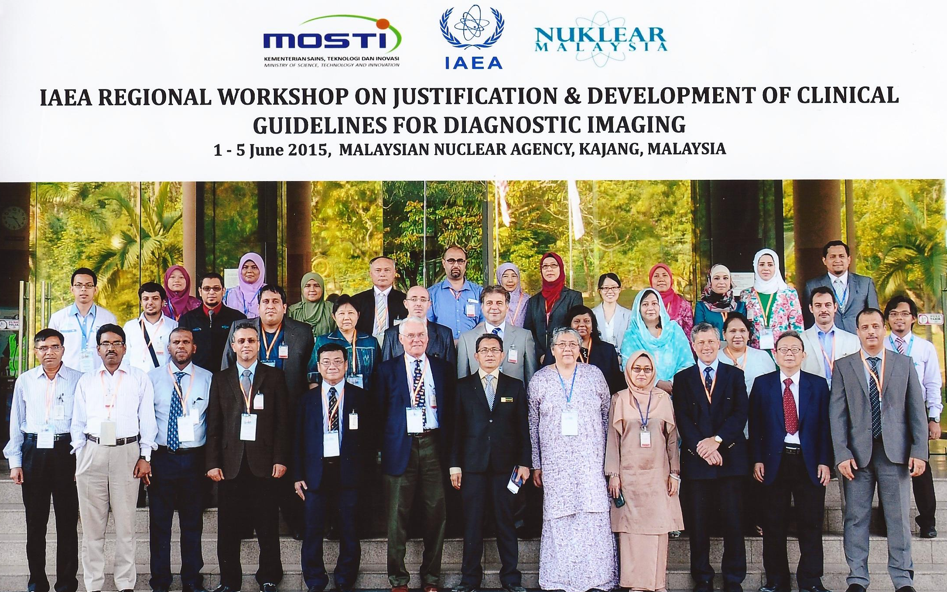
Malaysia: Referral Guidelines Workshop, 2015
Collaboration of the College of Radiology Malaysia & the Ministry of Health
Decision to adopt and adapt referral guidelines

Slide 39
Evidence for referral guidelines
Following RCR guidelines, overall referrals fell 13%
  BMJ. 1993 Jan 9;306(6870):110-1
RCGP Randomised controlled trial showed fewer referrals and better conformance
Oakeshott, Kerry, Williams. Br J Gen Pract. 1994 Sep;44:427-8.
Randomised trial with an educational reminder messages in reports is effective in reduction by up to 20% & does not affect quality of referrals.
Eccles , Steen , Grimshaw , Thomas , McNamee , Soutter, Wilsdon , Matowe , Needham , Gilbert. The Lancet, 2001; 357: 1406 – 1409.
Over 12 consecutive months no evidence of the effect of the intervention wearing off
Ramsay, Eccles, Grimshaw, Steen. Clin Radiol. 2003 Apr;58(4):319-21
Emerging evidence to show 2-20% improvement in conformance with clinical decision support tools.

Slide 40
Tips for guideline compliance
Guidelines that are acceptable to all specialties will improve compliance and reduce unnecessary paediatric skull radiographs
  Johnson K, Williams SC, Balogun M, Dhillon MS. Clin Radiol. 2005 Aug;60(8):936.
Psychological research shows that the more precisely behaviours are specified, the more they are likely to be carried out
Specifying what, who, when, where, and how will assist implementation
  Susan Michie, Marie Johnston. BMJ 2004;328:343-345

Slide 41
Improving clinical practice using clinical decision support (CDS) systems:
a systematic review
Kensaku Kawamoto et al BMJ 2005;330:765
Analysis of 70 randomised controlled trials identified 4 features to improve clinical practice—
CDS automatically as part of clinician workflow,
CDS at the time & location of decision making,
actionable recommendations provided, and
computer based
An effective system must minimise clinicians’ effort to receive and act on system recommendations
http://www.bmj.com/content/330/7494/765

Slide 42
Monitoring of guideline use
Clinical Audit
Clinic-radiological meetings (MDT meetings)
  Future imaging choices in the individual case
  Imaging referral behaviour.
Educational messages in reports esp. to GPs
Sustained 20% reduction in referral possible
    “Lumbar imaging for low back pain without suggestion of serious underlying conditions does not improve clinical outcomes. http://www.rcr.ac.uk:2059/adult/#Tpc151 http://www.nice.org.uk/guidance/CG88/chapter/1-Guidance ”
Regulatory inspection
Licensing

Slide 43
Metrics esp. for Economic benefit?
Value of test not the same as the cost
Benefit to a health organisation within the constraints of resources
Essential to measure outcome for clinical guidance & patient protocols
6. Societal benefit
5. Patient outcome
4. Therapeutic impact
3. Diagnostic impact
2. Diagnostic efficacy
1. Technical efficacy
The efficacy of diagnostic imaging
Fryback and Thornbury Med Decis Making 1991;11:88 http://www.ncbi.nlm.nih.gov/pubmed/1907710

Slide 44
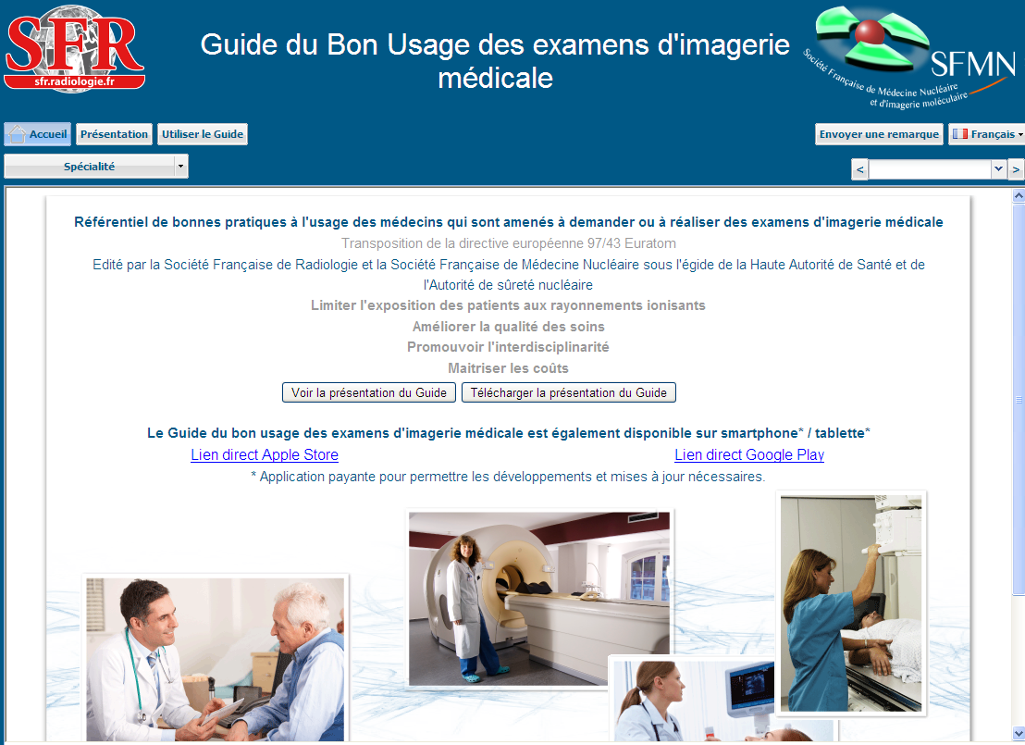

http://gbu.radiologie.fr/

Slide 45
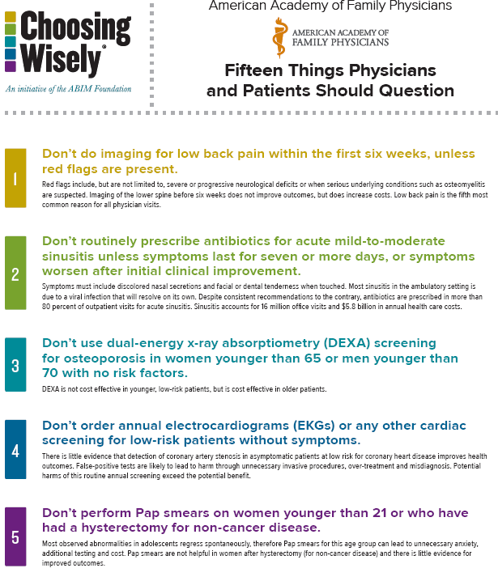
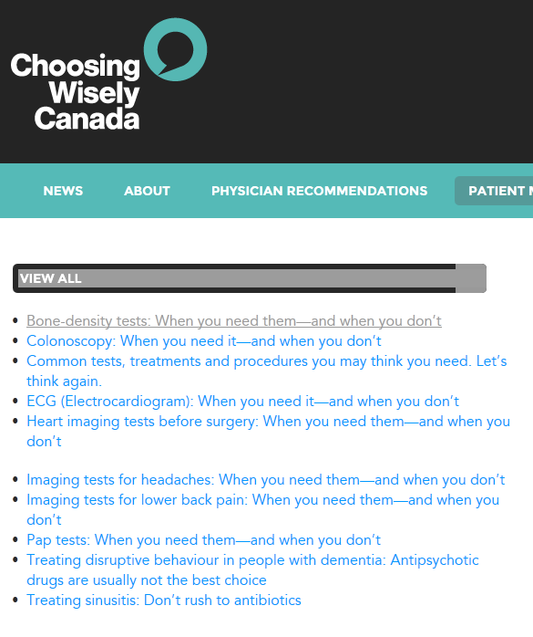
Combining imaging and clinical advice

Slide 46
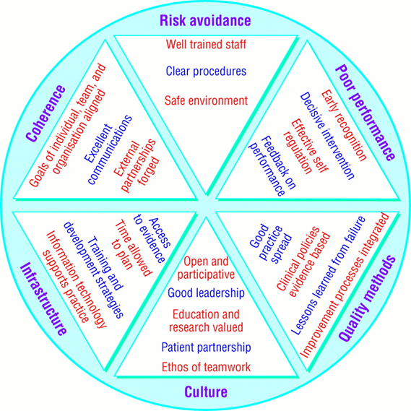
Integrating approaches of clinical governance (from Scally G , and Donaldson L J BMJ 1998;317:61-65)
Team working:
Radiol-radiog
Communication
with referrers
Regulation
Awareness
Appropriate
Imaging
Clinical audit
Efficiency
Education
Evidence-based
practice

Slide 47
Imaging referral guidelines: areas for consideration to help local implementation
Imaging referral guidelines- what is available
Format- tabular or flow chart algorithm
Media- print copy, web-based, app-based for tablets/smart phones, clinical decision support CDS
Barriers: Human, economic and process
Monitoring- audit, workflow, regulatory inspection
Tools for implementation- awareness campaigns, education, CDS
Long term goals- reduced utilisation, effective diagnostics, radiation safety culture, collective corporate responsibility for safety

Slide 48
Barriers and solutions to justification
High level support top-down approach
Radiologist as gatekeeper… Enable radiologist to amend requests
Clinician & Patient acceptance esp. integrate with clinical practice guidelines
Workflow solutions simple & effective
Monitor implementation & improvement
Radiation safety culture… governance
Awareness, Appropriateness & Audit;
Referrer, Radiologist, Radiographer & Regulator

