Slide 1
Justification and Optimization in Medical Exposures international perspectives and actions
Dr. Maria del Rosario Pérez
Department of Public Health, Environmental and Social Determinants of Health

Slide 2
Overview
About WHO
Radiation in medicine today
Radiation protection in medicine
Justification and optimization in diagnostic imaging
Global actions- WHO Global Initiative on Radiation Safety in HCS and Bonn Call for Action

Slide 3

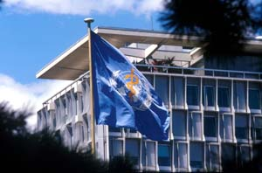
The World Health Organization
Function: act as the UN directing and coordinating authority on international health work
Objective: attainment by all peoples of the highest possible level of health
Notes:
LEE Jong-wook
Director General
3,500 fixed-term employees
Budget < US$ 3 billion
Communicable diseases
TB, malaria, polio, HIV/AIDS, …
Non-communicable diseases
Tobacco, mental health, …
Health and environment
Chemicals, water, radiation,…
….

Slide 4
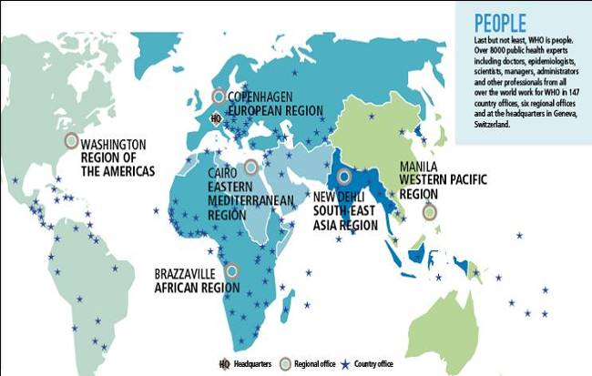
The WHO 3-level structure
194 Member States
Ministries of Health
Headquarters
Geneva
6 Regional Offices
147 Country Offices
IARC, Lyon

Slide 5

WHO's core functions
Articulate ethical and evidence-based policy positions
Setting norms and standards, and promoting and monitoring their implementation
Shaping the research agenda, and stimulating the generation, translation and dissemination of valuable knowledge
Providing technical support, catalysing change and developing sustainable institutional capacity
Monitoring the health situation and assessing health trends
Providing leadership on matters critical to health and engaging in partnerships where joint action is needed

Slide 6

The definition of "health"
“Health is a state of complete physical, mental and social well-being and not merely the absence of disease or infirmity.”
(WHO Constitution,1948)

Slide 7
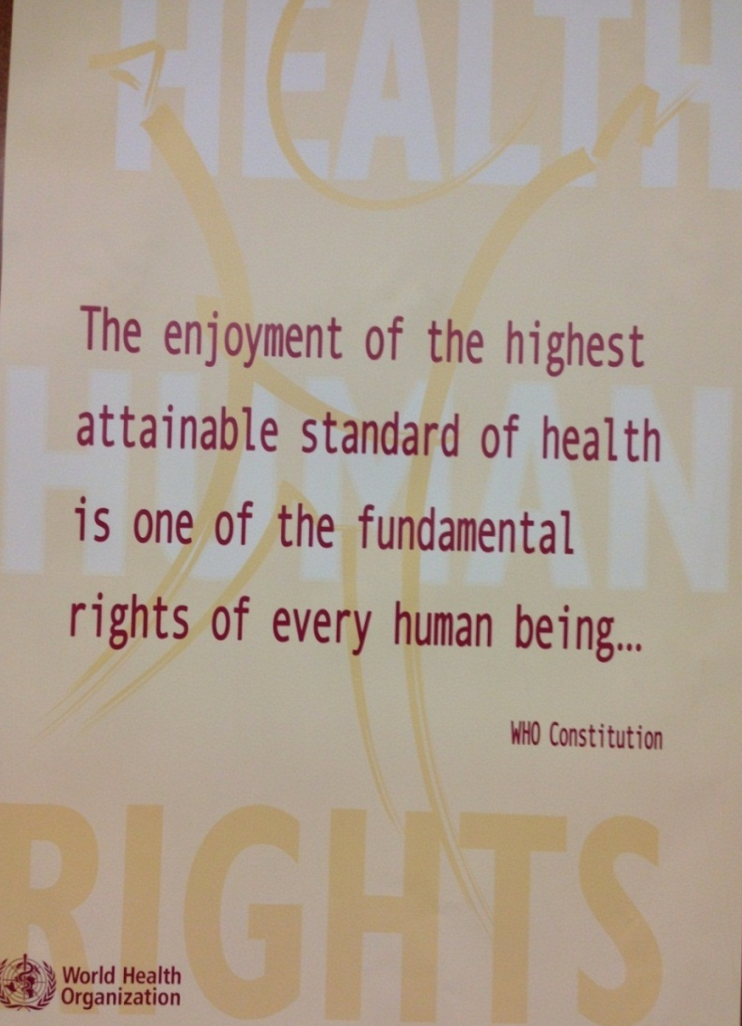
Health is a human right
The right to health includes access to timely, acceptable, and affordable health care of appropriate quality

Slide 8
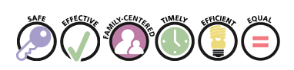
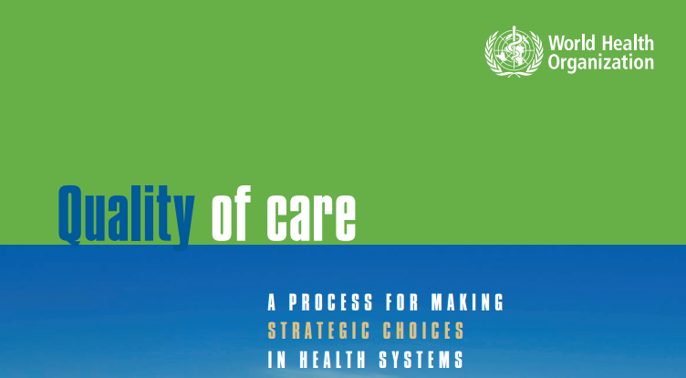
Health Care Quality Dimensions
Safety
Effectiveness
Patient-centeredness
Timeliness
Efficiency
Equality

Slide 9

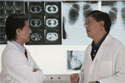
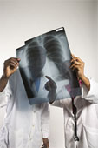
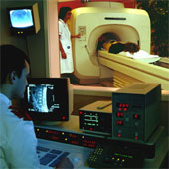
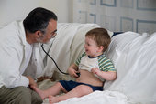
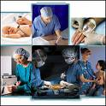
Good medical practice encompasses radiation safety
Health service delivery is one of the building blocks of health systems.
Good health services are those which deliver safe and effective health interventions to those that need them, when and where needed, with minimum waste of resources.
Radiation safety in medicine is embedded in health care quality and health systems strengthening.

Slide 10
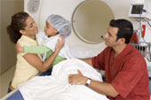
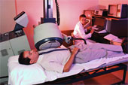

Radiation in medicine today
3,600 millions
X-ray exams
37 millions
Nuclear medicine procedures
7,5 millions
Radiation oncology treatments
(10% in children)
Annually worldwide

Slide 11
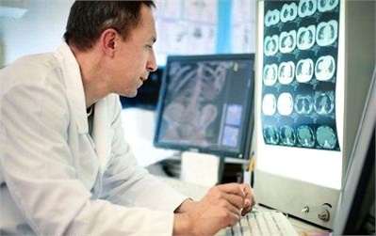
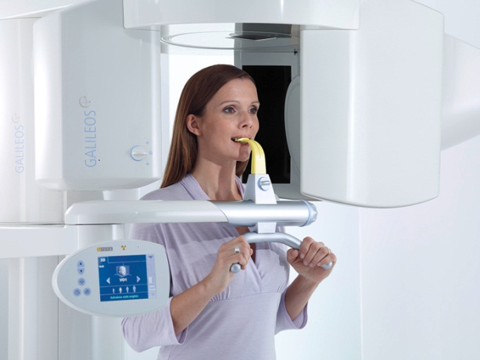
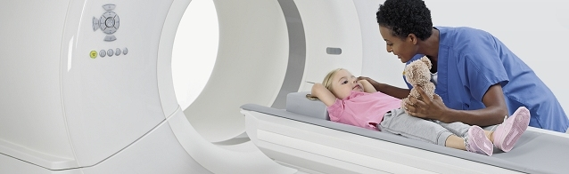
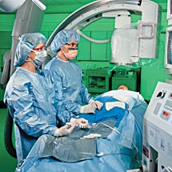
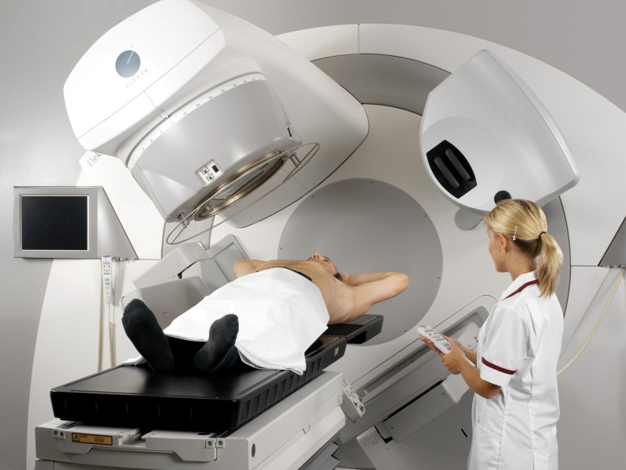
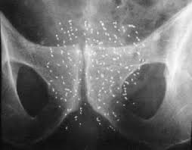
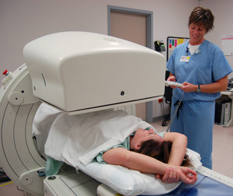
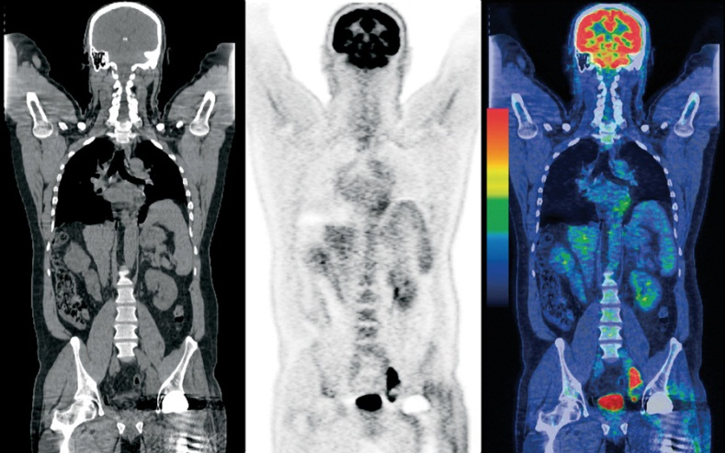
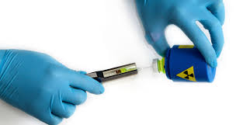
The use of radiation in medicine is the largest contributor to the exposure of the population from artificial sources (95%)

Slide 12
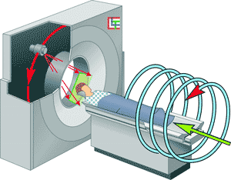
Radiation in Health Care
The use of radiation in the diagnosis and treatment of human diseases continues increasing.
Development of modern health technology makes new applications safer.
However, the inappropriate handling can lead to unnecessary or unintended radiation exposures, with potential health hazards for patients and medical staff.
RADIATION PROTECTION

Slide 13
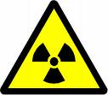

System of Radiological Protection
Purpose
  To provide an appropriate level of protection for people and the environment against the detrimental effects of radiation exposure without unduly limiting the benefits that may be associated with such exposure
external exposure
radiation dose
radiation risk
internal exposure
radiation source
exposure pathways
exposed individual

Slide 14
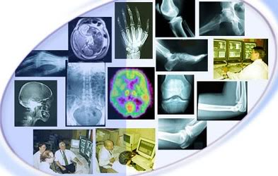
Challenge of radiation protection in health care
Control and minimize health risks, while maximizing the benefits that can be obtained
RISKS
BENEFITS

Slide 15



Three categories of exposure co-exist in health care facilities
Patients;
Comforters and carers;
Medical research volunteers
Medical exposures
Occupational exposures
  Health care providers
Public exposures
  Visitors, general public

Slide 16


The two pillars of RP in medical exposures
Radiation protection in medical exposures is based on two principles of radiation protection:
  justification of procedures
  optimization of protection and safety.

Slide 17

JUSTIFICACION
OPTIMIZACION
These two principles of radiation protection in medical exposures are implicit in the concept of
"First do no harm"
“ Primum non nocere”
Hippocrates (460 BC – 377) BC)

Slide 18
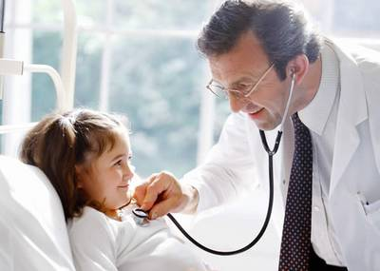

What does it mean in medical imaging?
The benefit outweighs the risk when a medical imaging procedure is:
  appropriately prescribed
  properly performed.
This is not the case if there is no clinical indication or the radiation dose is higher than necessary for the clinical purpose (e.g. adult protocols used for imaging children)
  Do the right procedure !
  Do the procedure right !
JUSTIFICATION
OPTIMIZATION

Slide 19
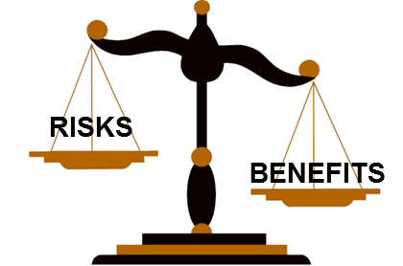

Appropriateness in imaging: "Best Test First !"
When choosing a procedure utilizing ionizing radiation, the benefit/risk ratio must be carefully considered.
If the clinical evaluation (e.g. physical examination) or other imaging modalities (e.g. US, MRI) could provide an accurate diagnosis, the use of ionizing radiation would be unnecessary
In addition to the scientific evidence, other factors have to be considered when making a decision about the imaging modality to be used (if any):
  e.g. local expertise, available resources, accessibility, affordability, patient values

Slide 20


Justification of medical exposures
It applies at three levels
Level 1: General justification
Level 2: Generic justification
Level 3: Individual justification

Slide 21

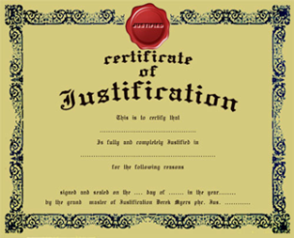
What is the level 1 of justification?
The first level refers to the general justification of the use of ionizing radiation in medicine.
As a general approach, the use of radiation in medicine is accepted as doing more good than harm, economic and social issues being considered.
Therefore, this first level of general justification can be taken for granted.

Slide 22
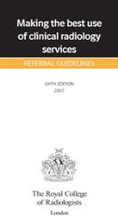
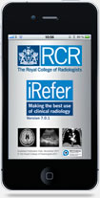
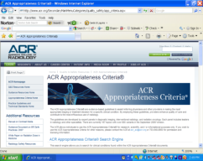
What is the level 2 of justification?
Second level -generic justification- refers to a particular radiological medical procedure for patients with a given clinical condition, or for a group of individuals at risk to a given condition that can be detected and treated.
Level 2 justification is assigned to the health authority in conjunction with appropriate professional bodies.
Referral guidelines/ appropriateness criteria refer to this level of justification.

Slide 23

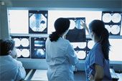
The level 3 : individual justification
Third level- individual justification of a procedure judged to do more good than harm to a particular patient.
It is assigned to health professionals involved in the patient's care ("consultation between the radiological medical practitioner and the referring medical practitioner, as appropriate").
They have to integrate the best available scientific evidence with their individual clinical expertise to decide what is appropriate for an individual patient.
RISKS
BENEFITS

Slide 24
Referral Guidelines for Medical Imaging
A medical imaging examination is useful if its outcome — either positive or negative — influences management of the patient or strengthens confidence in the diagnosis.
Referral guidelines for medical imaging provide information on which procedure is most likely to yield the most informative results, and whether another modality is equally or more effective, and therefore more appropriate.
These guidelines support the practice of evidence-based medicine and form a foundation to guide appropriateness in prescribing diagnostic imaging services.

Slide 25
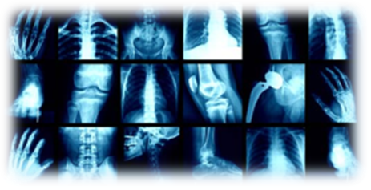
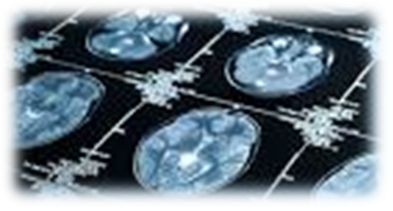
Optimization in medical exposures
The dose to the patient should be managed to ensure that it is commensurate with the medical purpose
In medical imaging the goal is to use the suitable dose to obtain the desired image ("diagnostic quality image")
"Not more nor less" dose

Slide 26
Optimization of protection
The optimization of protection is applied to:
  the design, appropriate selection, and construction of equipment, software and installations; and
  the working procedures (operational parameters).
Methods for dose reduction should be applied and protocols should be tailored according to patient size and level of acceptable noise for a given clinical indication (important in paediatric CT).
Diagnostic reference levels (DRLs) are tools for optimization

Slide 27
Diagnostic Reference Levels (DRLs)
DRLs are used to ensure that doses do not deviate significantly from those achieved at peer departments for that procedure (unless there is a known, relevant, and acceptable reason).
DRLs apply in radiodiagnosis, nuclear medicine, interventional radiology, to groups of patients rather than individual patients.
Their numerical values are ADVISORY (i.e. not mandatory).
They are intended to identify situations where the levels of patient dose or administered activity are unusually high or low and take actions if/as necessary.

Slide 28
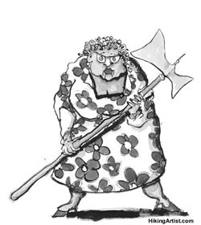
Justification & optimization in medical imaging
Patient journey
 |  | Booking |  | Registration |  | Preparation |  | Examination |  | Report |  | Transcription |  | Validation |  | Delivery
 |  | QA / Error reduction
Justification |  |  |  |  |  | Optimization
(adapted from Dr. L. Lau IRQN/ISR)
Gate keeper
Notes:
28

Slide 29
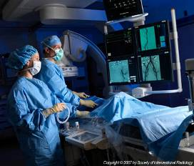
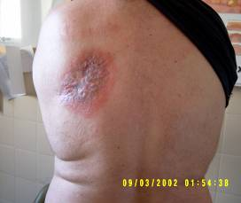
Optimization in interventional radiology
Fluoroscopy-guided interventional procedures are being more routinely used, and doses for patients and staff may be significant
Tissue reactions have been reported in patients undergoing interventional fluoroscopy (e.g. skin damage).
Optimization of protection in interventional radiology includes the establishment and use of DRLs. In addition to patient safety, RP of health workers is particularly important in this modality.

Slide 30
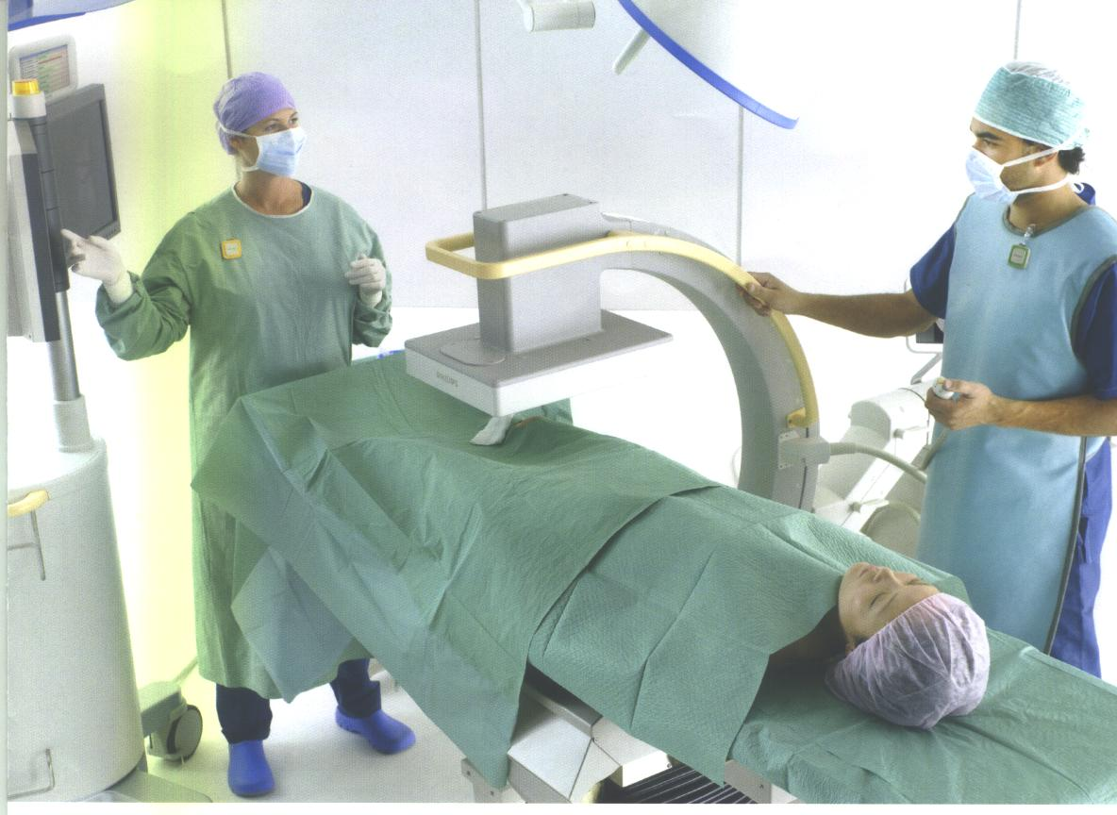
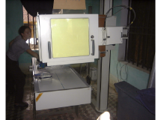
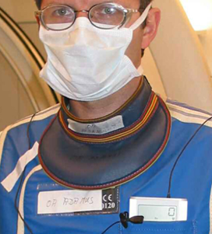

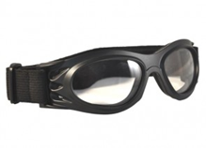
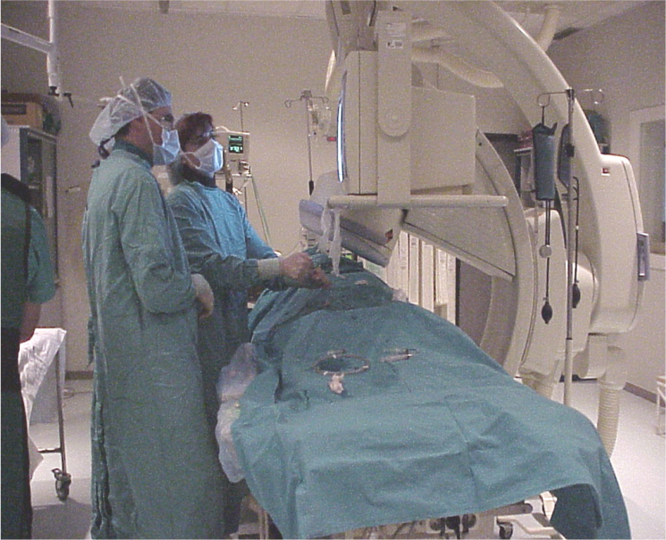
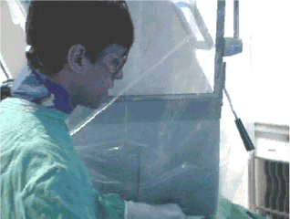
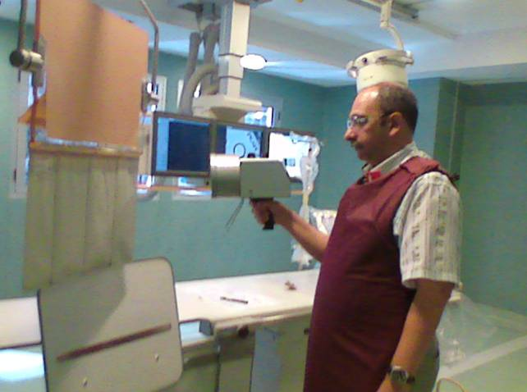
Interventional radiology: the highest doses in the lens of the eye of health workers

Slide 31
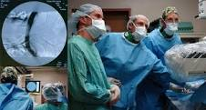
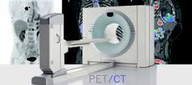
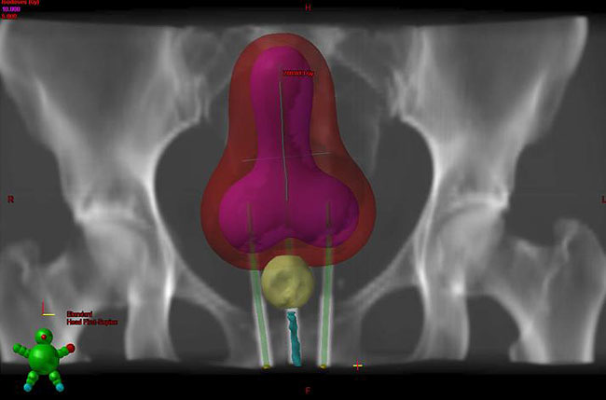
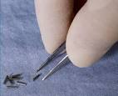
New occupational dose limit for the lens of the eye (to prevent cataract)
Health workers are the biggest group with potential implications from the reduction in the annual dose limit for the lens of the eye in the BSS (20mSv)
Including staff involved in:
  fluoroscopy guided interventional procedures;
  CT-guided interventional procedures;
  nuclear medicine procedures (e.g. preparation of radiopharmaceuticals, PET/CT, cyclotrons);
  manual brachytherapy.

Slide 32
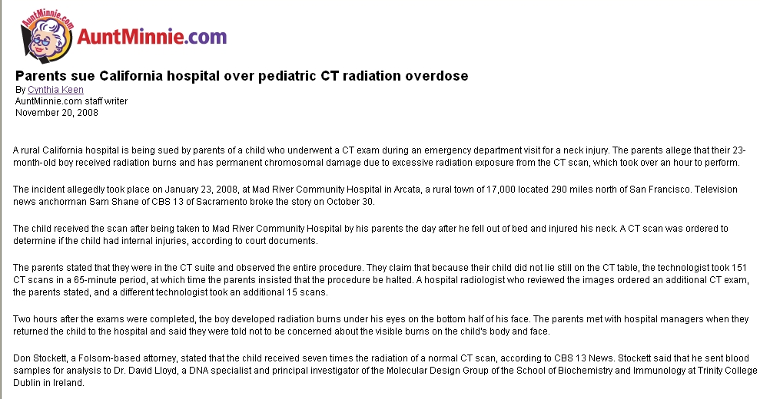
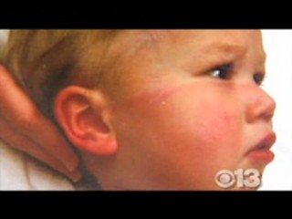
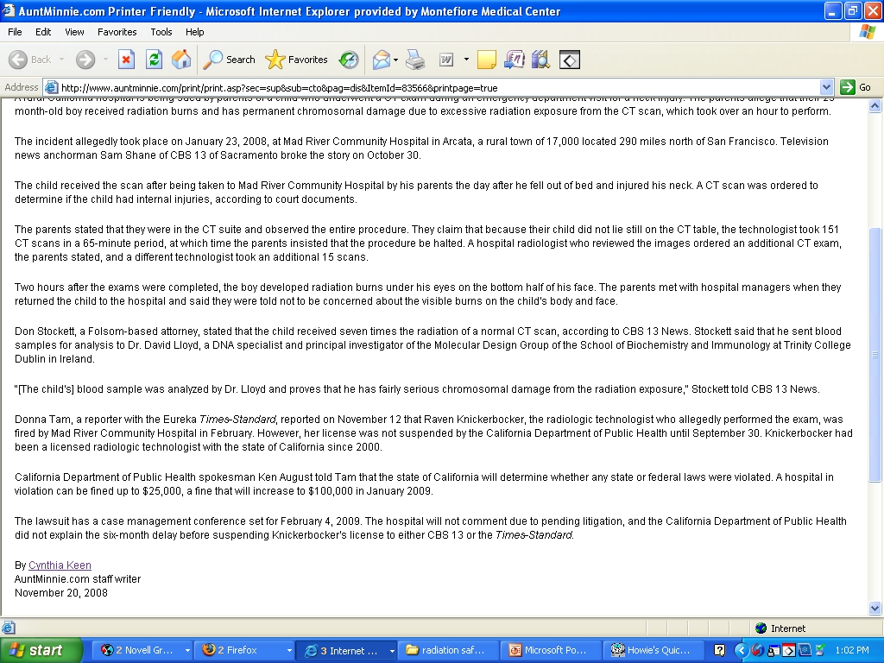
151 CT sequences over 65 minutes
Unintended exposures, errors , adverse events… have not only happened in radiotherapy. They have been also reported in nuclear medicine, interventional radiology, and diagnostic imaging !!
Education, training, Q&A, RP culture
Notes:
32
32

Slide 33



Recommendations of the Bonn Conference
Bonn Call for Action
actions to improve radiation protection in medicine in the next decade

Slide 34

Bonn Call for Action
Enhancing implementation of justification of procedures
Enhancing implementation of optimization of protection and safety
Strengthening manufacturers’ contribution to radiation safety
Strengthening RP education and training of health professionals
Shaping & promoting a strategic research agenda for RP in medicine
Improving data collection on radiation exposures of patients and workers
Improving primary prevention of incidents and adverse events
Strengthening radiation safety culture in health care
Fostering an improved radiation benefit-risk-dialogue
Strengthening the implementation of safety requirements (BSS) globally
hhttp://www.who.int/ionizing_radiation/about/14-2649_bonncallforaction.pdf?ua=1 ttps://rpop.iaea.org/RPOP/RPoP/Content/News/bonn-call-for-action-joint-position-statement.htm

Slide 35
Action 1: Enhance the implementation of the principle of justification
Introduce and apply the 3A’s (awareness, appropriateness and audit), which are seen as tools that are likely to facilitate and enhance justification in practice;
Develop harmonized evidence-based criteria to strengthen the appropriateness of clinical imaging, including diagnostic nuclear medicine and non-ionizing radiation procedures, and involve all stakeholders in this development;
Implement clinical imaging referral guidelines globally, keeping local and regional variations in mind, and ensure regular updating, sustainability and availability of these guidelines;
Strengthen the application of clinical audit in relation to justification, ensuring that justification becomes an effective, transparent and accountable part of normal radiological practice;
Introduce information technology solutions, such as decision support tools in clinical imaging, and ensure that these are available and freely accessible at the point-of-care;
Further develop criteria for justification of health screening programmes for asymptomatic populations (e.g. mammography screening) and for medical imaging of asymptomatic individuals who are not participating in approved health screening programmes.

Slide 36
Action 2: Enhance the implementation of the principle of optimization of protection and safety
Ensure establishment, use of, and regular update of diagnostic reference levels for radiological procedures, including interventional procedures, in particular for children;
Strengthen the establishment of quality assurance programmes for medical exposures, as part of the application of comprehensive quality management systems;
Implement harmonized criteria for release of patients after radionuclide therapy, and develop further guidance as necessary;
Develop and apply technological solutions for patient exposure records, harmonize the dose data formats provided by imaging equipment, and increase utilization of electronic health records.

Slide 37






WHO Global Initiative on Radiation Safety in Health Care Settings
Diagnostic radiology
Interventional radiology
Radiotherapy
Nuclear Medicine
This initiative is currently focused on supporting the implementation of the “Bonn Call for Action”

Slide 38
The Global Initiative: areas of work
Assessing population dose distribution due to the use of radiation in health care (collaboration with UNSCEAR) Setting research priorities and promoting a strategic research agenda on radiation protection in medicine (focusing on children) | Risk assessment
Reducing unnecessary radiation exposures (justification of medical examinations and optimization of protection) Promoting occupational health in health care settings Addressing health workforce needs Preventing accidental and unintended exposures, promoting reporting and learning systems Fostering cooperation between health authorities and regulatory bodies | Risk management
Providing guidance and tools to support benefit/risk dialogue (information to patients and health workers) | Risk communication
Some examples of activities related with each of these three areas of work

Slide 39


New UNSCEAR survey on medical exposures: UNSCEAR - WHO arrangement for cooperation on data collection
Joint Workshops on Data Collection in Medical Exposures in Africa, Asia and Europe (2014) and in Latin America (2015)

Slide 40


Training Course on Justification and Use of Imaging Referral Guidelines

Slide 41


WHO collaboration on global actions to scale-up medical physicist's role in RP in medicine
Regional Workshop of the role of MP in Medical Imaging, organized by IAEA in collaboration with WHO, November 2014, Dar es Salaam, Tanzania.
  Declaration from 23 African Ministries of Health
  Under the African Regional Cooperative Agreement for research, development & training (AFRA)
IUPESM 2015 (Toronto, June 7-12, 2015)
  WHO/ IAEA/ IOMP Special Sessions

Slide 42


    Side Event "Imaging for saving kids"
    at the 68th World Health Assembly
  Health authorities, health care providers (radiologists, medical physicists, radiographers), manufacturers, and patients' representatives
  4 Member States and 9 NGOs in Official Relations with WHO

Slide 43


Radiation safety culture in medicine
Joint IRPA-WHO-IOMP project
To collect stakeholders' feedback and develop a framework document providing guidance on the establishment and maintenance of a radiation safety culture in health care facilities.
Regional workshops during 2015-2016
  Latin America: Buenos Aires, April 2015
  Europe: Geneva, 30th Nov to 2nd December 2015
  Africa: linked to IRPA14, Cape Town, May 2016
  Asia:TBC

Slide 44




Global cross fertilization and networking
DRLS and PiDRLs included in these plans
2007 Image Gently: radiation safety in paediatric imaging, followed by Image Wisely: radiation safety in adult medical imaging (started in USA, expanded later)
2014: Eurosafe Imaging: holistic approach to improve safety and quality in medical imaging in Europe
2015: AfroSafe: multistakeholders campaign to improve safety and quality in medical uses of radiation in Africa
2016: Plans to launch a campaign in Latin America, other regions?

Slide 45


A multistakeholders campaign to improve radiation safety and quality in medical exposures in Africa

Slide 46










Iberoamerican Conference on RP in Medicine
Madrid, 18-20 October 2016
CIPRaM 2016
CONFERENCIA IBEROAMERICANA SOBRE PROTECCIÓN RADIOLÓGICA EN MEDICINA
MADRID, 18, 19 y 20 de octubre 2016
Casa de América, (Palacio de Linares), Madrid

Slide 47

Fostering risk-benefit dialogue
Risk-communication tool to support risk-benefit dialogue in pediatric imaging
Dialogue Seminar to test the tool followed by a Kids' Workshop jointly organized by WHO and NIRS (Chiba, Japan, 7-9 December 2014)
Justification and optimization (PiDRLs) are addressed in the risk-benefit dialogue
Communicating radiation risks in pediatric imaging to support
risk-benefit dialogue
Communication tool for health care providers
Global Initiative on Radiation Safety in Health Care Settings

Slide 48



Support BSS Implementation
WHO is one of the 8 cosponsor of the international BSS and is cooperating with them to support BSS implementation
  Both the International BSS and the EURATOM BSS have a robust set of safety requirements concerning radiation safety in medical exposures

Slide 49

Final considerations
WHO is committed to collaborate with relevant stakeholders and build global, regional and national partnerships to support the application of the BSS in medicine and to foster the implementation of the Bonn Call for Action worldwide.
This workshop on Justification and Optimization for Portuguese speaking countries provides a unique opportunity for building a platform for such collaboration

Slide 50


Muito obrigada !
perezm@who.int

