Slide 1
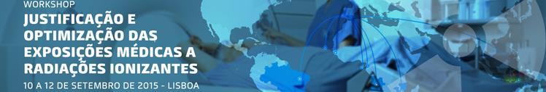
JUSTIFICATION AND OPTIMIZATION:
International standards and IAEA activities
Jenia Vassileva, Ph.D.
Radiation Protection Specialist
Radiation Protection of Patients Unit
Division of Radiation, Transport and Waste Safety

Slide 2
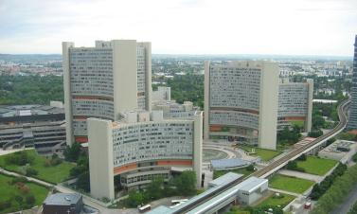
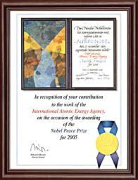
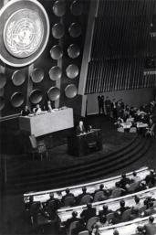
International Atomic Energy Agency - IAEA
Member of the United Nations family
Set up as the world´s "Atoms for Peace" organization in 1957
The world´s centre of cooperation in
the nuclear field
Winner of Nobel Peace Prize in 2005
Headquarters in Vienna, Austria
164 Member States
2500 staff from > 100 countries
Notes:
The IAEA Secretariat is made up of a team of some 2500 multi-disciplinary professional and support staff from more than 125 countries. They come from scientific, technical, managerial, and professional disciplines.
The Agency works with its Member States and multiple partners worldwide to promote safe, secure and peaceful nuclear technologies.

Slide 3
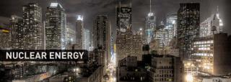
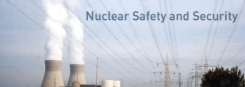
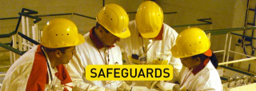
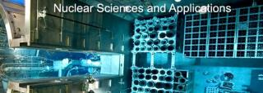
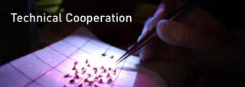
International Atomic Energy Agency - IAEA
IAEA statute: “To establish or adopt … standards of safety for protection of health and minimization of danger to life … and to provide for the application of these standards”

Slide 4
IAEA Organizational chart
Director General
Mr. Yukija Amano
Department of Technical Cooperation
Department of Nuclear Energy
Department of Management
Department of Nuclear Science and Applications
Programme Support and Coordination
Africa
Asia and
Pacific
Europe
Latin America
Department of Nuclear Safety and Security
Radiation, Transport and Waste Safety
Human Health
Department of Safeguards
Director’s
offices
Programme of Action for Cancer Therapy
Radiation and Monitoring Section
Radiation Protection of Patient Unit

Slide 5
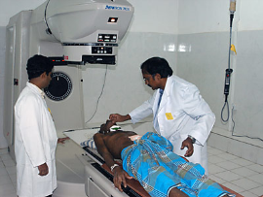
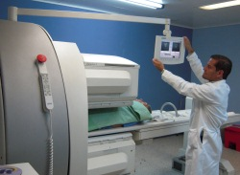
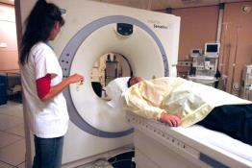
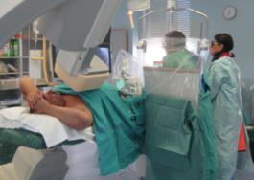
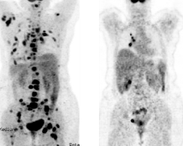
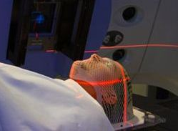
IAEA is the focal point for all issues related to radiation protection in medicine
Diagnostic and interventional radiology
Nuclear
medicine
Radiotherapy
Notes:
The International Atomic Energy Agency (IAEA) serves as a focal point for all issues related to the radiation protection of patients, staff and the public on medical uses of ionising radiation globally.

Slide 6
Outline
Overview
Background and current issues
International Basic Safety Standards (BSS)
  Responsibilities for medical exposure
  Justification and optimization
IAEA activities on implementation of BSS

Slide 7
1. Background and current issues

Slide 8
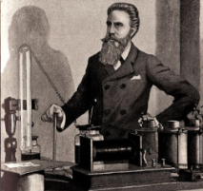
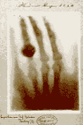

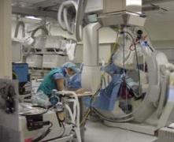
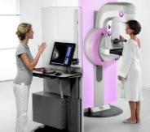
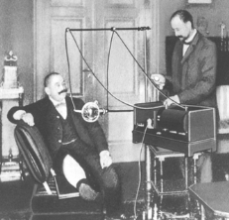
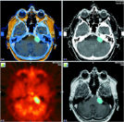
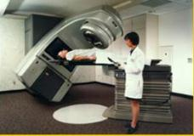
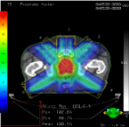
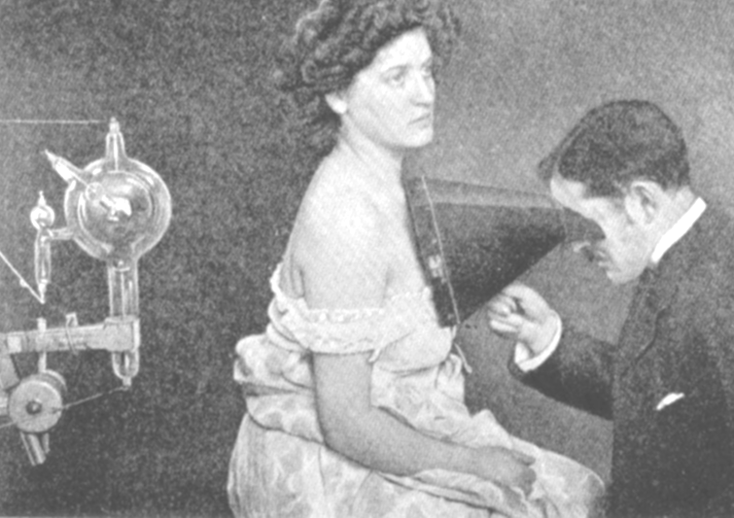
Benefits of the use of radiation in medicine
The use of radiation in medicine has brought tremendous benefits
to the global population
Notes:
Since the discovery of X-rays and radioactivity the use of radiation in medicine has brought tremendous benefits to the global population

Slide 9
Benefits of the use of radiation in medicine
More can be done with radiation in medicine
  More equipment
  More complex equipment
  New technologies and techniques
  New role
  Multi-Detector / Dual energy CT
  Digital Radiography
  Hybrid imaging
  Image-guided interventional procedures
  PACS, RIS
  Tomosynthesis, Cone beam CT
  IMRT, IGRT in radiotherapy……
Notes:
Since the discovery of X-rays and radioactivity the use of radiation in medicine has brought tremendous benefits to the global population

Slide 10
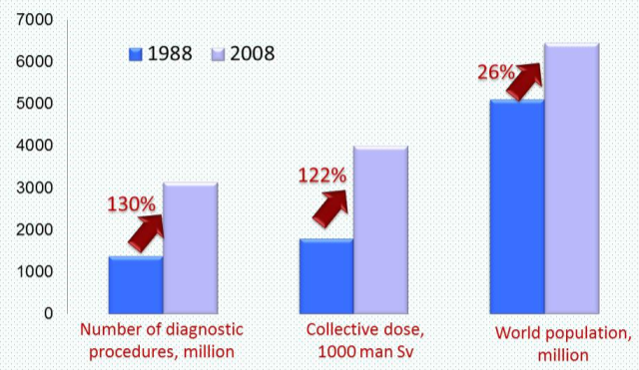
Benefits of the use of radiation in medicine
Global increase of the use of radiation
Access vary around the world
Issues vary around the world
Tailored approaches needed
Notes:
Since the discovery of X-rays and radioactivity the use of radiation in medicine has brought tremendous benefits to the global population

Slide 11
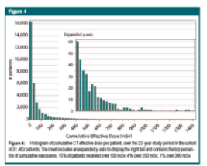
Global trends
Growth of high-dose radiation procedures:
CT, interventional , SPECT-CT, PET-CT
A significant fraction (20-50% in some areas) of radiological examination may be medically inappropriate
Increased individual patient doses from diagnostic exams
  Over the 22 years study period, 32000 patients
  > 33% of patients underwent more than
  5 lifetime CT scans
  5% underwent 22-132 CT scans
  15% received doses over 100 mSv;
  5% received doses over 250 mSv
  Increased cancerogenic risk at these doses
Sodickson et al.
Radiology 251; 175-184, 2009

Slide 12
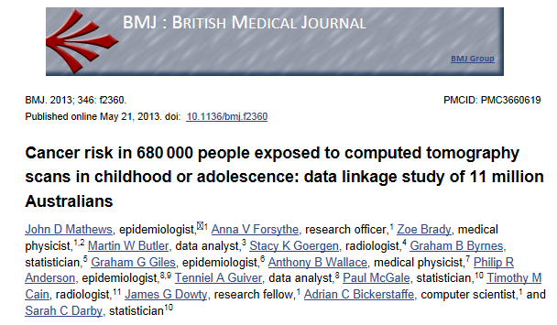
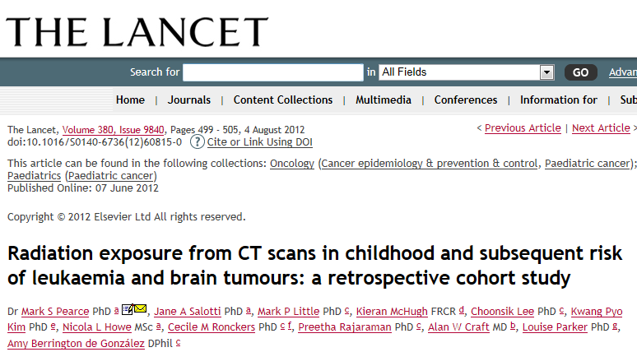
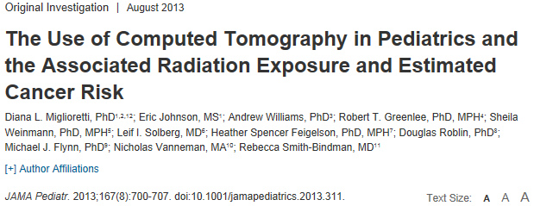
Radiosensitivity in children: three large scale studies
There is a small but definite risk of a CT scan performed in childhood to be associated with a later risk of cancer as a consequence of the CT examinations
Notes:
Additionally, three recent large-scale epidemiological studies provide evidences that there is a small but definite risk of a CT scan performed in childhood to be associated with a later risk of cancer as a consequence of the CT examinations

Slide 13
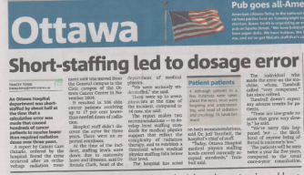
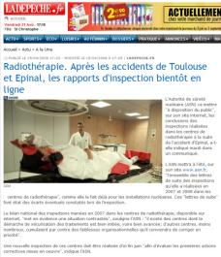
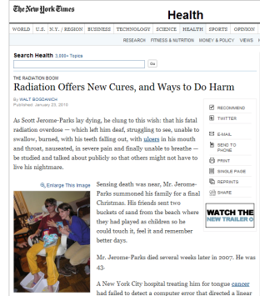
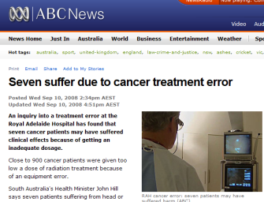
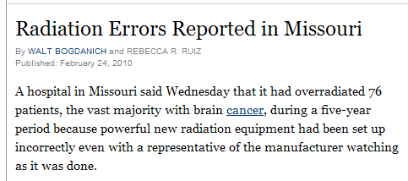
Medical radiation can cause harm
  Reports of accidents in radiotherapy, leading to injuries and death
Radiation accidents involving medical uses have accounted for more acute radiation deaths than any other source, including Chernobyl
Notes:
Hundreds of radiotherapy patients have been affected by accidental exposure because of improper calibration or improper use of radiotherapy equipment, or due to the inadequate knowledge or lack of awareness among the medical staff.
Radiation accidents involving medical uses have accounted for more acute radiation deaths than any other source, including Chernobyl
These accidents do not only affect patients directly (e.g. harm and death), but might also undermine the public’s confidence in the treatment
Preventable medical errors overall also cost countries billions of dollars each year

Slide 14
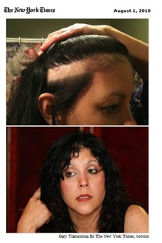
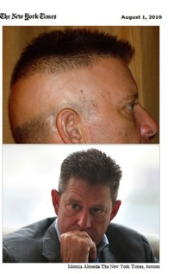
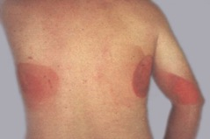
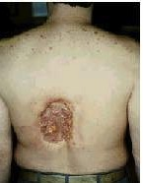
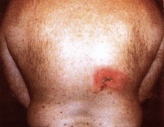
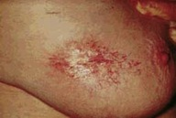
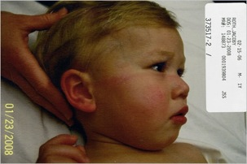
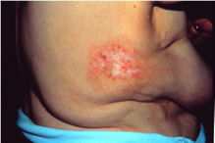

Medical radiation can cause harm
Interventional radiology
Computed tomography
Rarely in diagnostic radiology:
  1 case per 10000 patients;
In complex interventional procedures
CAN BE AVOIDED
(dose treshold for tissue reactions)
Notes:
Skin injuries or hair loss have been observed in fluoroscopically guided interventional procedures and even in computed tomography, with the same reasons identified – equipment failures and human errors due to neglecting the radiation risk and lack of adequate radiation protection system.

Slide 15
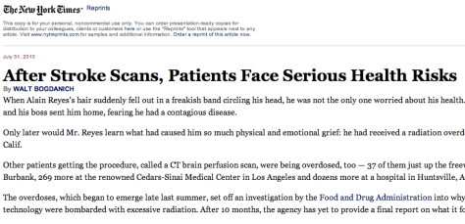
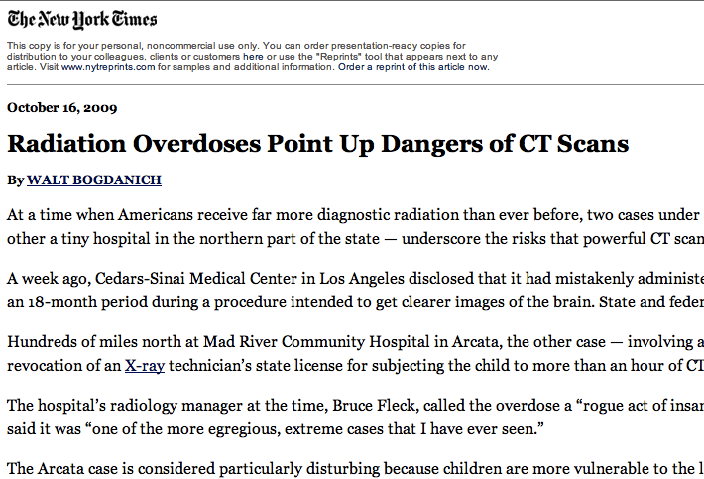
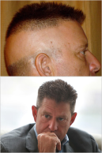
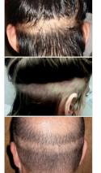
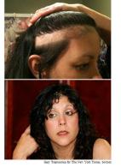
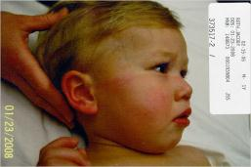

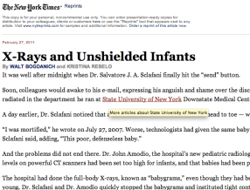
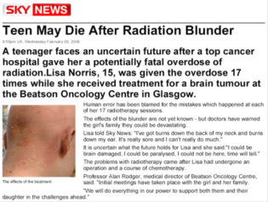

Medical radiation can cause harm
Human errors (improper calibration or improper use)
Lack of knowledge or experience
Lack of resources, support or safety culture
Lack of awareness

Slide 16

Patient dose and individual risk vary greatly
Lethal whole
body dose
Radiation risk
Tissue reactions
(skin, eye lens,..)
Annual dose from natural background
Increased risk of cancer
0.01mSv
0.1mSv
1mSv
10
mSv
100
mSv
1 000
mSv
10 000
mSv
100 000
mSv
Radiography
CT, NM, Image guided interventional procedures
Radiological procedures
Skin doses –
Image guided interventional procedures
Radiation therapy,
mainly to the target volume

Slide 17



















Do more good than harm
Radiation can cause harm
Radiation saves lives
Short-term effects (deterministic)
Long-term effects (stochastic)
  Carcinogenesis
  Hereditary effects
  Effects in the embryo/foetus
Principles of radiation protection
  Dose limits don’t apply to medical exposures
  Justification - perform only appropriate procedures
  Optimization - perform procedure appropriately
Notes:
Medical uses of ionizing radiation are amongst the longest established applications of ionizing radiation, and one of the most rapidly developing areas. The medical benefits of the use of ionizing radiation are indisputable, but there is an associated radiation risk for patients and medical staff. Patient and staff doses vary in a large extend, and both deterministic and stochastic effects are possible and have been observed.
Hundreds of radiotherapy patients have been affected by accidental exposure because of improper calibration or improper use of radiotherapy equipment, or due to the inadequate knowledge or lack of awareness among the medical staff. Skin injuries or hair loss have been observed in fluoroscopically guided interventional procedures and even in computed tomography, with the same reasons identified – equipment failures and human errors due to neglecting the radiation risk and lack of adequate radiation protection system. However, the increased utilization of image guided procedures and their use with a little concern of radiation risk, lead to observation of high doses to the eye lens of interventionists, and as a consequence – increased risk of radiation-induced cataract. Additionally, three recent large-scale epidemiological studies provide evidences that there is a small but definite risk of a CT scan performed in childhood to be associated with a later risk of cancer as a consequence of the CT examinations
Therefore, systematic approach should be applied to ensure that a balance is in place between being able to utilize the benefits from medical uses of ionizing radiation and minimizing the risk of radiation effects to patients, workers and members of the public.

Slide 18
2. International Basic Safety Standards (BSS)

Slide 19


















IAEA Safety Standards hierarchy
Fundamental safety objectives and principles for protecting people and environment
moral obligation
Safety Fundamentals
Requirements that
must be met to ensure protection of people and environment
legal obligations, "shall"
Safety
Requirements
Safety
Guides
Recommended ways of meeting the requirements,
“should”
All Safety Standards go through the IAEA Safety Standards Committees and Commission, and receive formal Member State comments

Slide 20

International BSS
Not mandatory
  No obligation for States to bring legislation into conformity, etc.
However
  Mandatory for Member States receiving technical assistance from IAEA
  Used as a template for many national regulations
Published July 2014
Co-sponsors:

Slide 21




International BSS
Essential principles
(moral obligation)
Essential requirements
(legal obligation)
Effects of radiation
Recommendations for protection
Notes:
The jointly sponsored edition of the Safety Requirements “Radiation Protection and Safety of Radiation Sources: International Basic Safety Standards” was published as General Safety Requirements Part 3 in July 2014. This edition supersedes the Interim Edition that was published in 2011, which itself superseded the International Basic Safety Standards that were issued as IAEA Safety Series No. 115 in February 1996. The joint sponsors are EC, FAO, IAEA, ILO, OECD/NEA, PAHO, UNEP, and WHO. The BSS will be published in all the official languages of the IAEA in due course.

Slide 22


International system of radiation protection
Principles:
- Justification
- Optimisation
- Dose limitation
Categories of exposure
- Medical
- Occupational
- Public
Requisites
- Information
- Assessment of exposure
- Stakeholders involvement
Dose criteria
- Dose limits
- Dose constraints
- Reference levels
Exposure situations
- Planned
- Emergency
- Existing

Slide 23






BSS definitions
Medical radiation facilities
A medical facility where radiological procedures are performed
  Diagnostic radiology
  Image guided interventional procedures
  Nuclear medicine
  Radiation therapy

Slide 24

BSS definitions
Medical exposure:
Exposure incurred by:
Patients* for the purpose of medical or dental diagnosis or treatment
Carers and comforters **
Volunteers in a programme of biomedical research involving their exposure
*A patient is an individual who is a recipient of services of health care professionals and/or their agents that are directed at (a) promotion of health;
(b) prevention of illness and injury; (c) monitoring of health; (d) maintaining health; and (e) medical treatment of diseases, disorders and injuries in order to achieve a cure or, failing that, optimum comfort and function. Some asymptomatic individuals are included.
For the IAEA safety standards, the term ‘patient’ refers only to those individuals undergoing radiological procedures.
**Carers and comforters are persons who willingly and voluntarily help (other than in their occupation) in the care, support and comfort of patients undergoing radiological procedures for medical diagnosis or medical treatment

Slide 25
Medical exposure in the BSS
Responsibilities (Req. 34 – 36)
Justification (Req. 37)
Optimization (Req. 38)
Pregnant or breast-feeding female patients (Req. 39)
Release of patient after radionuclide therapy (Req. 40)
Unintended and accidental medical exposure (Req. 41)
Reviews and records (Req. 42)

Slide 26
Responsibilities
Government (Req. 2 and 34):
Establish a legal and regulatory framework
Ensure, as a result of consultation between Health Authorities, professional bodies and the Regulatory Body, establishment of:
    Diagnostic reference levels (DRLs) (for patients)
    Dose constraints are established (for carers and comforters and volunteers in biomedical research)
    Guidelines and criteria for the release of patients after radionuclide therapy
Regulatory Body (Req. 3 and 35):
Establish and adopt regulations and guides for protection and safety
Establish a system to ensure their implementation
Authorization of health professionals to take the responsibilities of the Standards (only if they are specialized in the appropriate area; meet the respective education, training and competence requirements; are named in a list maintained up to date by the registrant or licensee)
Notes:
An area identified in the review of the BSS as needing improvement.

Slide 27

Responsibilities
Registrants and licensees (Req. 4 and 36):
Have the prime responsibility for protection and safety, which cannot be delegated
Ensure that no person incurs a medical exposure unless:
      it is a radiological procedure that has been requested by a referring medical practitioner and information on the clinical context has been provided, or it is part of an approved health screening programme;
      the medical exposure has been justified;
      a radiological medical practitioner has assumed responsibility for ensuring protection and safety in the planning and delivery of the medical exposure,
      the person subject to exposure has been informed as appropriate of the expected benefits and risks.
    Ensure that sufficient medical
    and paramedical personnel
    are available

Slide 28





Health professionals
  Radiological medical practitioner
  Medical radiation technologist
  Medical physicist
  Radiophar-macist
  Competence is normally assessed by the State by having a formal mechanism for registration, accreditation or certification
  Referring medical practitioner

Slide 29
International BSS – justification and optimization

Slide 30

Justification and optimization
Justification
Optimization
Perform only appropriate procedure
Perform procedure appropriately

Slide 31
Justification of medical exposures
3 levels of justification according to the ICRP
Level | Scope | Responsibility
Level 1 | General justification of the use of radiation in medicine | Taken for granted – accepted as doing more good than harm
Level 2 | Generic justification of a given radiological procedure | Health authority in conjunction with appropriate professional bodies
Level 3 | Justification of medical exposure for individual patient | Consultation between the radiological medical practitioner, and the referring medical practitioner

Slide 32


Justification for an individual patient
  Referring medical practitioner
  Radiological medical practitioner
    Clinical context, medical history
    Knowledge about procedure – benefits, risks, limitations
    “Request for consultation” rather than “order/instruction to perform”
What needs to be considered?
  Appropriateness of the request
  Urgency of the procedure
  Characteristics of the exposure
  Characteristics of the individual patient
  Relevant information from previous radiological procedures
Notes:
The justification of medical exposure for an individual patient shall be carried out by means of consultation between the radiological medical practitioner and the referring medical practitioner, as appropriate, with account taken, in particular for patients who are pregnant or breast-feeding or are paediatric, of:
(a) The appropriateness of the request;
(b) The urgency of the radiological procedure;
(c) The characteristics of the medical exposure;
(d) The characteristics of the individual patient;
(e) Relevant information from the patient’s previous radiological procedures.

Slide 33
Justification for an individual patient
  Referring medical practitioner
  Radiological medical practitioner
    Clinical context, medical history
    Knowledge about procedure – benefits, risks, limitations
    “Request for consultation” rather than “order/instruction to perform”
  Relevant national or international referral guidelines to be taken into account for the justification of the medical exposure of an individual patient
  Particular attention to be taken for patients who are pregnant, breast-feeding or paediatric
Notes:
The justification of medical exposure for an individual patient shall be carried out by means of consultation between the radiological medical practitioner and the referring medical practitioner, as appropriate, with account taken, in particular for patients who are pregnant or breast-feeding or are paediatric, of:
(a) The appropriateness of the request;
(b) The urgency of the radiological procedure;
(c) The characteristics of the medical exposure;
(d) The characteristics of the individual patient;
(e) Relevant information from the patient’s previous radiological procedures.

Slide 34


Asymptomatic individuals – intended early detection of disease
  Health screening programme – justification to be performed by the health authority in conjunction with appropriate professional bodies
  If not as part of an approved health screening programme – individual justification by:
    Referring medical practitioner and radiological medical practitioner
    In accordance with professional body guidelines
    Individual informed of the benefits, risks and limitations
Notes:
Justification for radiological procedures to be performed as part of a health screening programme for asymptomatic populations shall be carried out by the health authority in conjunction with appropriate professional bodies.
Any radiological procedure on an asymptomatic individual that is intended to be performed for the early detection of disease, but not as part of an approved health screening programme, shall require specific justification for that individual by the radiological medical practitioner and the referring medical practitioner, in accordance with the guidelines of relevant professional bodies or the health authority. As part of this process, the individual shall be informed in advance of the expected benefits, risks and limitations of the radiological procedure.

Slide 35

Volunteers as part of a programme of biomedical research
Justified only if:
  it is in accordance with the provisions of the
  Helsinki Declaration
  takes into account the guidelines published
  by the Council for International Organizations
  of Medical Sciences, together with the
  recommendations of the ICRP;
Subject to approval by an ethics committee (or other institutional body with similar functions)
Subject to dose constraints
Subject to applicable national / local regulations
Notes:
3.161. The medical exposure of volunteers as part of a programme of biomedical research is deemed to be not justified unless:
(a) It is in accordance with the provisions of the Helsinki Declaration [20] and takes into account the guidelines published by the Council for International Organizations of Medical Sciences [21], together with the recommendations of the ICRP [22];
(b) It is subject to approval by an ethics committee (or other institutional body that has been assigned functions similar to those of an ethics committee by the relevant authority), subject to any dose constraints that may be specified (as required in paras 3.149(a)(ii) and 3.174), and subject to applicable national regulations and local regulations.

Slide 36



Optimization of protection and safety
Req. 38: Registrants and licensees and radiological medical practitioners shall ensure that protection and safety is optimized for each medical exposure.
Patient
dose
Diagnostic quality
Too low a radiation dose could be as bad as too high a radiation dose
It is of paramount importance that the medical exposure leads to the required outcome.

Slide 37







Optimization of protection and safety
  Design considerations
  for equipment
  Quality Assurance
  Calibration
  Operational considerations
  Dose constraints
Patient
dose
Diagnostic quality
  Dosimetry of patients
  Diagnostic Reference Levels (DRLs)

Slide 38






Optimization cycle
Facility 2
Facility 3
1. Asses typical dose in a X-ray room
2. Compare with national DRL
3. Image quality adequate?
4. Apply changes
Facility 1
DRLs
Facility 4
Facility 5
Facility 6

Slide 39



Optimization of protection and safety
Particular aspects of medical exposures are considered in the optimization process for:
Paediatric patients
  Embryo or fetus
  Breastfed infant
  (from procedure with radiopharmacetical performed to mother)

Slide 40


Optimization of protection and safety
Arrangements for appropriate radiation protection in cases where a female patient is or might be pregnant or is breast-feeding.
signs in appropriate languages in appropriate places;
other means of communication, to request
female patients who are to undergo a
radiological procedure to notify in the event
that she is or might be pregnant,
or she is breast-feeding
procedures for ascertaining the pregnancy
status of a female patient of reproductive
capacity before the performance of any
radiological procedure that could result
in a significant dose to the embryo/fetus.

Slide 41

Unintended and accidental medical exposures
New requirement aimed at prevention
Scope for investigation by the licensee expanded, to now include:
  For diagnostic or image-guided interventional procedures
    Wrong individual, wrong volume/tissue of the patient
  Inadvertent in utero exposures
Licensee must keep a record
Reporting to Regulatory body limited to significant events or as required by the Regulatory body

Slide 42



Radiological review
A requirement for radiological review introduced
Radiological review: A systematic examination or review of the radiological procedures being performed in a given medical radiation facility, that seeks to improve the local implementation of the radiation protection principles of justification and optimization.
Responsibility of the radiological medical practitioners

Slide 43

From standards to practice
Difficulties:
  medical domain
  requires cooperation between
  regulatory body,
  health authority,
  professional bodies
Barriers:
  lack of awareness
  self-referral
  defensive medicine
  self-presentation
  financial, social, or medico-legal pressures
Standards

Slide 44
3. IAEA activities on implementation of BSS

Slide 45



















IAEA activities to support implementation
Safety standards
Safety reports
Training courses
Training material
Providing standards
Providing training Providing guidance
Facilitating knowledge exchange
Giving technical assistance
Building awareness
Technical documents
Fellowships
Public website
Scientific visits
Meetings
Involve in projects
Workshops
Providing tools
Reporting systems
Direct advice
Scientific publications
Assessments
Press campaigns
Missions
Information campaigns
AAA International campaign
Awareness, Appropriateness, Audit
45

Slide 46
Providing guidance – safety guide
Safety Guide on Radiation Protection and Safety in Medical Uses of Ionizing Radiation
  How the BSS applies to facilities
  Aimed at (primarily):
    End-users: Medical radiation facilities: “What do I need to do to ensure that my facility’s medical uses of radiation are in compliance with the BSS”
    Regulatory Bodies: “What do the Government need to do to ensure that the facilities in the country meet the requirements of the BSS”
  The Safety Guide is expected to be co-sponsored by relevant UN organizations (e.g. WHO, PAHO, ILO).
  Cooperation in developing from international / regional organizations

Slide 47

Providing guidance – safety guide
Safety Guide on Radiation Protection and Safety in Medical Uses of Ionizing Radiation
Development process:
    2012 – 2014: first draft prepared by 3 drafting group (DR&IR; NM; RT)
    2014 – 2015: soliciting and addressing comments by MS, and organizations internal approvals, comments from MS, next draft, approval by a number of committees….
    2015 – 2016: target publication

Slide 48






Providing guidance – safety reports
IAEA publications on radiation protection of patients
Safety Reports published in last few of years on : (1) PET/CT; (2) Guidance levels in interventional procedures; (3) Cardiac CT; (4) CT Colonography and (5) Release of Patients after Radionuclide Therapy; (6) Radiation Protection in Paediatric Radiology
Freely available from www.iaea.org

Slide 49

Providing guidance - website
Dedicated public website – http//rpop.iaea.org
Updated monthly
Information for
Health professionals
Member States
Patients
Additional resources
Publications
Safety Standards
Training material
Posters

Slide 50

Providing guidance – training material
Dedicated public website – http//rpop.iaea.org

Slide 51


Providing guidance – posters and leaflets
Dedicated public website – http//rpop.iaea.org

Slide 52




Providing guidance – posters and leaflets

Slide 53

Facilitating knowledge exchange
Technical meetings
March 2015: Justification of medical exposure
April 2015: Patient exposure tracking
2-6 November 2015: Implementation of the Safety Guide

Slide 54


Facilitating knowledge exchange
Incident reporting databases
  Anonymous
  Voluntary
  Learning from incidents
SAFRAD
  Interventional procedures
SAFRON
  Radiation therapy

Slide 55


Facilitating knowledge exchange
Information databases for medical staff
ISEMIR Working Group on Interventional Cardiology
  Gathering an overview picture of the situation concerning occupational exposures and radiation protection of staff in interventional cardiology all over the world
Lens injury studies among medical staff
  RELID (Retrospective Evaluation of Lens Injuries and Dose) (RELID) started in 2008 and covers staff working in interventional cardiology, with e.g. SOLACI: Latin American Society on Interventional Cardiology

Slide 56

Building awareness
Information campaign
for strengthening justification in diagnostic imaging
                Awareness
                Appropriateness
                Audit
AAA

Slide 57



Building awareness
https://www.facebook.com/rpop.iaea.org
https://twitter.com/rpop_iaea
4000 likes in Facebook
1200 likes in Twitter

Slide 58


Technical cooperation
Regional and national projects:
  High number of countries participating in technical cooperation projects on radiation protection of patients
  Tasks in all major areas of patient protection
  Expert missions, direct advice and provision of tools
  Fellowships
  Scientific Visits
  Regional and national training courses

Slide 59

Technical cooperation

Slide 60


Technical cooperation

Slide 61












Publications from the TC projects

Slide 62




Providing training
Providing training courses
  Regional training courses
  National training courses supported
  Main target audience: health professionals in hospitals; but also radiation protection professionals

Slide 63


International Action Plan for Radiation Protection of Patients
  Bonn Conference
  536 participants and observers in attendance
  77 Member States and 16 organizations represented
  88 presentations in the main programme
  2 breakout sessions (EC and UNSCEAR)
  214 contributed papers
  68 posters displayed

Slide 64

International Action Plan for Radiation Protection of Patients
The Bonn Call-for-Action
joint position statement with WHO
highlights ten main actions and related sub-actions, that were identified as being essential for the strengthening of radiation protection in medicine over the next decade.
Next IAEA conference on Radiation Protection in Medicine in 2017

Slide 65

Conclusion
Medical uses of ionizing radiation only have a place in the context of medical practice. The system for ensuring radiation protection needs to fit in with the larger system for ensuring good medical practice
The International BSS set basic requirements for protection and safety
Implementation is a challenging task; reaching stakeholders and making efforts effective and lasting is complex
A systematic approach should be applied to ensure that there is a balance between being able to utilize the benefits from medical uses of ionizing radiation and minimizing the risk of radiation effects to patients, workers and members of the public
The IAEA addresses these issues globally, in co-operation, through the International Action Plan, in a variety of actions
The MS are welcome to contribute and use available resources

Slide 66


Keep being informed
Visit us at
http//rpop.iaea.org
j.vassileva@iaea.org

